Slide 1
Age of Anxiety & The Great Depression

Slide 2
Impact of WWI
End of the Old Order→ changing political structures of Europe
Fear of “Bolshevism”→ Communist revolutionaries throughout Europe
Desire for tradition→ Conservatism
Treaty of Versailles→ Resentment
Economic Crises: Great Depression
Predicted by John Maynard Keynes who criticized Treaty
Decline in production across Europe (except Russia)
Massive inflation & unemployment (Grm: 43%, GB: 18%, USA: 25%, Fr 5%)
“Lost Generation”
1928: Kellogg-Briand Pact→ outlaws war as illegal, 62 nations, no enforcement

Slide 3
Russia
Under Lenin→ “Dictatorship of the Proletariat”
War Communism (Russian Civil War 1918-1920)
Nationalization of all means of production
Secret Police (Cheka)
Crop failures→ starvation, decreased industrial output
Kronstadt Rebellion (1921)→ previously pro-Bolsheviks sailors, crushed leads to NEP
New Economic Plan (NEP)→ Response to economic ruin, some capitalist policies
“Necessary step backwards”

Slide 4
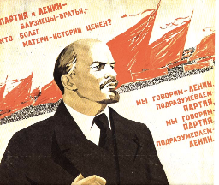
Russia: NEP
Eliminate harsh aspects of War Communism
Gov would not seize grain surplus, could be sold by peasants
Small business allow to stay open; gov still controls heavy industry, banks, RRs
Improved Russian Economy
Industy returns to pre-wwi levels
Workers have shorter hours/better conditions
Temporary relaxation of terror and censorship
1922: Renamed Soviet Union (Union of Soviet Socialists Republics, USSR)
Nobility ended, loss of Orthodox Church influence, more freedom for women and peasants (…in theory)
Lenin dies in 1924→ Power Struggle → Stalin

Slide 5
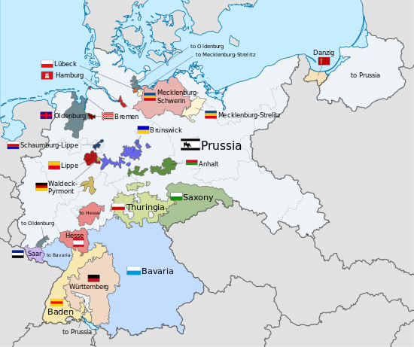
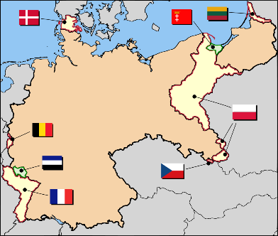
Germany
Weimar Republic→ Social Democratic Party takes control
Depended on conservative military & Freikorps
Spartacists: Communists briefly take Berlin
Sign Treaty of Versailles, “diktat”→ Stab in the Back
Appears weak & unpopular
New Constitution
Bicameral: Reichsrat (Federal States) & Reichstag (Popular Vote, led by Chancellor)
President with 7 year term
Female suffrage

Slide 6
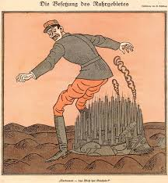
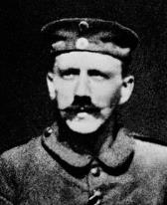
Germany: Ruhr Crisis, 1923
Can’t pay the $34 billion in reparations
French Raymond Poincaré occupies Industrial center of Ruhr
Began to print cash to pay→ hyperinflation
Savings of middle class is gone
Resentment: Western government, business, workers, Jews, communists
Beer Hall Putsch: Former solider Adolf Hitler fails to overthrow Bavarian state, one year in jail, write Mein Kampf
Gustav Stresemann assumes leadership
Calls off resistance in Ruhr
US loans Germany cash (Dawes Plan)→ Econ recovery
Restores Germany to union with European nations (Locarno Pact)

Slide 7
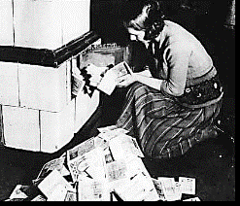
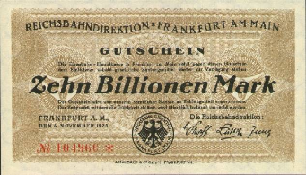
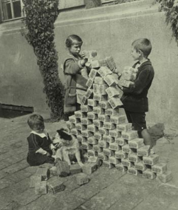
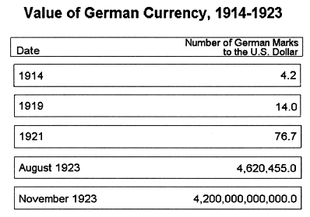
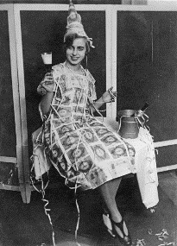
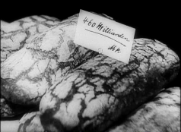
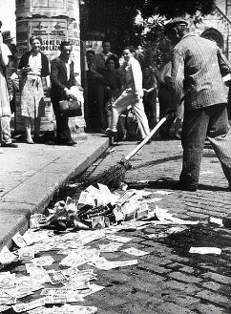
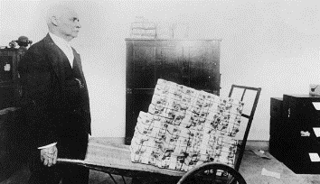
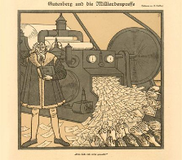
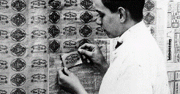

Slide 8
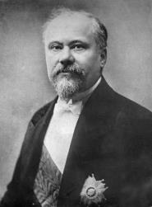
France
Economic chaos & political unrest post-wwi
Multi-party government dominated by conservatism
1926: Poincaré recalled→ slashed spending & raised taxes, restore war economy
Not as industrialized so Depression not as great
Increased class tensions→ radical right supported fascist reorganization
Popular Front→ coalition of republicans, socialists, communists (shocking right?)
Led by Leon Blum
French New Deal→ social reform programs, failed due to thigh inflation & political unrest
Remain politically divided until late 1930s

Slide 9
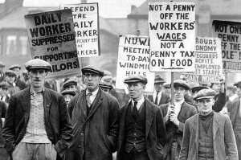
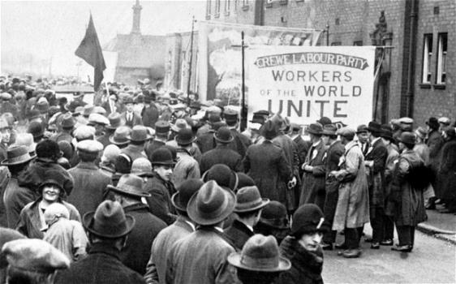
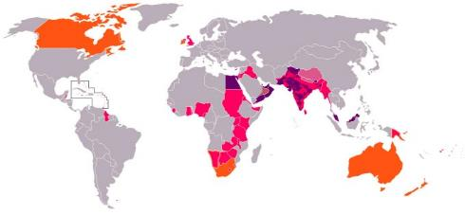
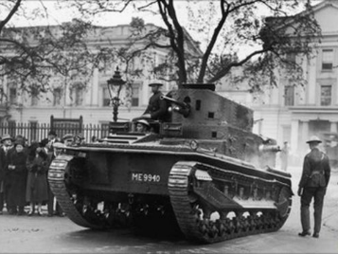
Great Britain
High unemployment (12%)→ 1926: General Strike
Labour Party grows→ champions of social welfare, replaced Liberal party to opposed conservatives; seen as pro-Communists
Conservative Party in power 1924-1929→ compromised on social issues such as women’s suffrage & welfare
Old order (read: nobility) starting to lose power
Losing their Empire
Decolonization movements(India & Africa)
Egypt→ only remain in control of Suez Canal
Equality of Dominions (Canada & Australia)
Ireland War of Independence & Civil War
Fight Depression with traditional economic theory, not complete until rearmament for WWII
Pink: colonies held by 1945, orange: dominions, pink in orange: colonies of dominions, purple: protectorate and Princely states.

Slide 10
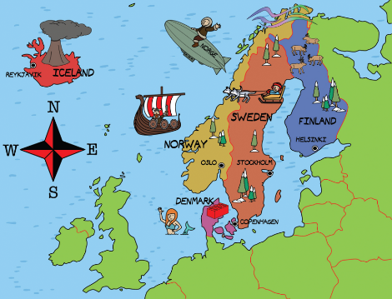
Scandinavia
Recovers the most quickly from the Depression due to socialist policies
Remain socialist today
Did this need it’s own slide? Probably not, but hey, I can do whatever I like cause I’m the teacher.

Slide 11
Art & Culture

Slide 12
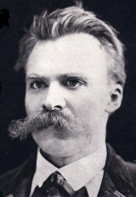
Philosophy
Era of pessimism
Rejection of faith in progress & Pro-rationalism
Friedrich Nietzsche (1844-1900)
Rationalism
“God is dead”→ Christianity kills individualism
Will to Power→ creativity of a few “supermen” could reorder the world (übermenshcen)
Existentialism→ life is absurd with no apparent meaning
Jean Paul Sartre

Slide 13
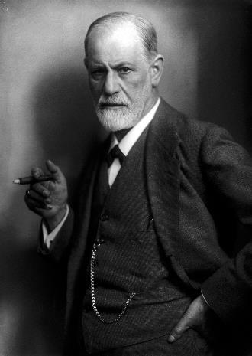
Sigmund Freud
Emphasis on humans as greedy and irrational
Inventor of psychoanalysis
Human unconscious (id) is driven by desires and battles with the rational consciousness (ego) and moral values (superego)
Shattered enlightenment view of rationality

Slide 14
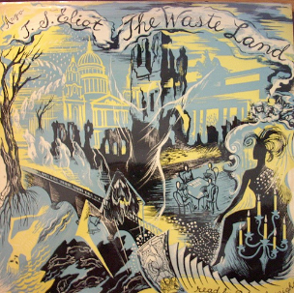
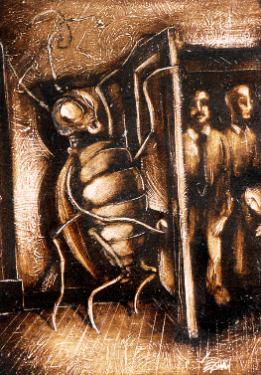
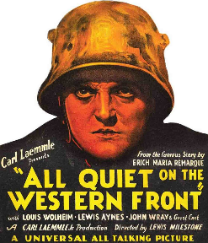
Authors
TS Eliot: “The Waste Land”
Fraz Kafka: helpless individuals destroyed by hostile/surreal forces, The Metamorphosis
Erich Remarque: All Quiet on the Western Front
American Generation in Paris: Fitzgerald, Hemmingway, Gertrude Stein

Slide 15
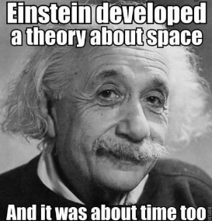
Science
“New Physics”—challenging long-held beliefs, led to uncertainty
Max Planck: quantum physics→ new ideas about atoms, energy, matter
Albert Einstein: Theory of relativity: infinite universe, subatomic world
Ernest Rutherford: first to split the atom
Werner Heisenberg: principle of uncertainty—impossible to predict behavior
Created more questions than answers

Slide 16
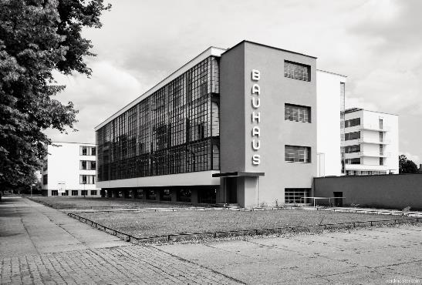
Architecture
Function over Form
Skyscrapers
Bauhaus Movement → clean, light, steel

Slide 17
Art
Cubism
Complex geometry
Multiple perspectives
Pablo Picasso
Dadaism
Attacked “standard” art
Art that’s not art
Surrealism
Influenced by Freud and psychoanalysis
Salvador Dali

Slide 18
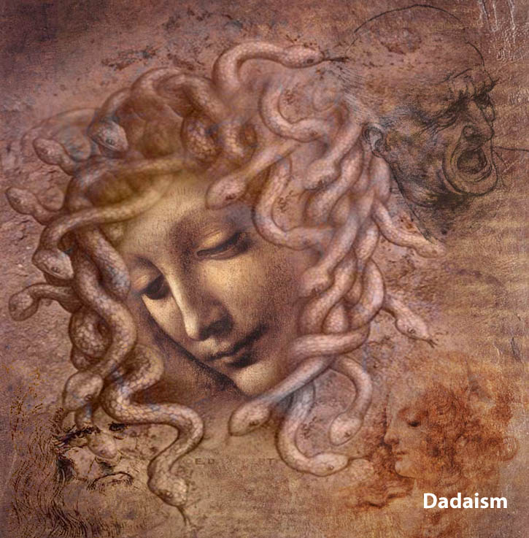

Slide 19
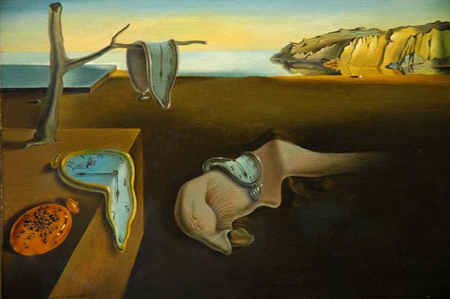

Slide 20
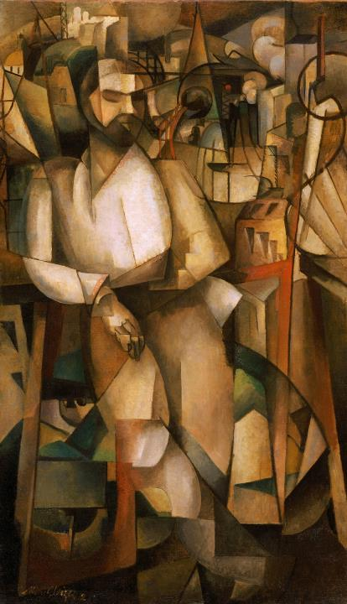

Slide 21
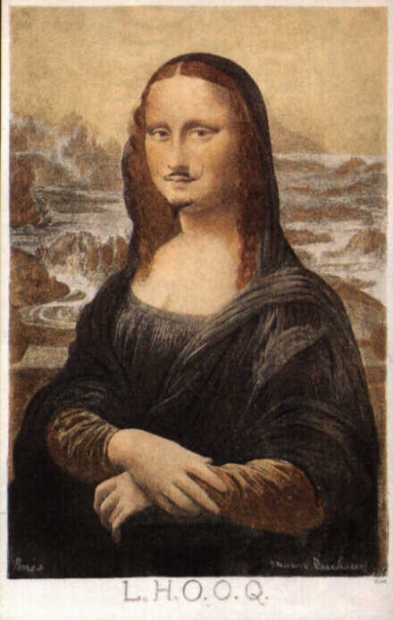

Slide 22
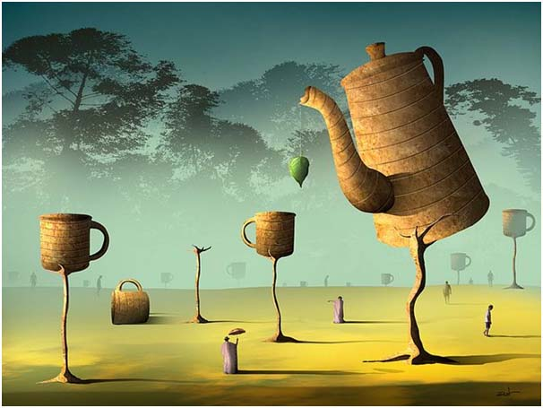

Slide 23
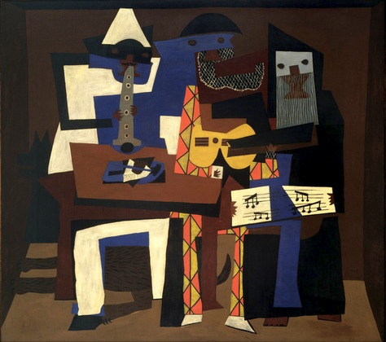

Slide 24
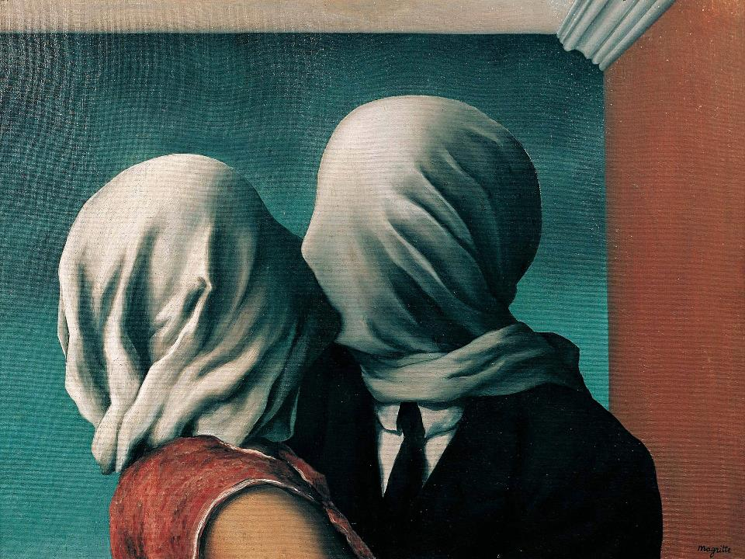

Slide 26
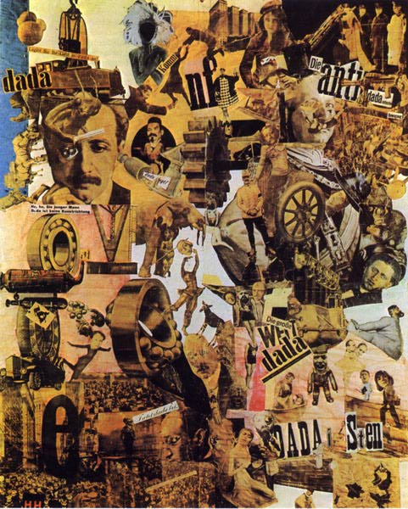

Slide 27
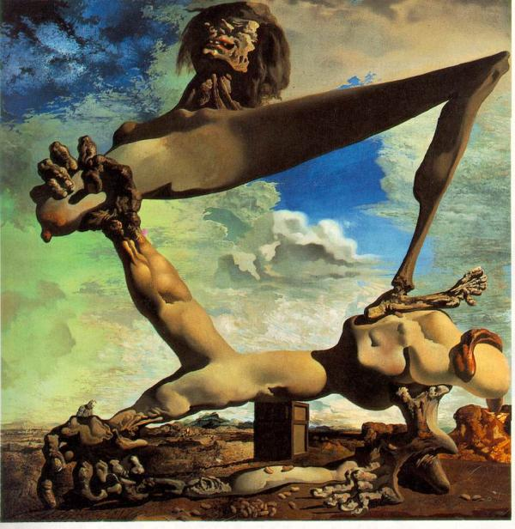

Slide 28
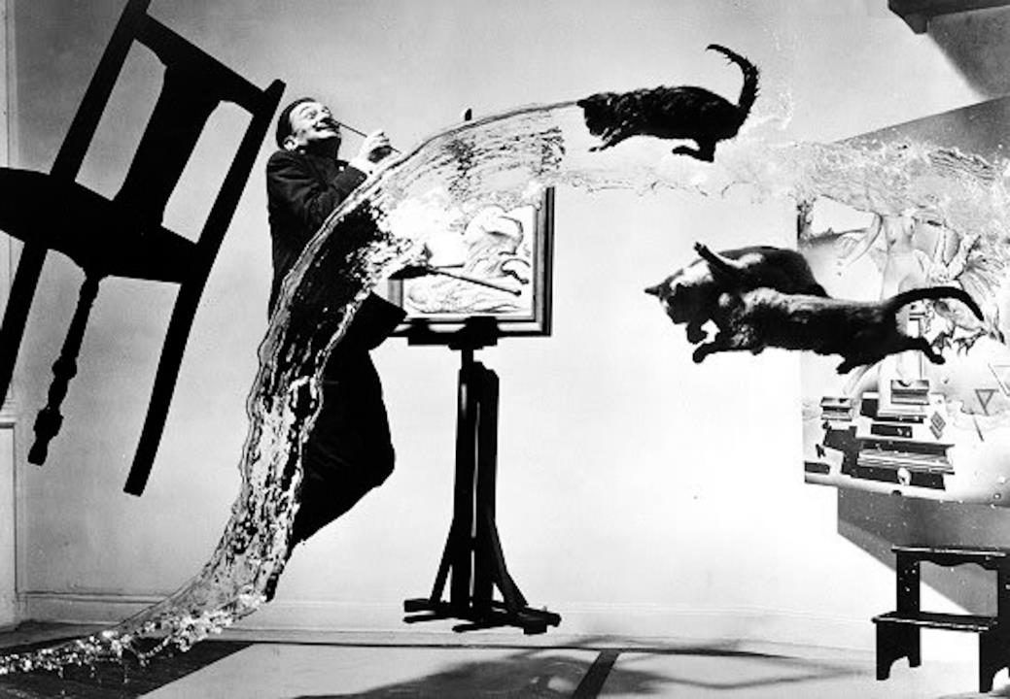

Slide 29
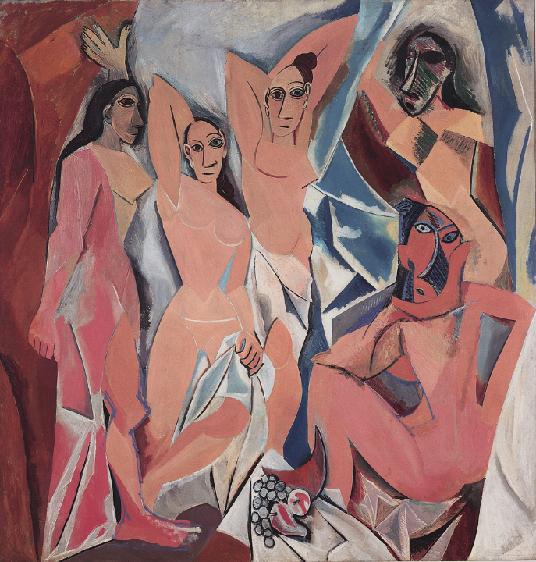

Slide 30
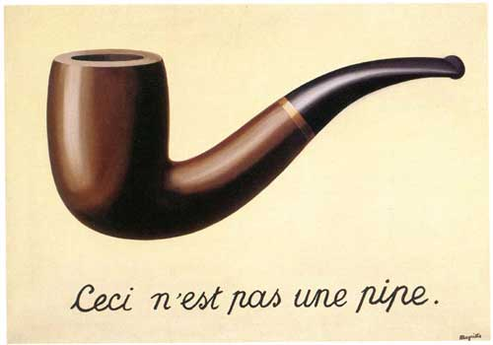
Translation: This is not a pipe.

Slide 31
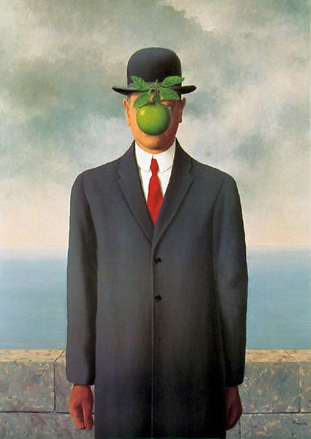

Slide 32
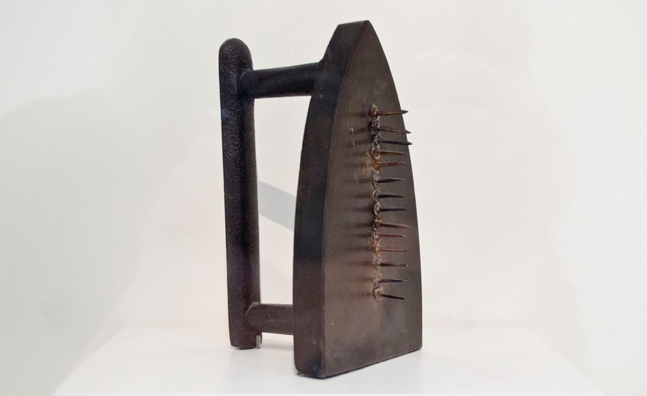

Slide 33
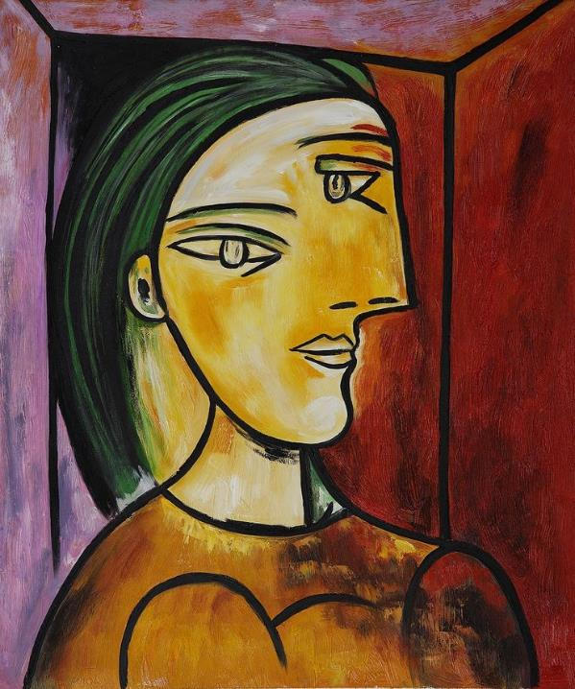

Slide 34
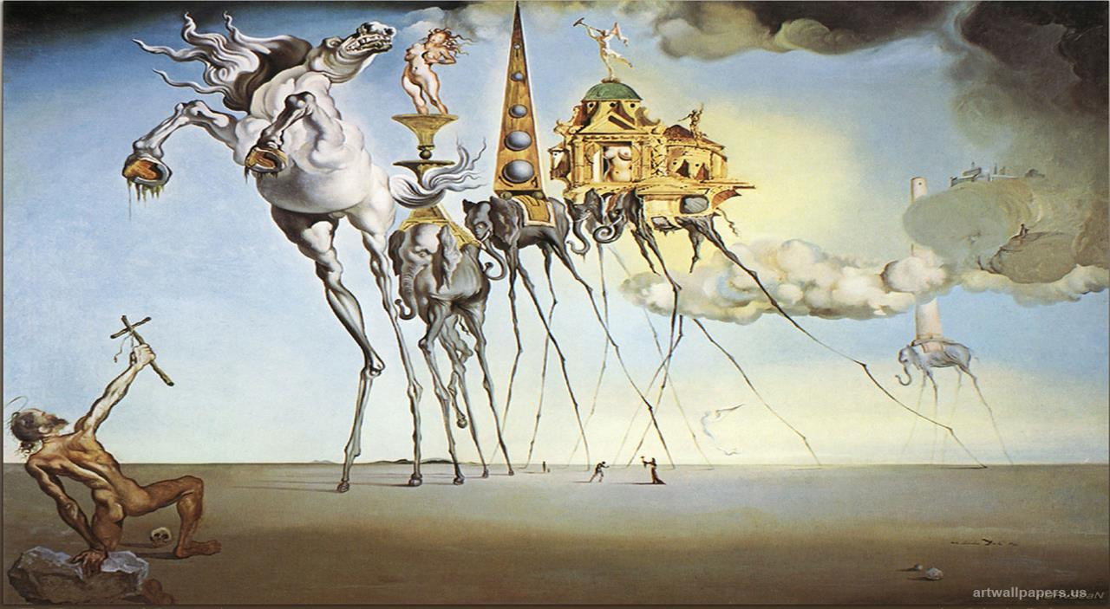

Slide 35
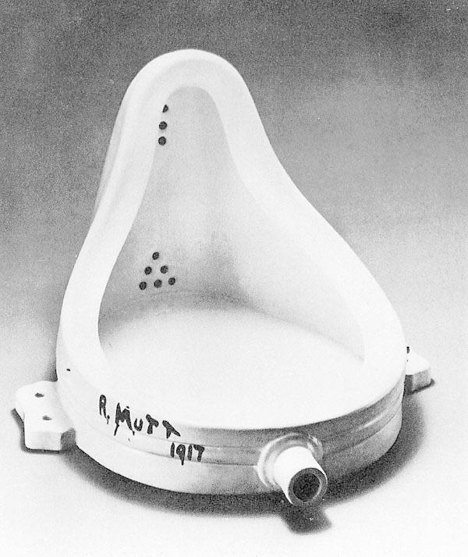

Slide 36
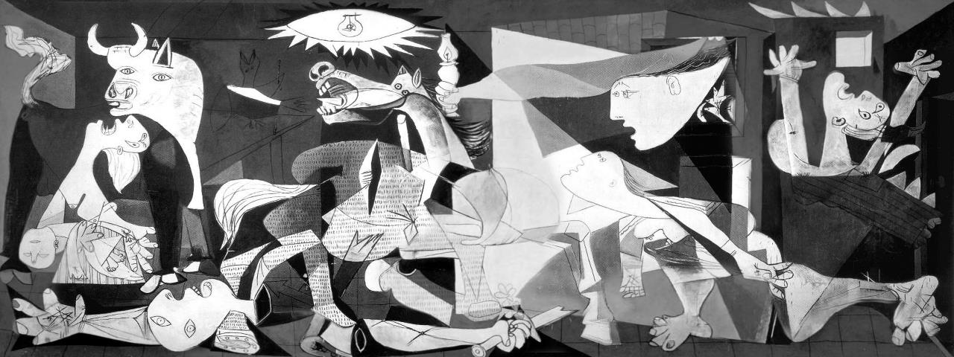

Slide 37
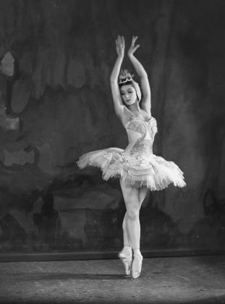
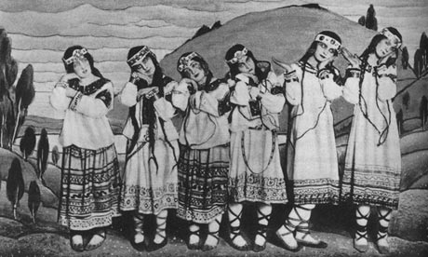
Music
Modern classical music reflects “age of anxiety”
Arnold Schönberg: 12-tone technique (atonality)
Igor Stravinsky: “Rite of Spring”

