Slide 1
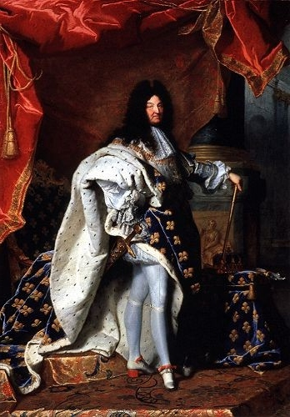
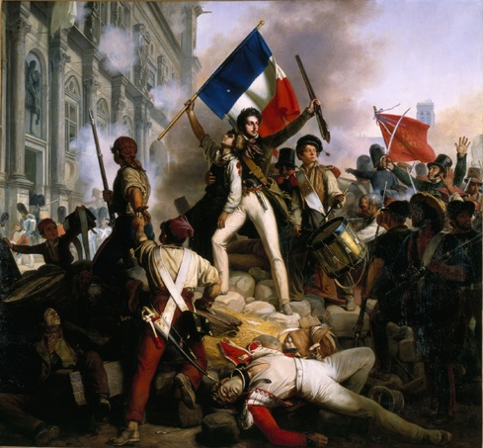
Formula to Revolution
?
Discontent & Revolution
Absolute Ruler
Enlightenment Thinkers & Ideas

Slide 2
Anatomy of a Revolution
Crane Brinton

Slide 3
What is it?
Theory on Revolutions
Most revolutions follow the same general pattern
Can predict
Why is this important?
“Those who do not know their history are doomed to repeat it.”

Slide 4
Stages: Step 1
On the eve of revolution, the government has failed to meet the needs of the people, has denied political power to new and powerful social or economic groups, and has lost the support of the intellectuals.
Social classes are upset
Scholars and thinkers give up on society
The government doubts itself
The government doesn’t get support
The government can’t control the economy

Slide 5
Stages continued…
The revolution begins with a dramatic act that demonstrates the inability of the government to control the course of events.
The moderates in the revolutionary movement seize power and attempt a program of moderate reform.
Can’t satisfy everyone
The moderate reform program arouses opposition and violence—by counter-revolutionary forces within the country and by fearful foreign countries.

Slide 6
Stages continued…
To preserve the revolution in this “crisis stage”, the extremists of the revolutionary movement seize control and employ force and terror against enemies of the revolution.
More radical group
Opposition is punished
With the crisis surmounted and the public sick of the bloodletting, the terror comes to an end.
Moderates regain power

Slide 7
Final Stages
In the ensuing period of political instability, a powerful leader emerges, seizes power, and rules as a dictator.
The public acceptance of the dictator is based on the belief that he will preserve some of the gains of the revolution while at the same time providing political stability and social cohesion.

