Slide 1
Baroque Art

Slide 2
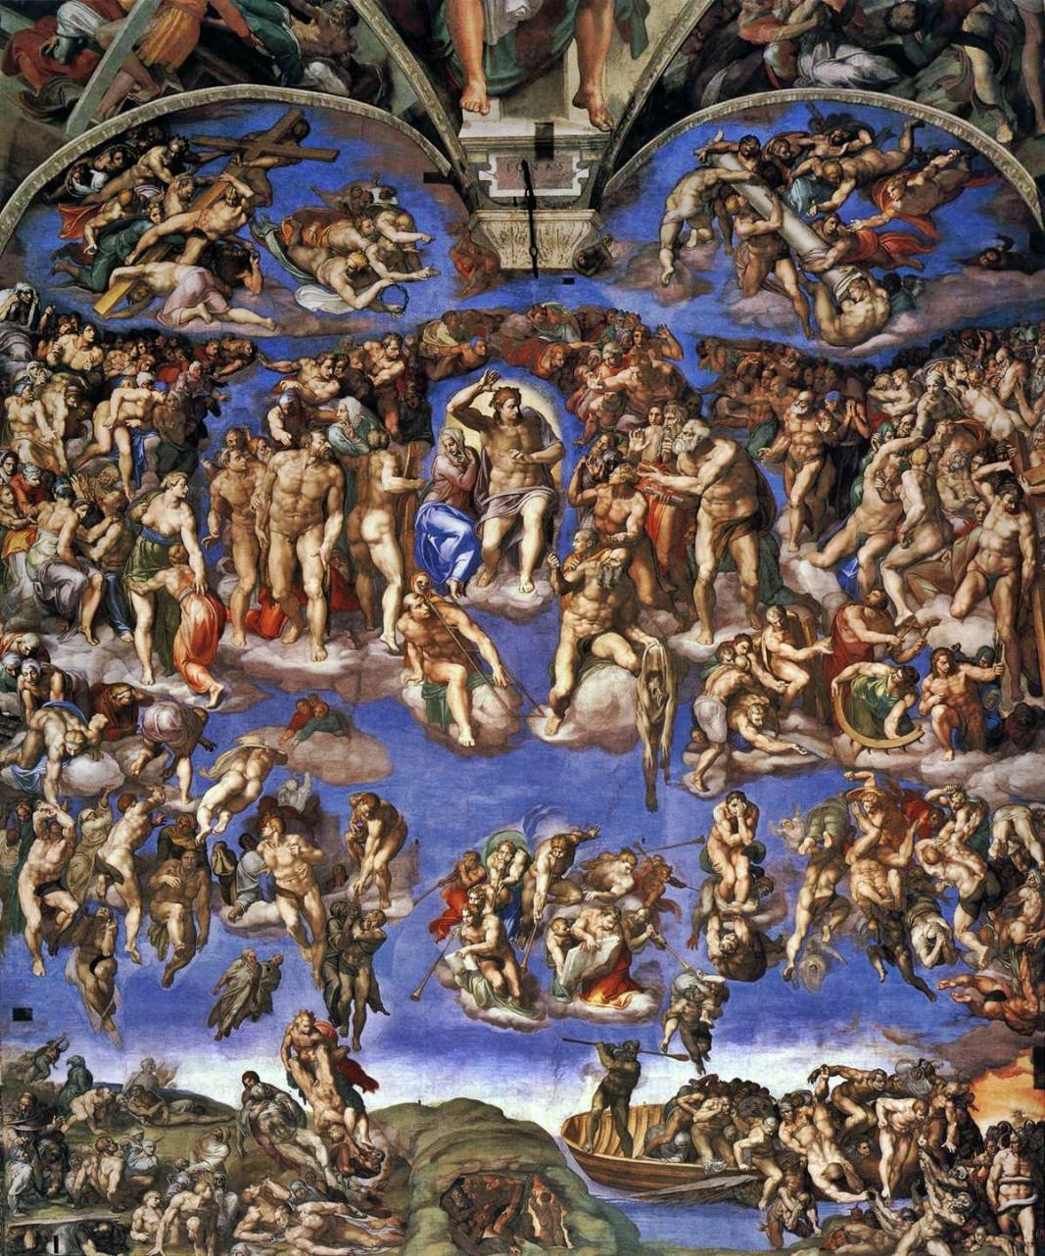
History: Counter-Reformation
Triumph of the Catholic Church
Church supported artists
Only traditional doctrine represented
Criticized Renaissance art
In the North: merchant class patronizes

Slide 3
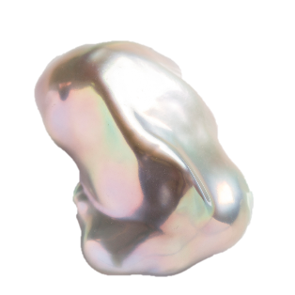
Characteristics
From Portuguese word barroco
Initially pejorative: excessive “ornamentation” or extravagance in visual arts, architecture, music
No straight lines, overly dramatic, bold colors, shadow play (chiaroscuro), intense, shows movement
Operas, Chamber Music
Artists: Peter Paul Rubens, Artemisia Gentileschi, Caravaggio, El Greco, Bernini
Musicians: Handel, Pachelbel, Purcell

Slide 4
Caravaggio

Slide 5
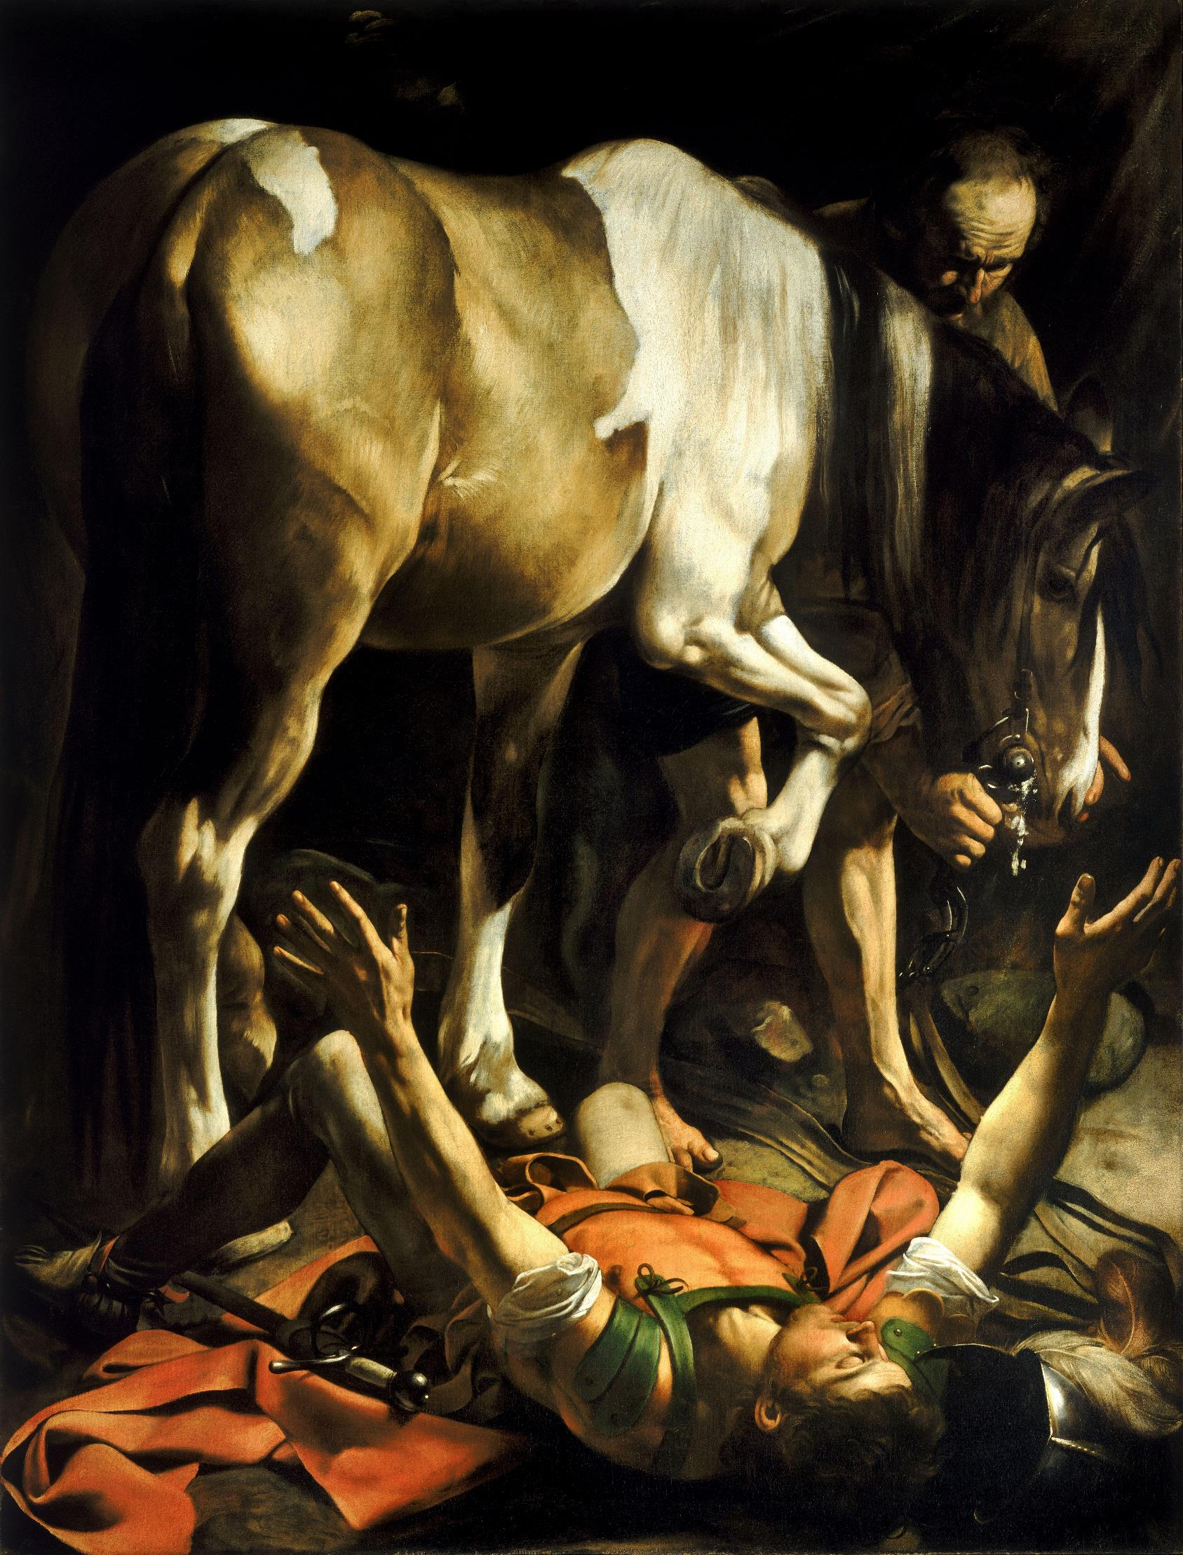

Slide 6
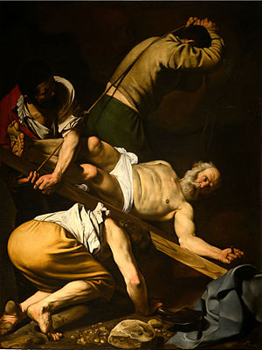

Slide 7
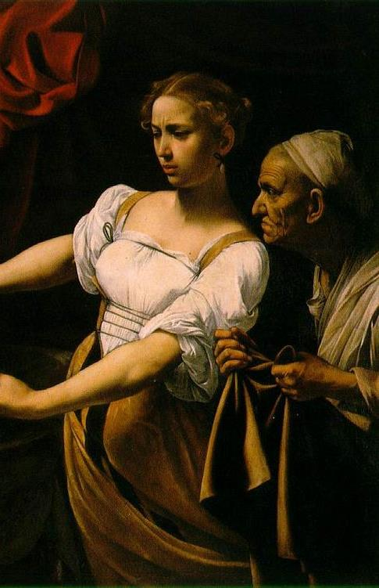
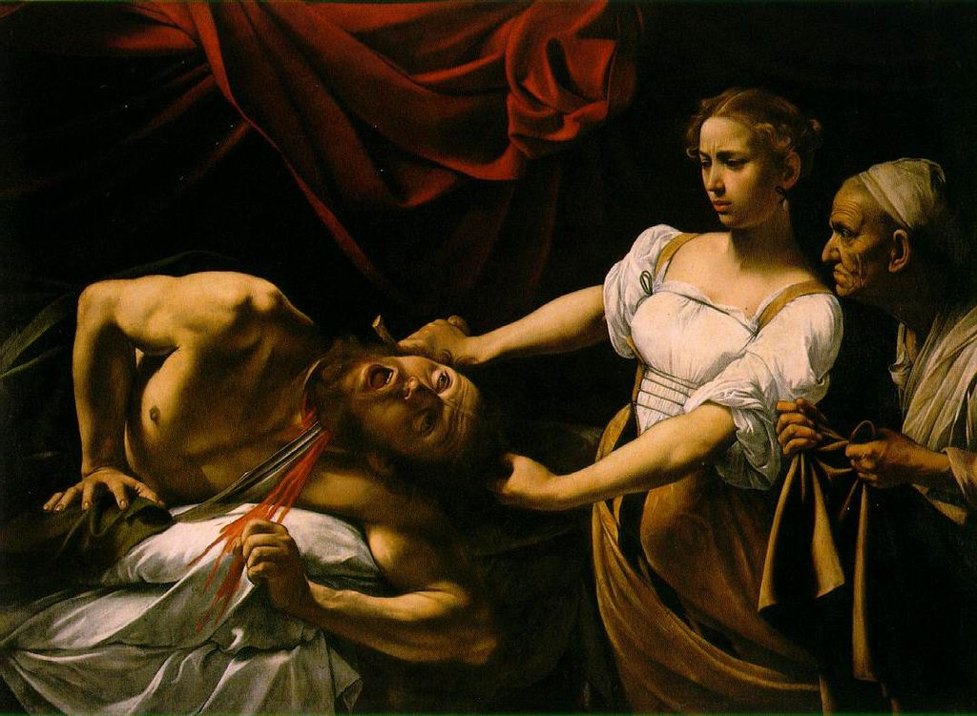

Slide 8
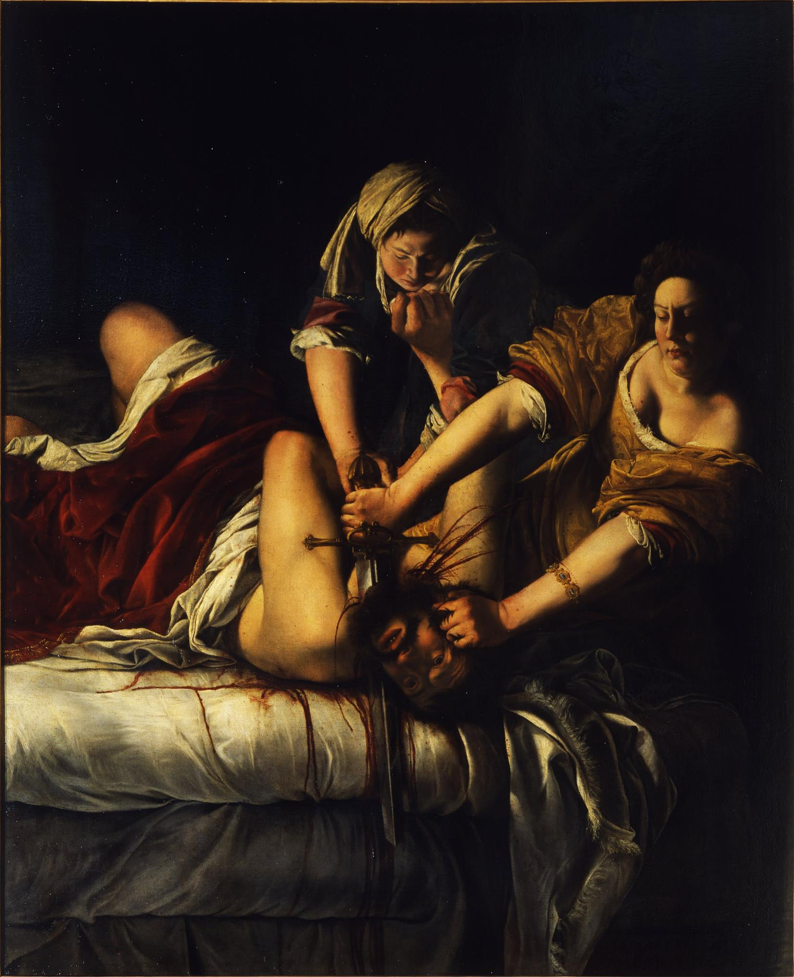
Artemisia Gentileschi

Slide 9
Bernini

Slide 10
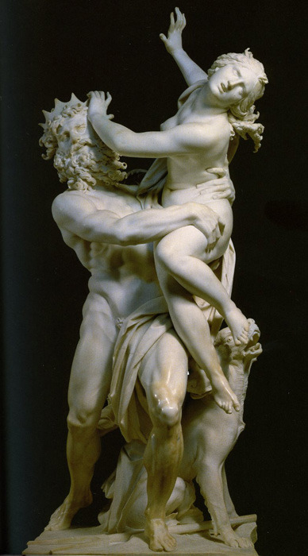

Slide 11
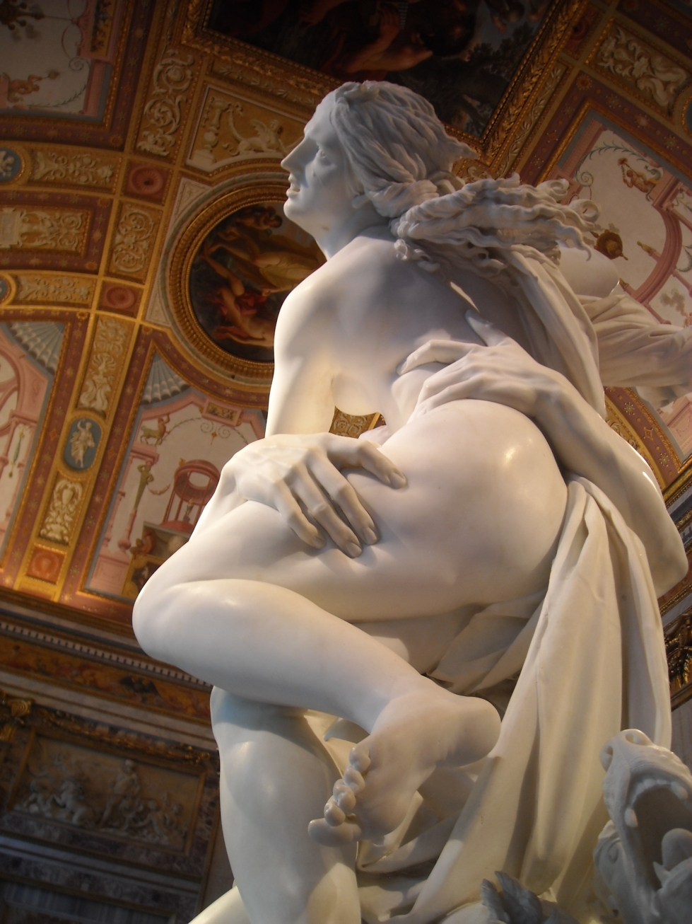

Slide 12
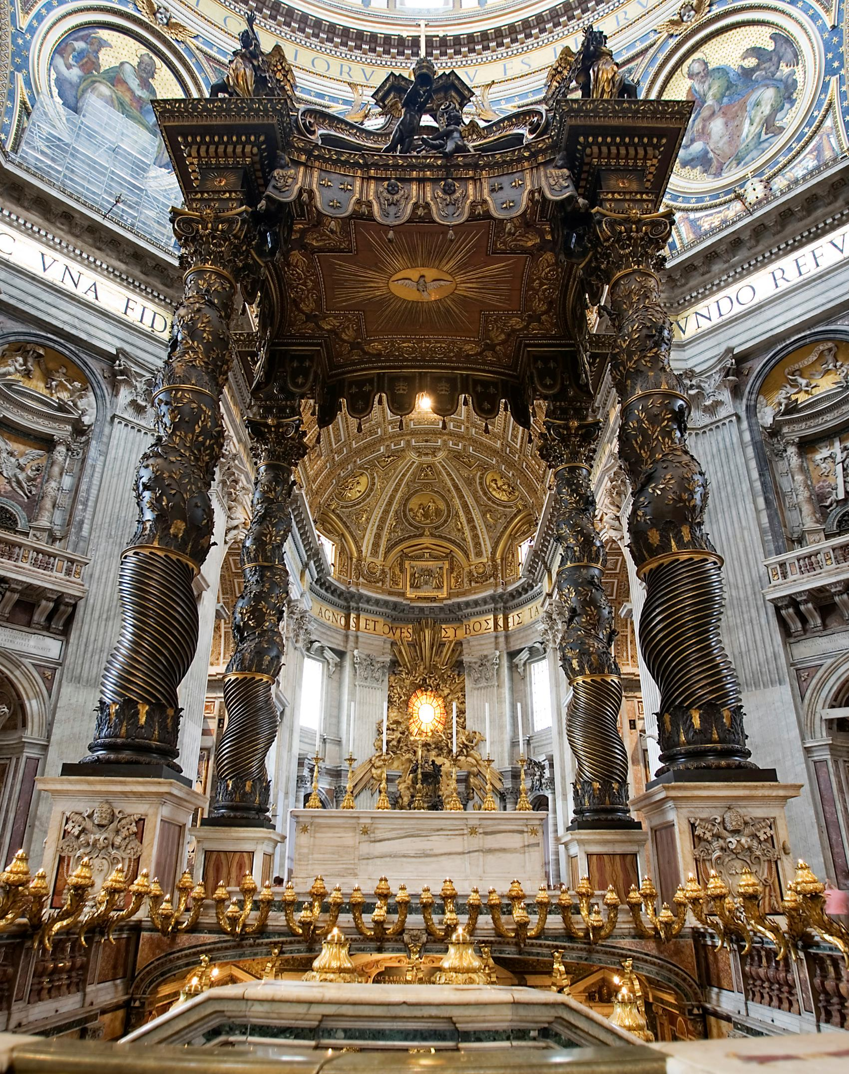

Slide 13
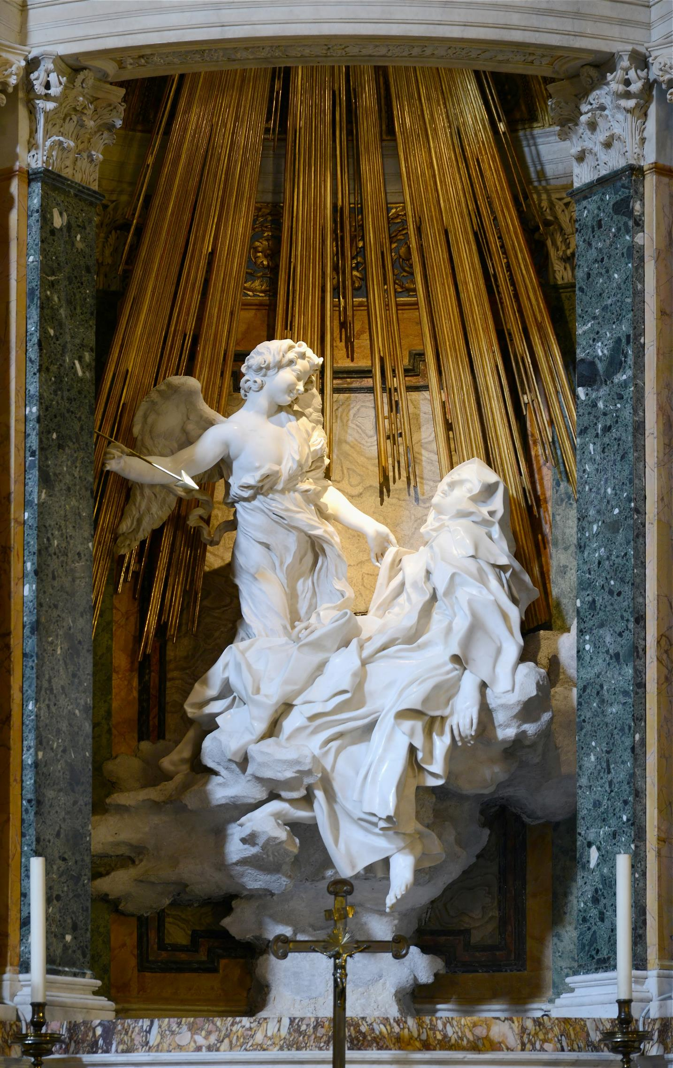

Slide 14
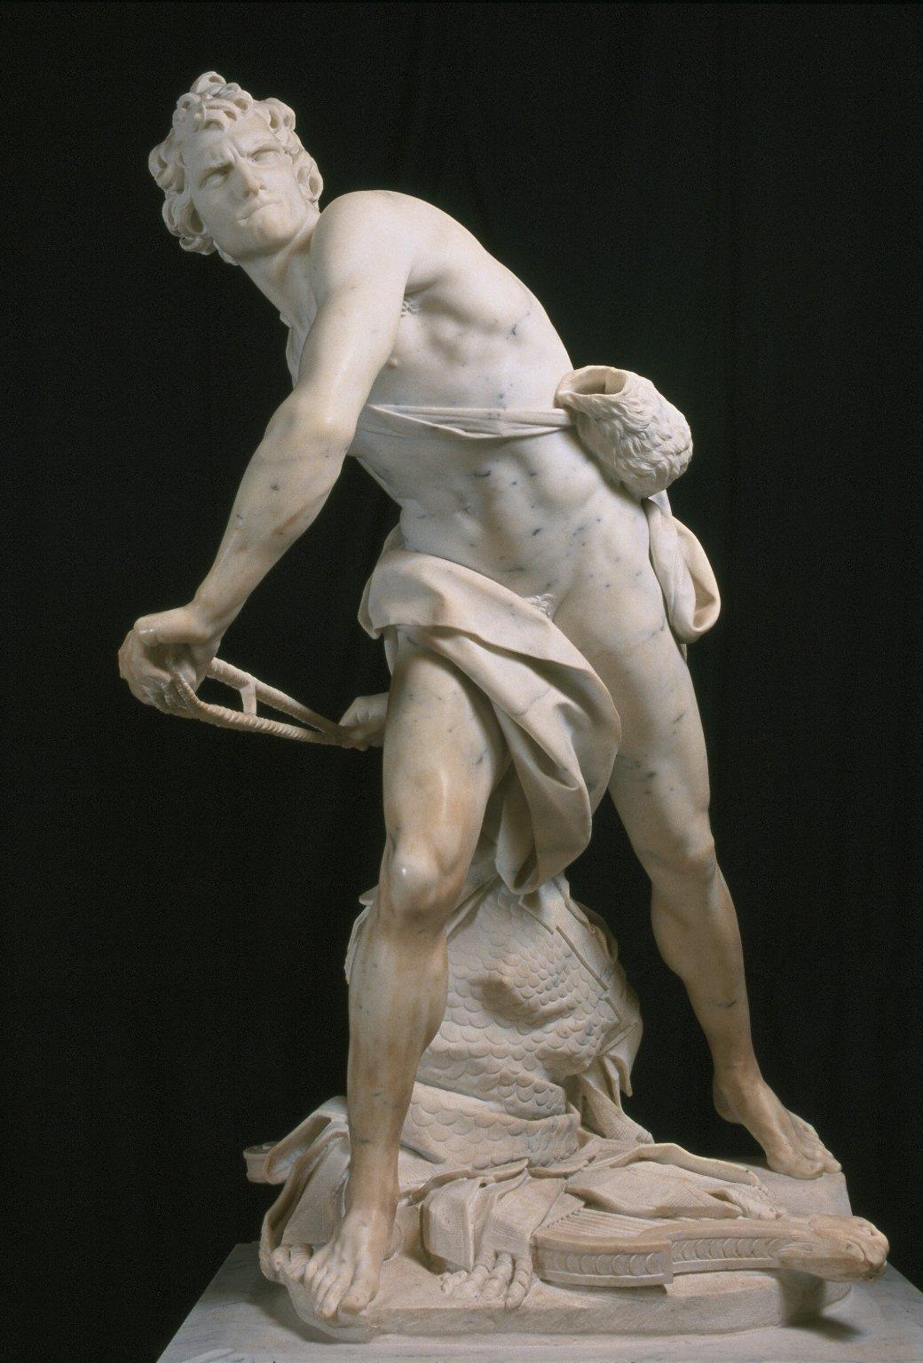

Slide 15
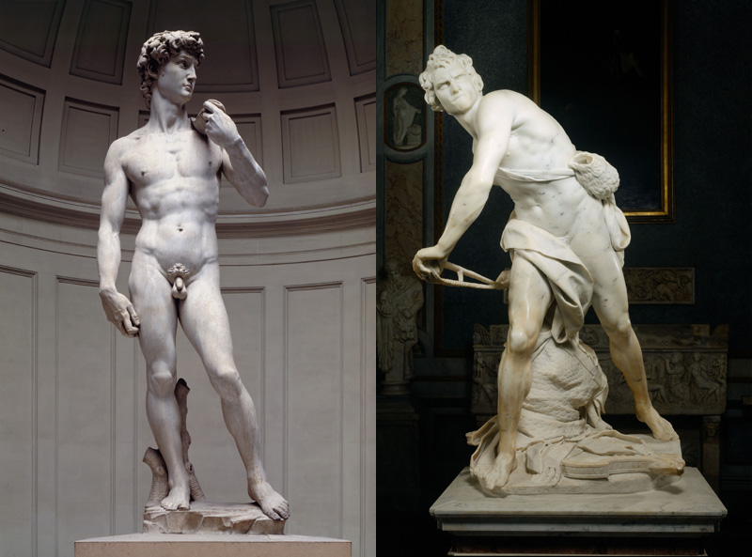
Michelangelo v. Bernini

Slide 16
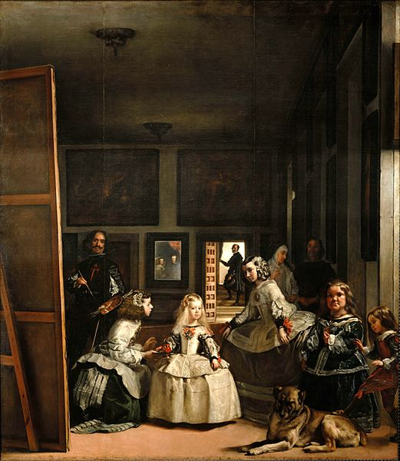
Las Meninas, Velazquez

Slide 17
Peter Paul Rubens

Slide 18
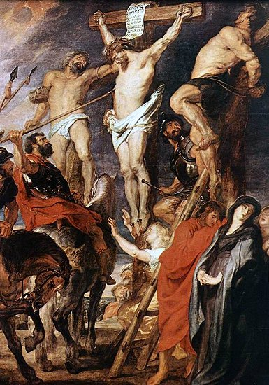

Slide 19
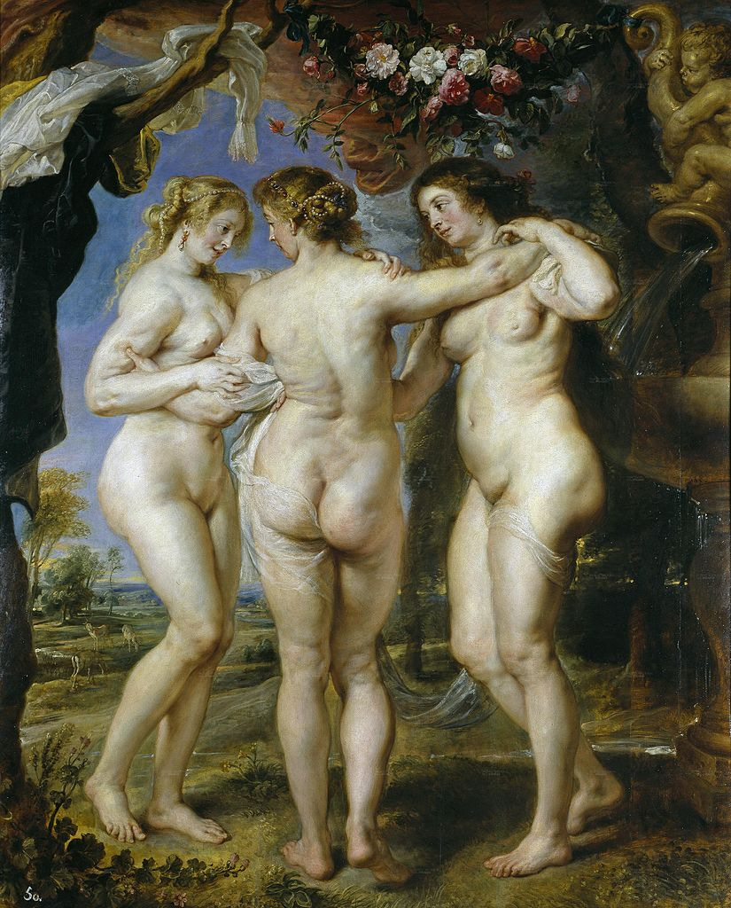

Slide 20
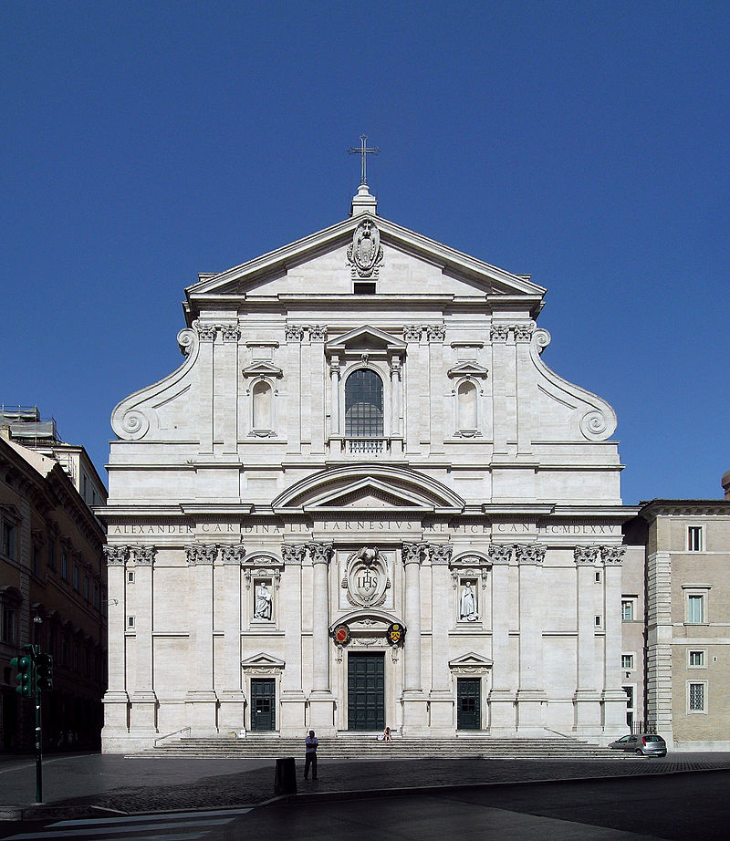
Church of the Gesù

Slide 21
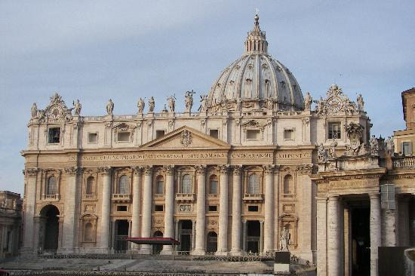
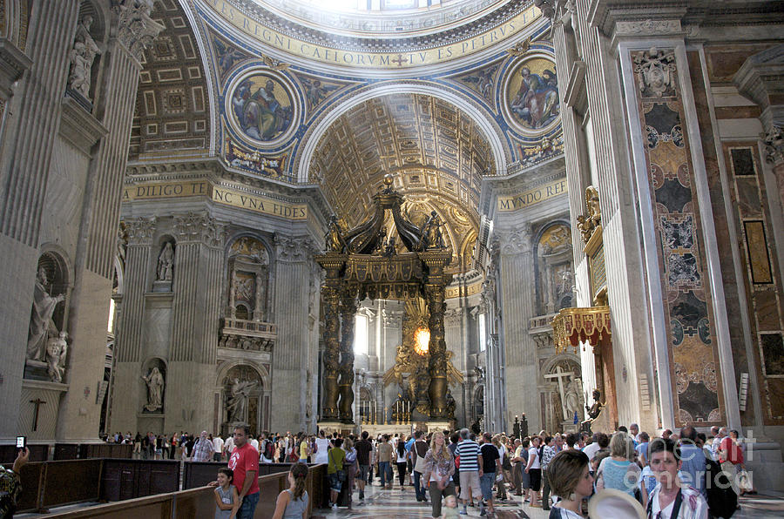
St. Peter’s Basilica

Slide 22
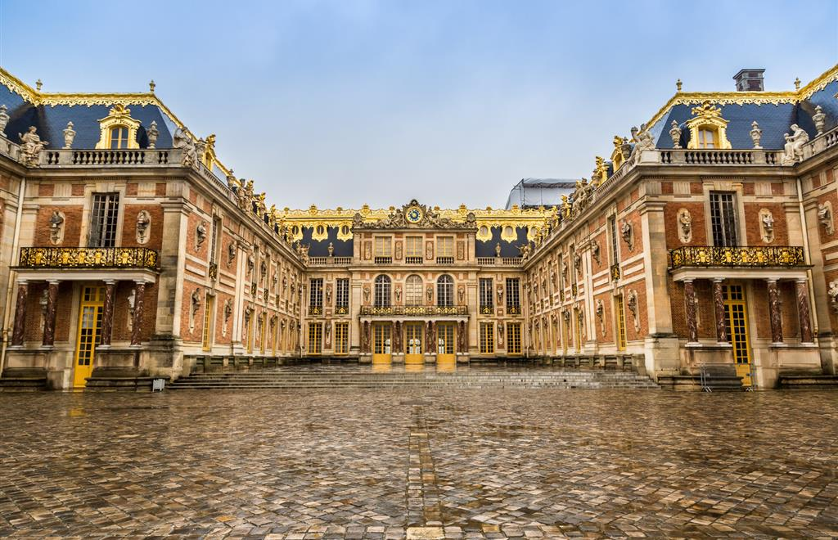
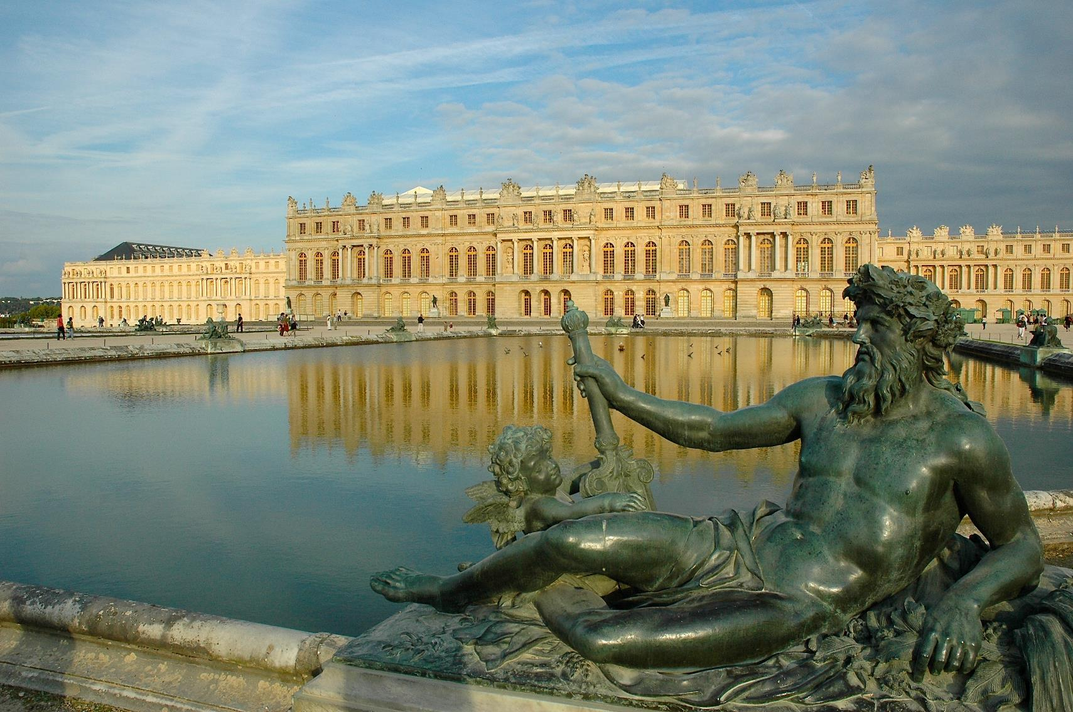
Versailles

Slide 23
