Slide 1
Historical Case Study: Irish Nationalism
Notes:
The font used in this PowerPoint is Kelt, which is a free download from http://www.fonts2u.com/kelt-normal.font

Slide 2
Focus Question: When, if ever, is it ok to take up arms and fight for what you think is right?

Slide 3
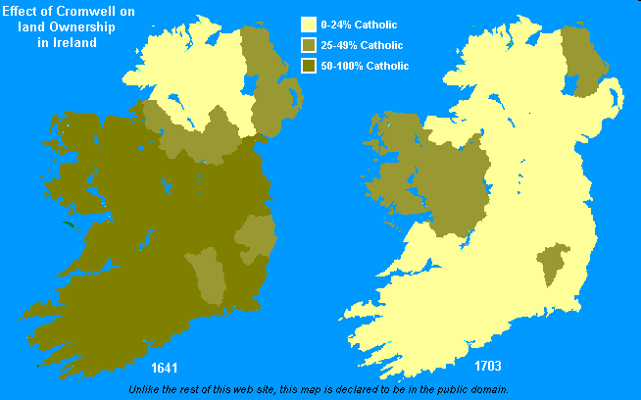
Background
Notes:
Ireland first came under English influence during the reign of King Henry II of England in 1169, when he sent Norman troops there to establish a feudal system. Under the Tudor kings of England, a conquest of Ireland put the entire island under English control. During the reign of James I, the Plantation System was established. This put English landlords in charge of Irish lands, and forced Irish citizens to pay for land that families had often been living on for centuries. Many times they couldn’t afford these new prices and were evicted from the land when they couldn’t afford to pay. When Oliver Cromwell was in power, he sent troops to Ireland in order to rid the country of Catholics, killing many and forcing many others off their lands (see map below). The native Irish population was pushed into poverty. After an Irish rebellion against the English crown in 1798, the English parliament extended its control by passing the Act of Union in 1800, which joined England, Ireland, Scotland, and Wales under the single government of the United Kingdom of Great Britain. After that time, the Irish continued to lobby England for Home Rule, or the right to local self-government. Catholics continually lost rights, including land ownership and participation in the government.
Something to pay attention to in this map: in the 1641 map, most of the country is Catholic owned, except the Northern county, which is mostly owned by Protestants. This is a result of the Plantation system established by James I, when an influx of English protestants moved to Northern Ireland. This will become a major issue with the Irish War for Independence in the 1920s.
In the 1703 map, Western Ireland remains most Catholic because it was considered by the English to be the most “barbarian” part of Ireland where the most culturally Irish lived. Even today, this remains the most traditional of the Irish counties.

Slide 4
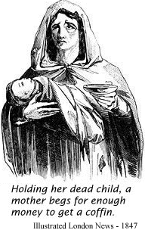
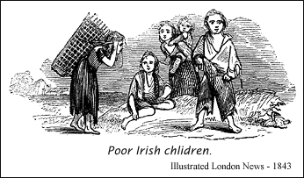
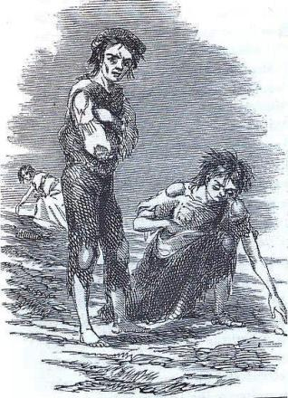
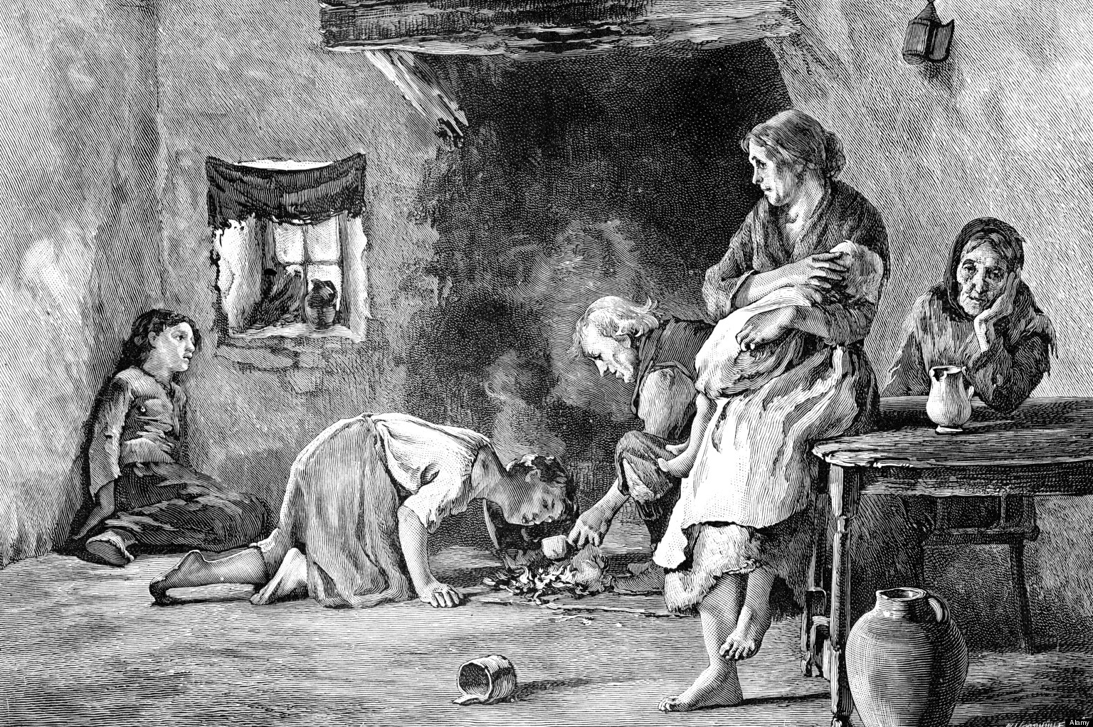
Notes:
In the 1840s, a blight on the potato crop was discovered. Most of the Irish poor sustained themselves almost wholly on potatoes, and when the crop harvest over two years failed, many of the poorest people in Ireland were starving.

Slide 5
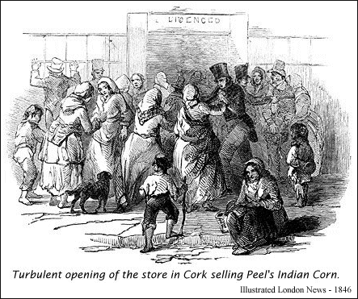
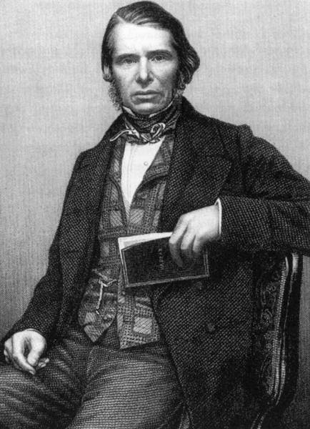
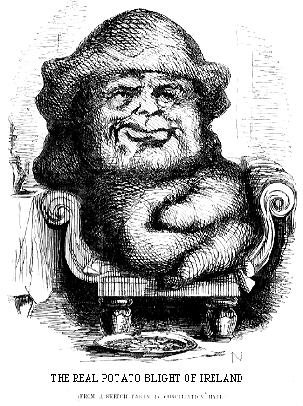
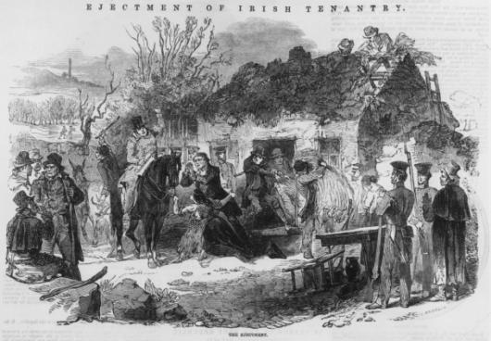
God gave us the potato blight, the English gave us the famine
Notes:
Charles Trevelyan was a senior British civil servant in the administration of Ireland in Dublin Castle. During the Famine, he was in charge of administering relief, but his inactive attitude was believed to have made the Famine worse. He saw the Famine as a "mechanism for reducing surplus population". The stereotype of the poor Irish is that they were lazy, and he therefore saw this as God’s punishment on the people. He refused to hand out much of the food sent for relief to Ireland. Additionally, the food that was sent was a hard corn that was mainly used in sloop for pigs, however, the desperate Irish fought over what was sent. At the same time, grain was continually exported out of Ireland by English landlords to sell in other parts of the world, rather than distributed to the people. Irish who could not support themselves lost their homes when the could not pay rent to these landlords. This led to the saying that the famine was caused, not by the potato blight, but by the British. Many Irish were forced to emigrate. The population of Ireland dropped from 8 million to 4 million during this time (approx 1 million from deaths). The population of Ireland never recovered completely (still around 3-4 million today).

Slide 6
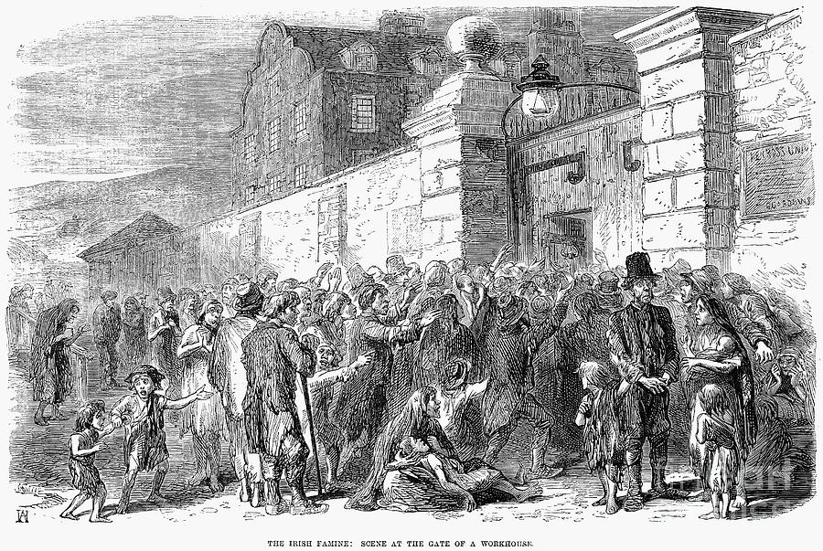
The Irish Famine: Scene at the Gate of a Workhouse

Slide 7
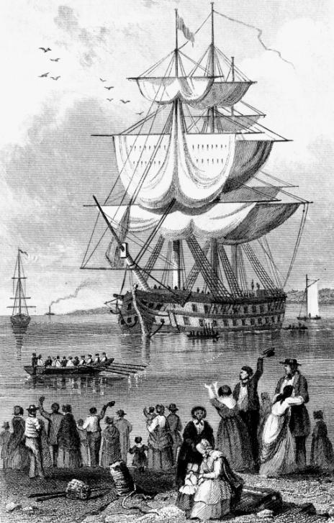
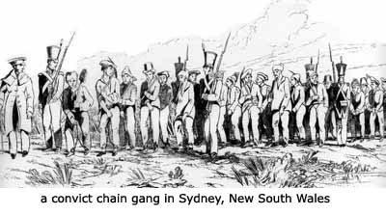
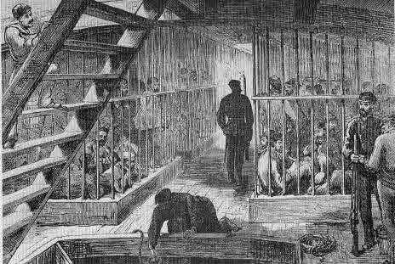
Australia
Notes:
This also led to an increase in crime. Irish who were captured would be sent to the penal colony in Australia (also known as Botany Bay). Often Irish citizens who advocated for Home Rule would be deported, or exiled, here. Most of the convicts were thieves who had been convicted in the great cities of England. Only those sentenced in Ireland were likely to have been convicted of rural crimes. Simple larceny, or robbery, could mean transportation for seven years. Compound larceny - stealing goods worth more than a shilling (about $50 in today's money) - meant death by hanging.
Work on the chain gangs in Australia was notoriously difficult and demeaning. Many criminals died from the treatment they received before the end of their sentence

Slide 8
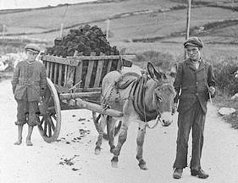
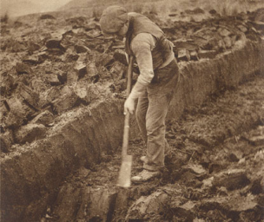
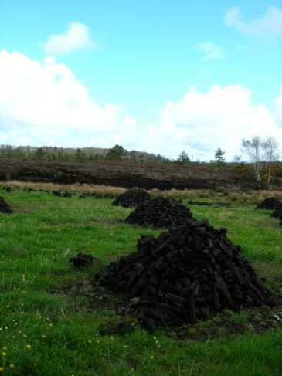
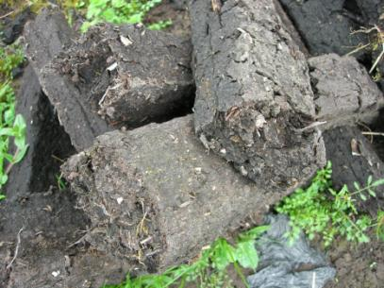
Footing Turf
Notes:
In Ireland, one of the main sources of fuel is peat turf. In order for farmers to use this turf they would engage it what is called “footing turf” where they use a very sharp farm tool and push it into the ground with their foot to cut small rectangles of soil. It was dangerous work if you weren’t careful. The turf would then be stacked in piles to dry and could also be sold for extra money.

Slide 9
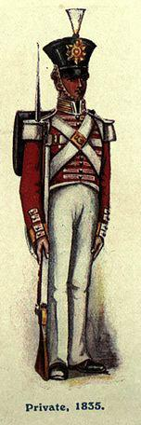
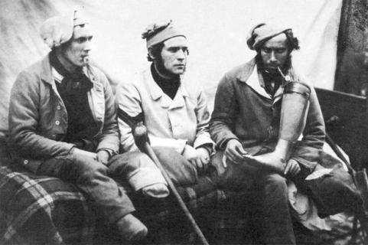
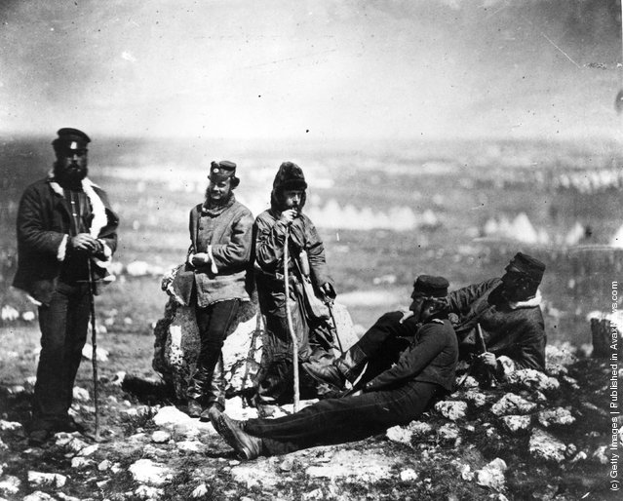
The Crimean
Notes:
The Crimean War was fought between the Russians and a coalition of British, French, and Ottoman forces. Although the war was successful for British forces, the fighting was fierce, bloody, and the conditions were poor. Irish regiments were often sent to the front line and experienced the worst conditions of the fighting. Above you see a photograph (this was one of the first wars in which photography was used) of an Irish regiment relaxing in the field. Above are wounded soldiers. Medical care in Crimea was notoriously sub-par, and many soldiers lost limbs during the fighting. Once they returned home, wounded soldiers were poorly compensated for their losses, especially considering many were farmers who could not longer work in the fields (you can’t foot turf without a foot).

Slide 10
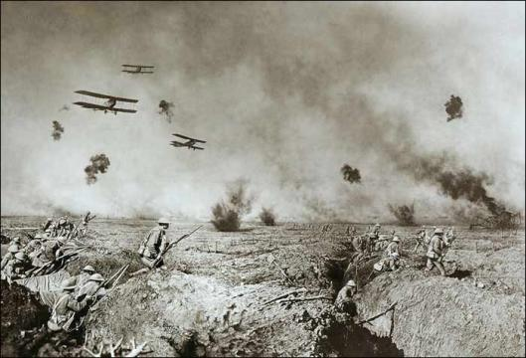
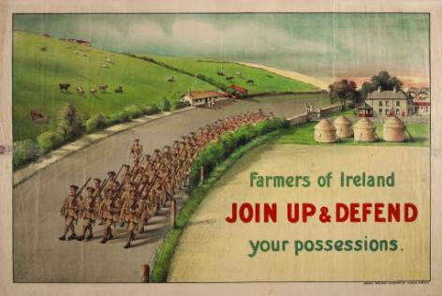
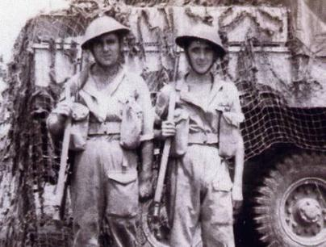
World War I
Notes:
During WWI, many Irish were hesitant to fight for the British and were even sympathetic to the Germans. The British engaged in a propaganda campaign in word to encourage Irishmen to join the fighting. They even dangled the idea of Home Rule if they supported the English. This war was one of the first modern wars in terms of technology, including airplanes. Above are pictured two Irish brothers who enlisted in the British army. Many Irish regiments were sent to the front lines and there were more Irish deaths than any other nationality in the British army. It also became apparent that there was no intention by the British to offer the Irish the promised Home Rule.

Slide 11
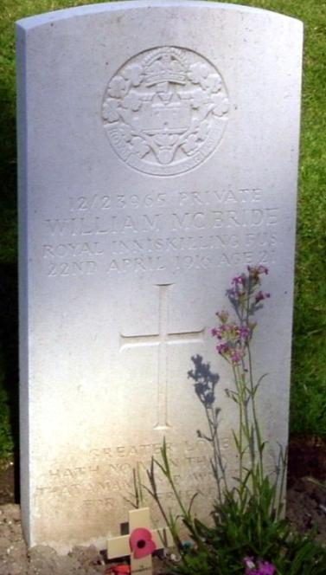
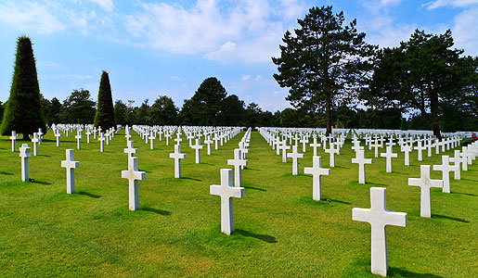
World War I
Notes:
The above tombstone maybe the one for which the song “Green Fields of France” was based on. The actual Willie McBride in the song is, however, a fiction.

Slide 12
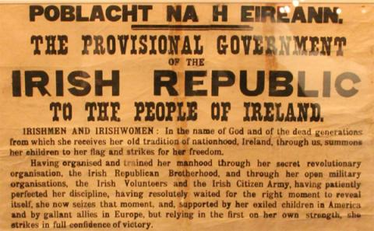
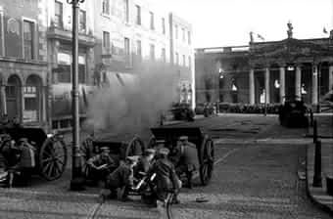
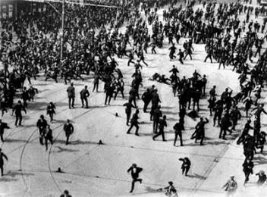
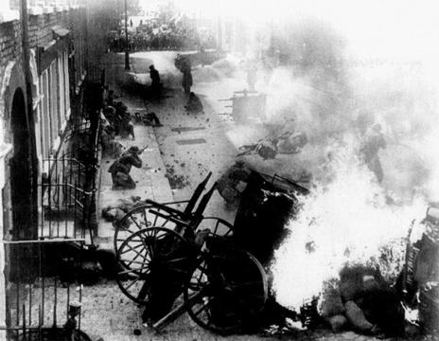
Easter Rising of 1916
Notes:
On Easter of 1916, Irishmen in Dublin declared a rebellion against the British forces. They issued a Proclamation of Irish Independence and attempted to establish an Irish Republic. The leaders of this rebellion were members of the Irish People’s Army, the forerunner of the IRA (Irish Republican Army). The rebels took control of the General Post Office (GPO) in Dublin’s City Center. The rebellion failed, and the leaders of the rebellion were executed. They had tortured and so mistreated the leaders of the rebellion, that one man was unable to stand before the firing squad and had to be given a chair for his execution.

Slide 13
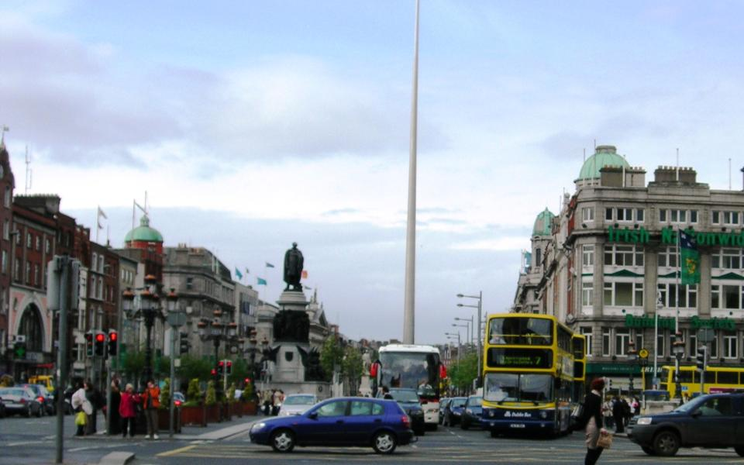
Notes:
This and the next slide contain modern photographs of the city center of Dublin. This photo is a wide shot of O’Connell street. This is a great opportunity to have students think about local history, as the effects of the uprising can be seen when you look closely. I like to point out a few elements of this picture: The statue at the center is of Daniel O’Connell, an Irish parliamentary figure who fought for Catholic rights. To his left, the flags flying are on top of the GPO (General Post Office).

Slide 14
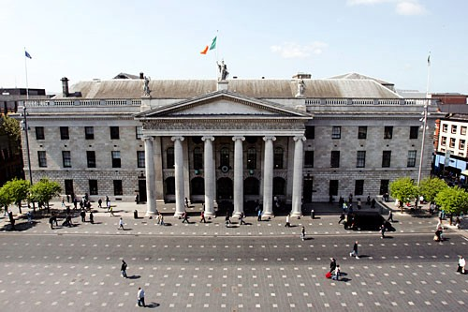
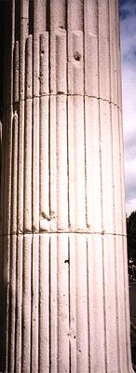
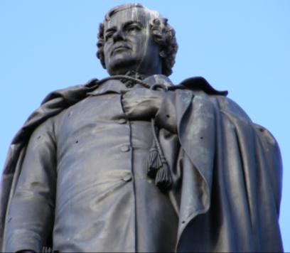
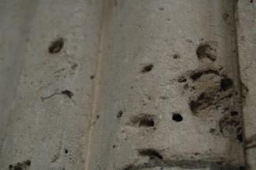
Notes:
Now for close up pictures: The top is the GPO. The column on the left still has marks from the bullet holes from the uprising. The close-up of the O’Connell statue also points out the holes from bullets. It’s also interesting to point out the irony of these bullet holes in a statue of a main who fought for equality and peace through legal means.

Slide 15
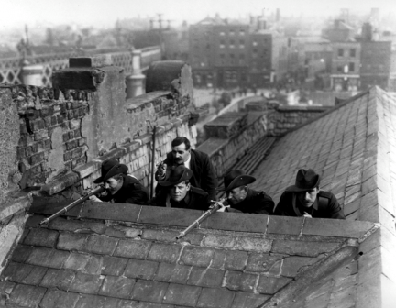
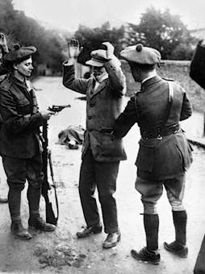
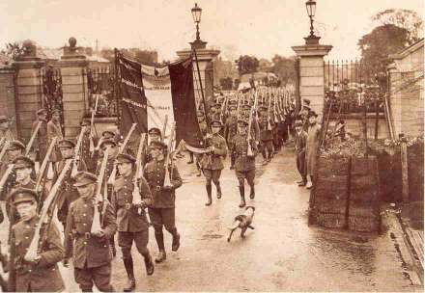
Irish War of Independence & Irish Civil War
Notes:
Following the execution of the leaders of the Easter Uprising, Irish was thrown into a War for Independence against the British. The Irish People’s Army was more of a militia or a guerilla army. The military police force sent by the English got the nickname the “Black and Tans” due to the color of their uniform. In the pictures above (left to right, top to bottom) you see IRA members on the roof of a home, Black and Tans searching an elderly Irishman, British military forces in Ireland, a color photograph of the Black and Tan uniform. It is also to important to point out that some Irish who were loyal to Britain would join the British forces and/or the Black and Tans. In 1921, the British signed a treaty with the Irish officially creating the free Irish Republic, the first independent state in Ireland since the conquest of Henry II. HOWEVER…there was a problem…

Slide 16
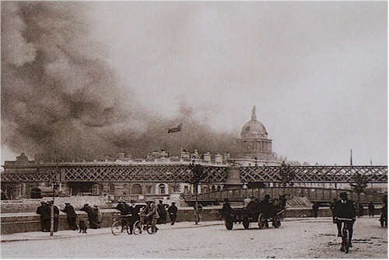
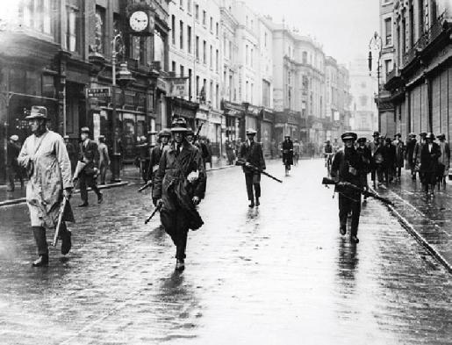
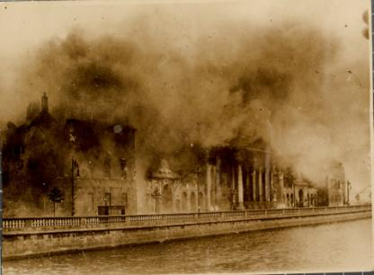
Irish War of Independence & Irish Civil War
Notes:
When the British formed the Irish Republic, it did not apply to the whole island. The three lower counties were granted independence, but the northern-most county was retained as part of the United Kingdom. This was mostly due to it’s more Protestant-English culture dating back to James I’s plantation system (see the first slide with the maps). However, this was unpopular by Northern Catholics and many Irish living in the country-side. This led to a Civil War in Ireland immediately following the treaty between those who supported the treaty and those who wished for a untied Irish Republic.

Slide 17
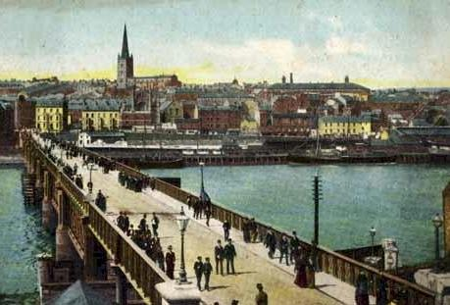
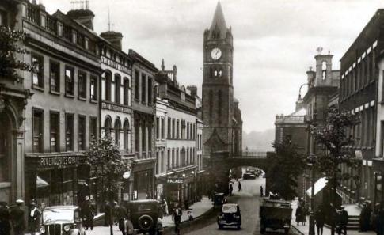
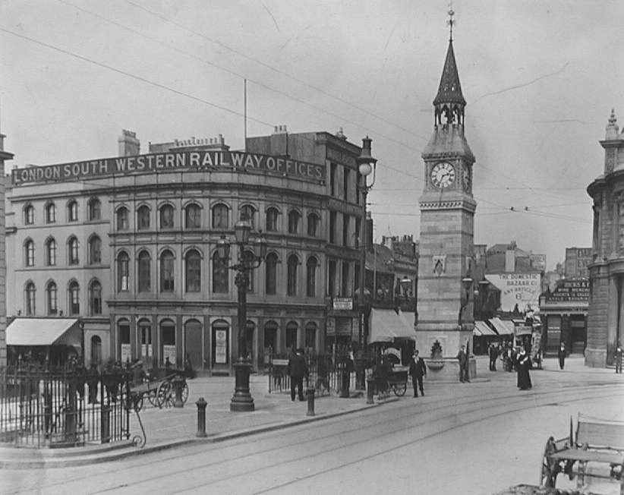
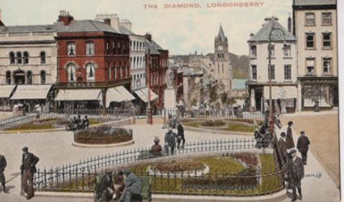
Old Derry
Notes:
Before the Irish Civil War, one of the most important cities in Northern Ireland was Derry (as it is called by Republican Irish) or Londonderry (as it is called by Loyalists and the English). Around the turn of the 20th Century, Derry was a relatively peaceful factory town, however, this changed after the Irish Civil War, when Derry became a hotbed of rebellion.

Slide 18
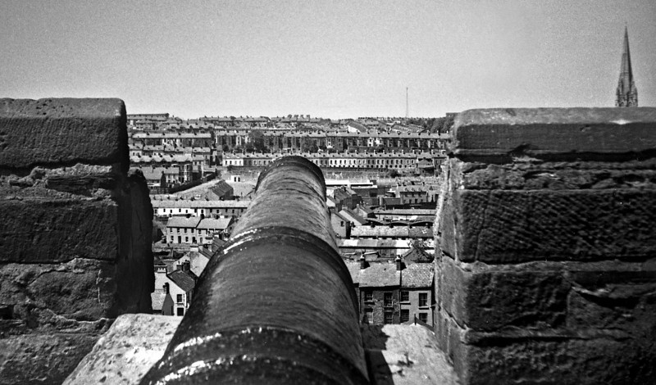
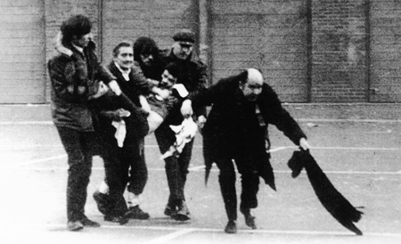
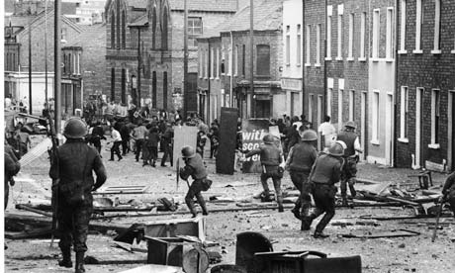
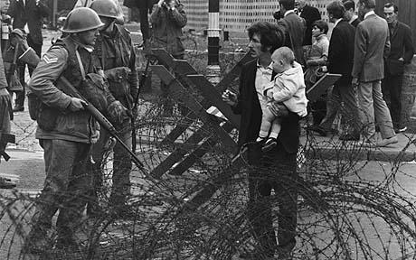
The Troubles
Notes:
During the Irish War of Independence, the Northern Irish town of Derry (or Londonderry) was rocked by violence, partly prompted by the guerilla war raging between the Irish Republican Army and British forces, but also influenced by economic and social pressures. By mid-1920 there was severe sectarian rioting in the city. Many lives were lost, and in addition many Catholics and Protestants were expelled from their homes during this communal unrest. During a period known as The Troubles, the city became a focal point for the Irish Civil Rights movement. The city became militarized and barricades were constructed. British soldiers were installed in the city to try to keep the peace. It came to a head on January 30, 1972, in an incident known as Bloody Sunday. During a Northern Ireland Civil Rights Association march, shots rang out and 26 civil-rights protesters and bystanders were shot by soldiers of the British Army. 13 young men—seven of whom were teens—died immediately or soon after. Two protesters were also injured when they were run down by army vehicles. Five of those wounded were shot in the back. No one knows if the protesters or the soldiers fired first.

Slide 19
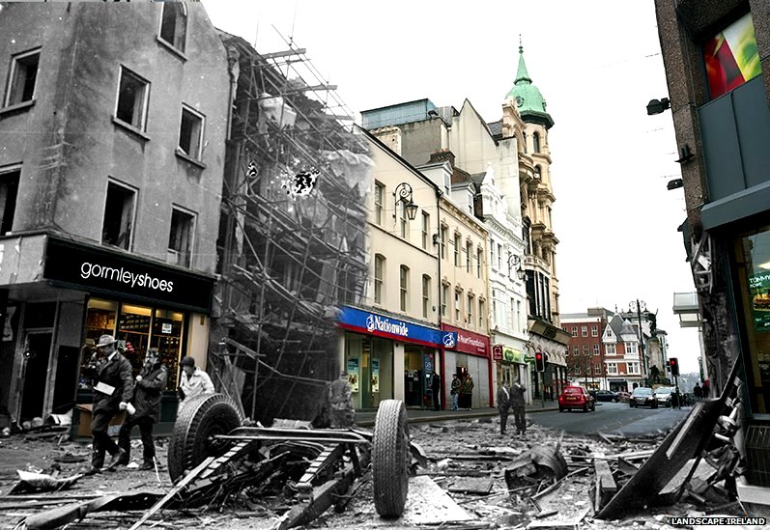
Notes:
The Troubles in Derry lasted decades. The IRA and Sinn Fein (the political branch of the IRA) eventually became tagged as a terrorist organization due to attacks in other parts of Ireland and in England against British civilians. Even today, Irish Catholic and Protestant neighborhoods in Ireland are separated by fences and can be closed off to each other during potentially disruptive situations.

Slide 20
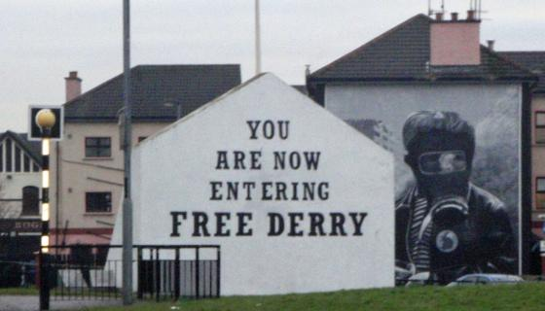
Notes:
One expression of the tension in Derry has come out in murals painted all over the city. Some of them are less politically focused or focus on issues outside of Ireland (see next slide). Despite major strides between the Irish and English, there is still a politically charged atmosphere in Northern Ireland.

Slide 22
Notes:
https://www.youtube.com/watch?v=YTm7PbMqq-w

Slide 23
Focus Question: When, if ever, is it ok to take up arms and fight for what you think is right?

