Slide 1
Intro to Absolutism

Slide 2

What is it?
Complete Sovereignty of National Power
  Hereditary Assumption of Power
  Divine Right of Kings
Good v. Bad?

Slide 3



Western v. Eastern Absolutism
Western
Eastern
France, Spain
Ruler not subordinate to national assemblies
Nobility under monarch’s control
Bureaucrats are career officials, often middle class
Large standing armies
Control of church & education
HOP RAP (aging v. new empires)
Powerful nobility, weak middle class, oppressed peasantry
Serfs & Robots
Permanent taxes
Large standing armies
Diplomatic Relations
Smurfs & Robots

Slide 4
Constitutionalism
Government power is limited by law
Emphasis on Civil Rights & Liberties
England: Constitutional Monarchy, King and Parliament
Netherlands: Republican Confederation, stadtholders

Slide 5
Who are the names?
Jean Bodin
  French Civil War
  Only absolute control can provide order and stability
Thomas Hobbes
  State of nature: Mankind is naturally “Nasty brutish and short”
  Fear of anarchy
Bishop Jacques Bossuet
  Divine Right of Kings: no authority to man, only God
Cardinal Richelieu & Louis XIII

Slide 6
Louis XIV
Consolidating power
  Cultural—Versailles (Fronde)
  Economic—Colbert
  Political—Cardinal Mazarin, intendant system, also Versailles
  Religious—revoke Edict of Nates
One Law, One King, One Faith

Slide 7
Wars of Louis XIV

Slide 8
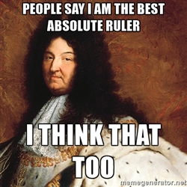
So what’s he trying to do?
Conquer New Territory
French Dominance
Weaken Rivals
Personal Glory

Slide 9
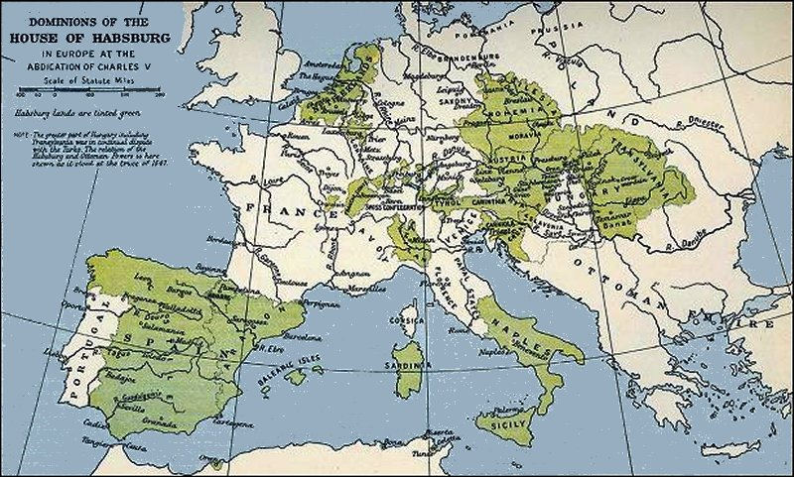

Slide 10
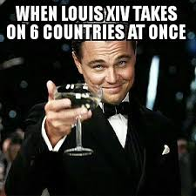
Wars of Louis XIV
War | Causes | Key Events | Significance
The War of Devolution (1667-1668) | Challenge Hapsburg Dominance in Europe: France v. Spain | Overruns Belgium & Franche-Comté, but returned to Spain | Secret Treaty of Dover w/ British: Money & Navy Double team the Dutch
The Franco-Dutch War (1672-1678) | Treaty of Dover; Wants that land & Spain out, Small Confederation v. Large State | Rampjarr: Disaster Year, 1672; change of leadership to Wm III (Orange), Flood country | Dutch period of decline, Louis gains Spanish Netherlands
The Nine Years War AKA War of the League of Augsburg (1688-1697) | Wm III b/cm English King, Grande Alliance forms v. Louis | French navy burned, King William’s War in North America | Both sides go broke, Treaty settled, Fr leaves territory of HRE
The War of Spanish Succession (1701-1714) | Spanish King Charles II dies w/o heir

Slide 11
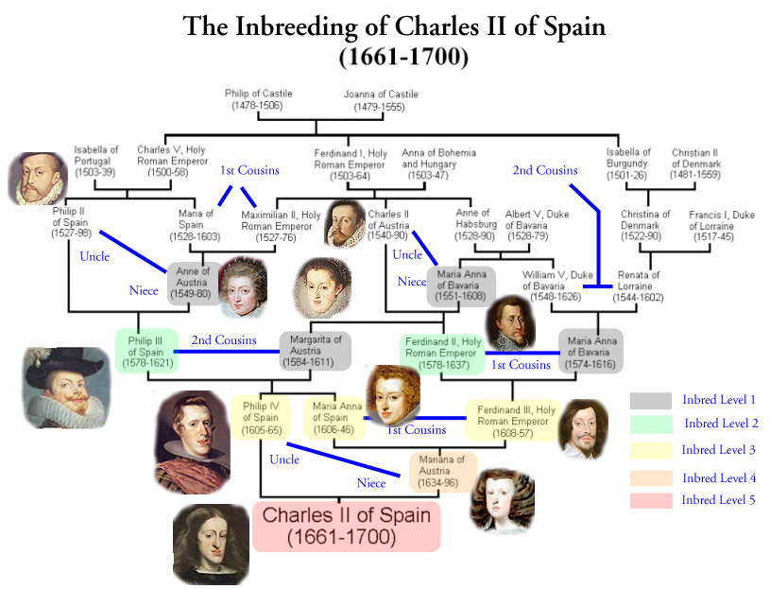

Slide 12
Wars of Louis XIV
War | Causes | Key Events | Significance
The War of Devolution (1667-1668) | Challenge Hapsburg Dominance in Europe: France v. Spain | Overruns Belgium & Franche-Comté, but returned to Spain | Secret Treaty of Dover w/ British: Money & Navy Double team the Dutch
The Franco-Dutch War (1672-1678) | Treaty of Dover; Wants that Spain out, Small Confederation v. Large State | Rampjarr: Disaster Year, 1672; change of leadership to Wm III (Orange), Flood country | Dutch period of decline, Louis gains Spanish Netherlands
The Nine Year’s War AKA War of the League of Augsburg (1688-1697) | Wm III b/cm English King, Grande Alliance forms v. Louis | French navy burned, King William’s War in North America | Both sides go broke, Treaty settled, Fr leaves territory of HRE
The War of Spanish Succession (1701-1714) | Spanish King Charles II dies w/o heir, everyone has a claim | France holds own against Grand Alliance, did not lose/gain territory: Draw | Treaty of Utrecht: Bourbons in Spain, Gibraltar base, Changes Balance of Power

Slide 13
Consequences of Louis’s Wars
Did he achieve his goals? Yes & No
Bankrupted France
Weak leadership under heir: Louis XV
  Spent money lavishly
  Policies influenced by mistress Madam du Pompadour

Slide 14
Wait what about Spain?
Weak rulers
High inflation—economic decline
Decrease of power and influence

