Slide 1
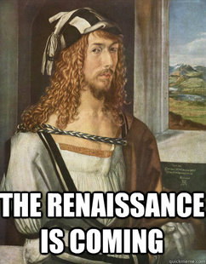
ITALIAN RENAISSANCE
14th – 16th Century
(1350-1600)

Slide 2
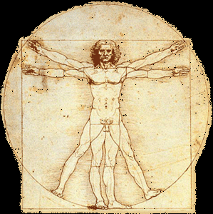
THEMES
Departure from the Middle Ages
“rebirth”
Modern Era
Changes in Art, Architecture, Literature, Science, Technology, Politics, Religion
Notes:
– revival of classical learning, character, and life
--Beginning of the Modern Era
--TWO FLAVORS – ITALIAN, NORTHERN

Slide 3
DEFINITION
Intellectual and cultural transformation of Europe
Giorgio Visari (1511-1574) – Lives of the Most Excellent Italian Architects, Painter, Sculptors (1550) – rinascita
Jacob Burckhardt The Civilization of the Renaissance of Italy (1860)
Notes:
– Italian “rebirth”
--Italy, France, Spain, Low Countries, central Europe
--Defined in their own time period as something separate
About half of the original edition was devoted to the art of the Renaissance. Thus, Burckhardt was naturally led to write the two books for which he is best known, his 1860 Die Cultur der Renaissance in Italien ("The Civilization of the Renaissance in Italy") (English translation, by S. G. C. Middlemore, in 2 vols., London, 1878), and his 1867 Geschichte der Renaissance in Italien ("The History of the Renaissance in Italy"). The Civilization of the Renaissance in Italy was the most influential interpretation of the Italian Renaissance in the 19th century and is still widely read.

Slide 4
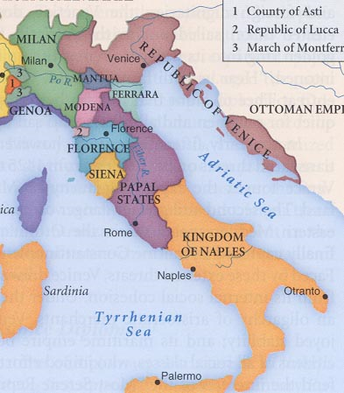
RENAISSANCE
Florence
The Individual
New World View
Gradual shift from religion
Notes:
Florence “birthplace” Italy

Slide 5
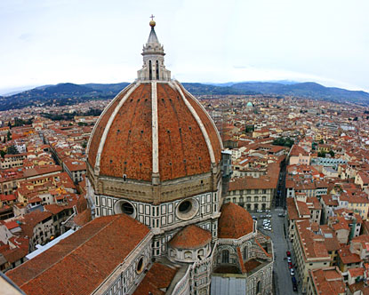
FLORENCE
Capital of Tuscany
Republic
Guilds – Goldsmiths, Lawyers, Merchants (wool & silk), Poets

Slide 6
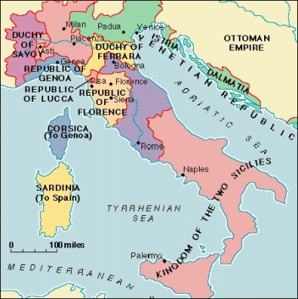
WHY ITALY?
Northern Italy
Crusades (1095-?)
Growing merchant class
Government
Rich & Powerful
Patronize the Arts
“Economic growth laid the material basis for the Italian Renaissance” - McKay
Notes:
– market economy – banking, wool trade
new wealth and ideas
literate and with leisure
Not united no single authoried
Want to show off, glory

Slide 7
ECONOMIC FACTORS
Geographical position – crossroads of trade
Commercial competition
Venice, Genoa, Milan
Powerful merchants controlled politics
Medici Family
Politically unstable

Slide 8
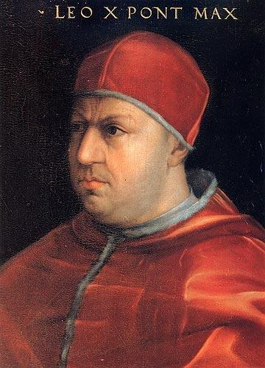
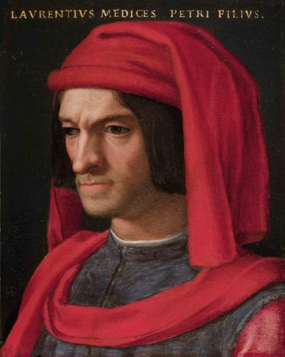
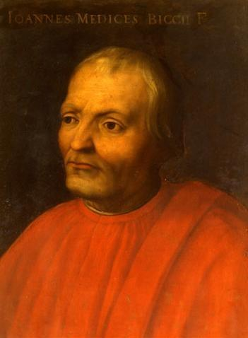
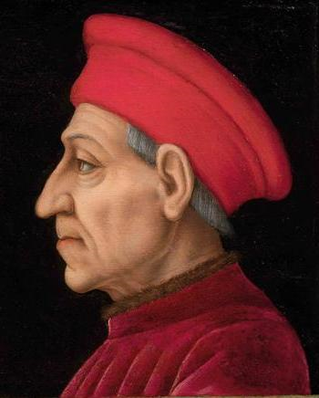
THE MEDICI FAMILY
Status and power thru COMMERCE (banking)
Giovanni de Medici (1360-1429) – Founder
Cosimo de Medici (r. 1434-1464) – “The Elder”
Lorenzo de Medici ( r. 1469-1492) – “The Magnificent”
Pope Leo X (1513-1521), Pope Clement VII (1523-1534)
Notes:
– not thru warfare, marriage, or inheritance–
Wool Industry, “God’s Banker” – Papal Banking

Slide 9
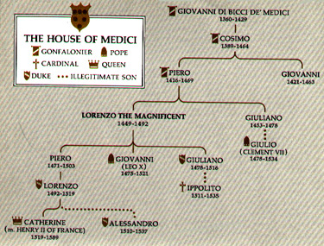
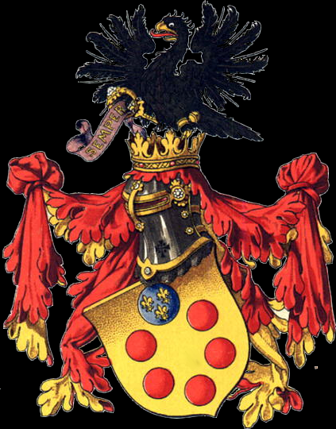

Slide 10
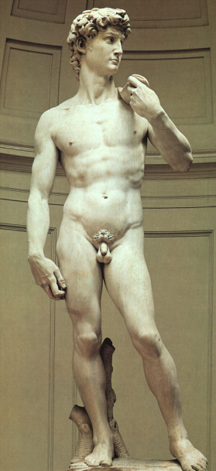
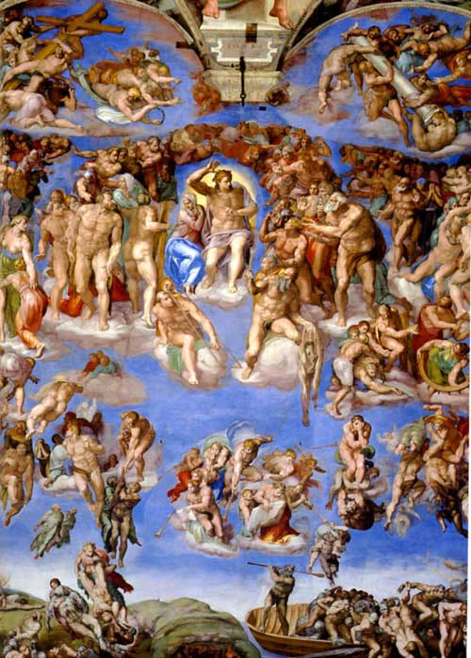
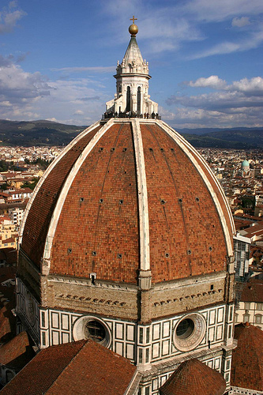
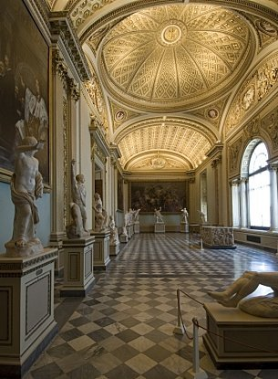
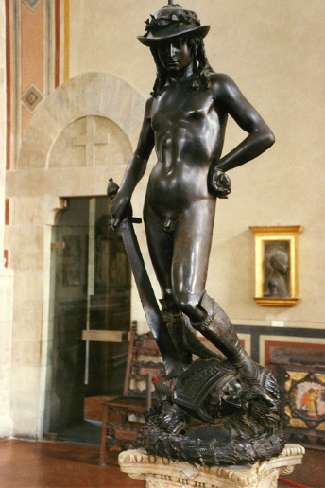
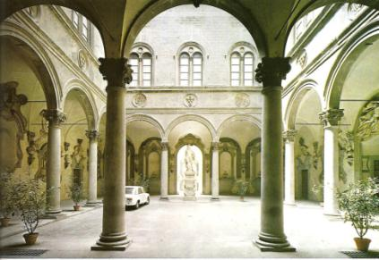
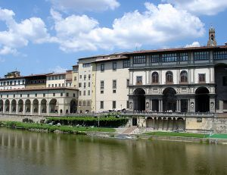
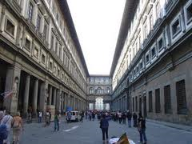
PATRONAGE
ARCHITECTURE
Brunelleschi’s Duomo
Uffizi Gallery
Palazzo Medici
ART
Donatello’s David
Michelangelo's David, The Last Judgment
Botticelli’s Birth of Venus

Slide 11
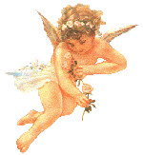
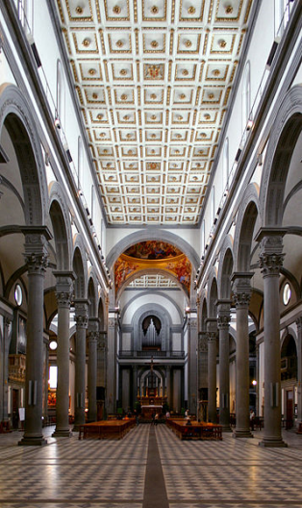
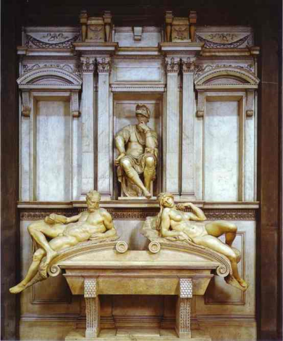
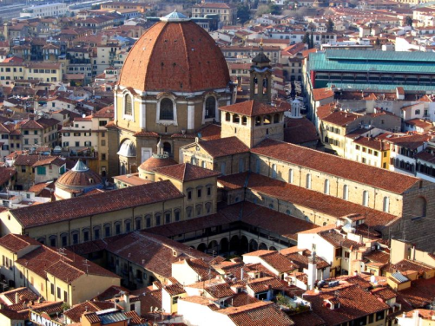
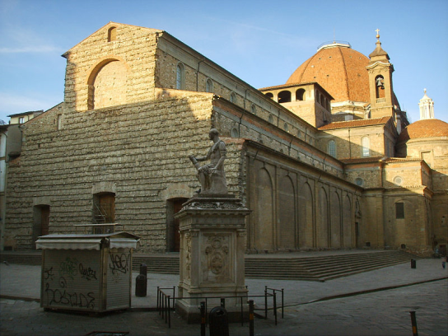
MEDICI CHAPEL
Basilica of San Lorenzo
“Chapel of Princes”
Medici Tomb
Michelangelo
“New Sacristy” (1520)

Slide 12
“The princely court afforded the despot or oligarch the opportunity to display and assert his wealth and power. He flaunted his patronage and learning and the arts my munificent gifts to writers, philosophers, and artists.” - McKay

Slide 13
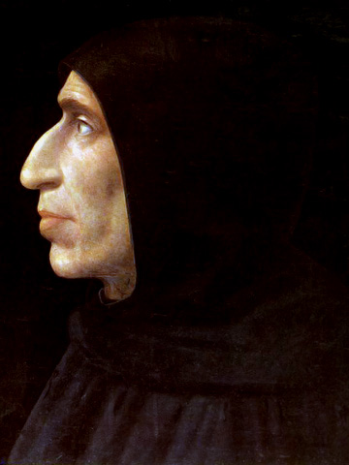
SAVONAROLA
Girolamo Savonarola (r. 1494-1498)
Dominican Friar
Bonfire of the Vanities
Excommunicated by Pope Alexander VI (r. 1492-1503)
1498 “burned an the stake”

Slide 14
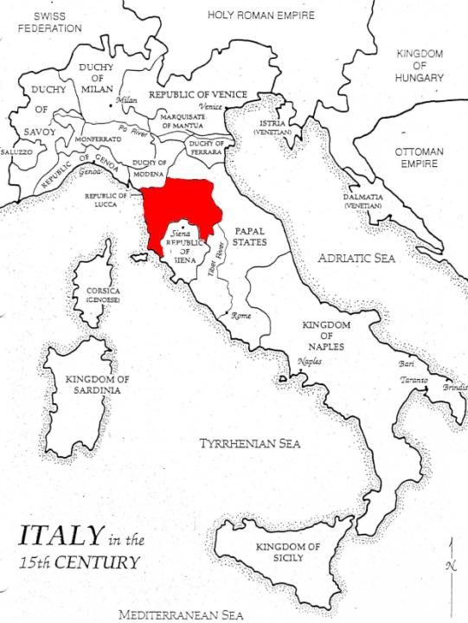
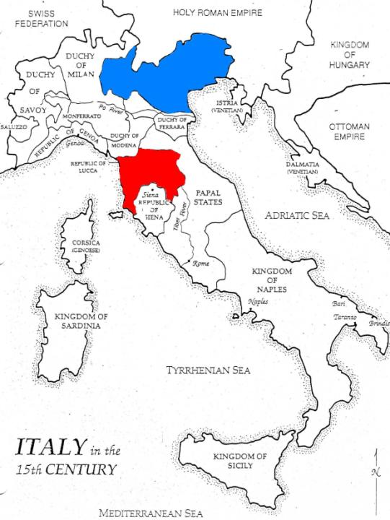
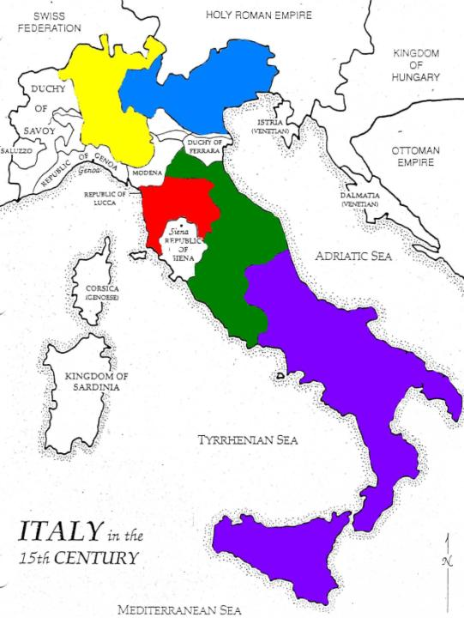
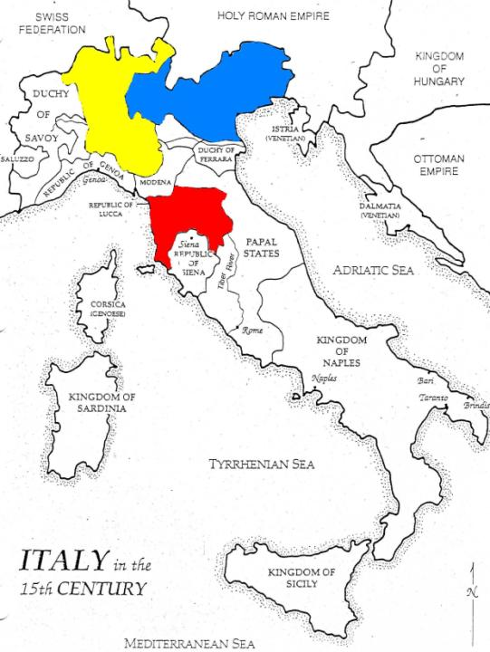
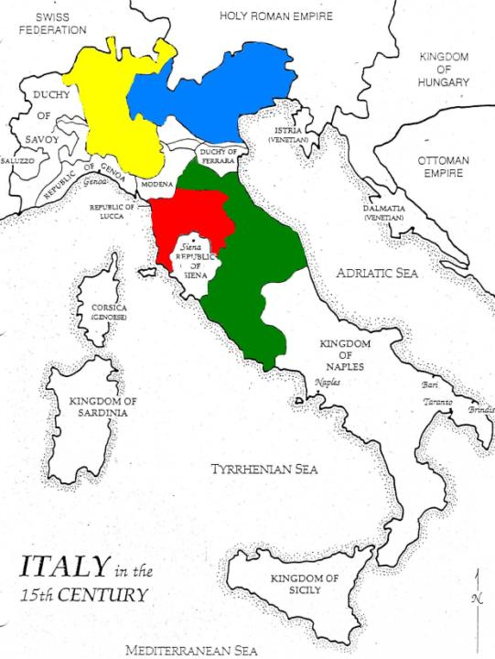
POLITICAL FACTORS
MILAN
VENICE
Five Major City-States
Venice, Milan, Florence, Papal States, and Naples
Competition, Bribery, Intrigue, Murder, Money, Power
Pope vs. Kings
3 Types of government evolved in Italy – Communes, Republics, *Oligarchies
FLORENCE
THE PAPAL STATES
NAPLES
Notes:
– merchants guilds northern Italian cities
– power reside with people – popolo – (middle class) excluded from gov’t rose up to overthrow city gov’t and establish republics (or façade?)
ruled by an elite wealthy few – merchant aristocracies
– one man ruled

Slide 15
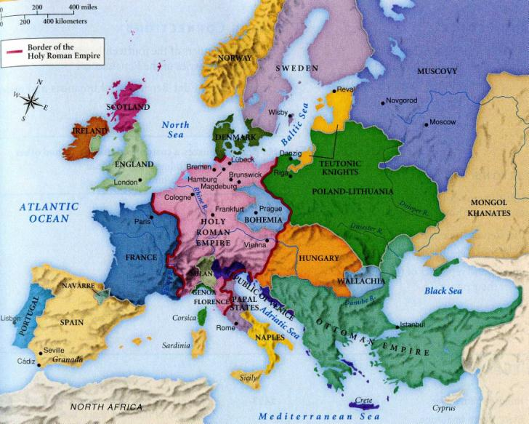
POLITICAL FACTORS
Western Europe – rise of monarchial states – Spain, France, England
Central Europe – Florence, Switzerland, Venice – self-rule republics
Eastern Europe – Holy Roman Empire (HRE), Poland-Lithuania, Ottoman Empire
Map – Lynn Hunt

Slide 16
SOCIAL FACTORS
Did the Renaissance affect all social classes?
Elite, upper classes, few
Patronize the arts = $$$$
Key social characteristics – Individualism, Humanism, Secularism, Criticism

Slide 17
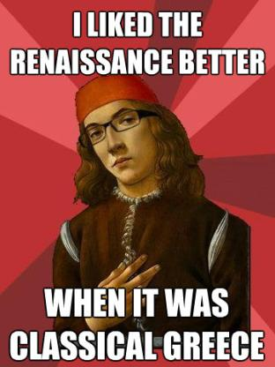
HUMANISM
Intellectual movement
Humanities
“new learning”
Emphasis on education and literacy
Study of Classical Texts
Virtù
The Book of the Courtier, Castiglione
Civic Humanism
NOT UNCHRISTIAN!
Notes:
– grammar, rhetoric, history, poetry, moral philosophy
–liberal and secular
Literary culture
Greek and Latin classicsto reveal human nature
– reaching for perfection, fully developed mind and body, shape own destiny
engagement in politics is noble, necessary

Slide 18
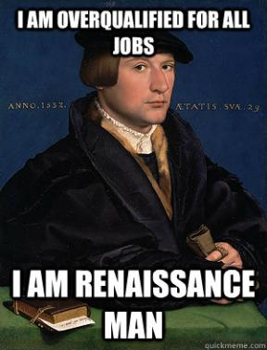
WELL-ROUNDED MAN
Renaissance Man – the gentleman has the ability to do many things well: academically, socially, politically, culturally
Notes:
Thus, a gentleman should develop every aspect of his personality
Free, Intelligent, trusting in his ideas

Slide 19
INDIVIDUALISM
Personal achievement
“man is the measure of all things”
“Individualism stressed personality, genius, uniqueness, and the fullest development of capabilities and talents”
“Thirst for fame, a driving ambition, a burning desire for success drove such people to the complete achievement of their potential”
“The quest for glory was a central component of Renaissance Individualism”

Slide 20
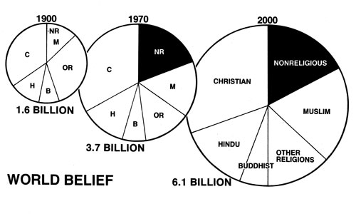
SECULARLISM
Material world > Spiritual World
Again: DOESN’T MEAN YOU DON’T BELIEVE IN GOD

Slide 21
CRITICISM
Ability to analyze both pro and con
Don’t just take someone else’s word
“All this literary activity was of a scholarly type, in which authors broadened their understanding as much by reading as by personal experience of the world. And scholarly activity, the habit of attending closely to what the page really said, had consequences that went beyond either pure literature or local patriotism. A new critical attitude developed.” (Palmer, 55)

Slide 22
CONSEQUENCES
Weakening of Church Authority
Modern frame of mind emerges
Revival of Classical style, ideas, text
Improved technology – Printing
Use of vernacular
Increasing self-awareness – “know thyself”
Continued subordination of women
Life in the present can be improved, not just in the hereafter
Greater interest in science, exploring unknown
Awesome ART!

