Slide 1
New Monarchs
c. 1460-1550

Slide 2
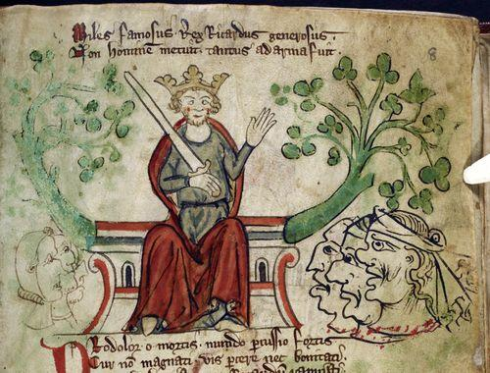
Old Monarchs?
No Unity or Nation
Feudal
Not much control over laws or taxes
Dependent on nobility

Slide 3
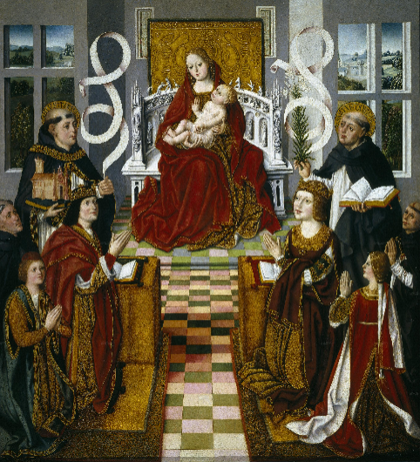
The Shift
Consolidated power
Foundation for modern nation-state
Made use of Roman Law
“Will and Welfare of the People”
“Sovereignty”—not Absolute

Slide 4
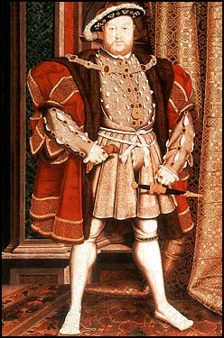
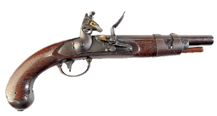
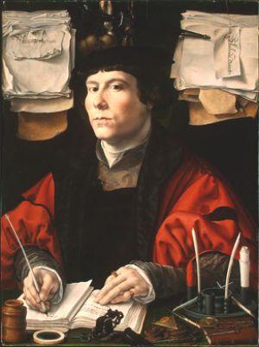
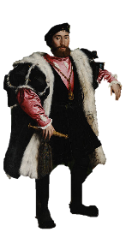
What did they look like?
Reduced power of nobility
Taxation
Land confiscation
Reduced power of clergy
Gun Powder
Effective bureaucracies—central control
Increased power of middle & merchant classes
Mostly Western Europe

Slide 5
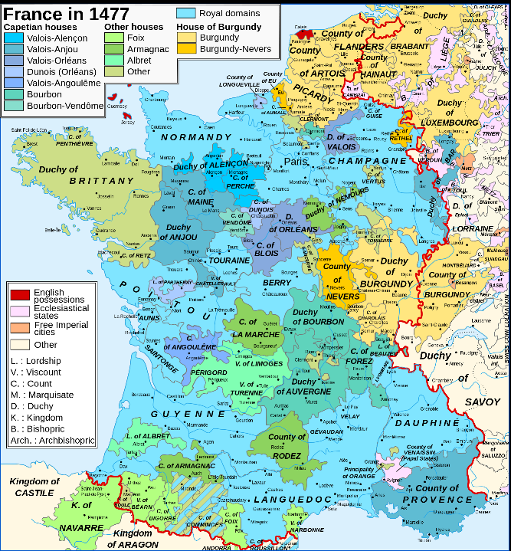
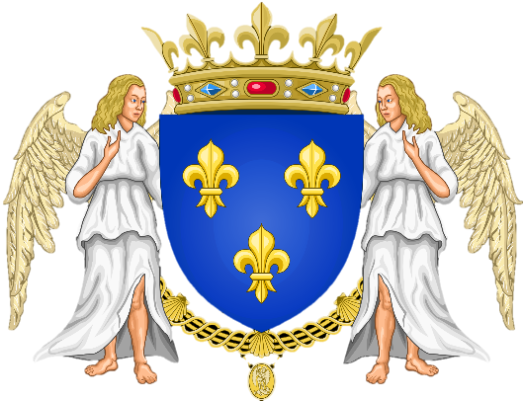
France
Valois Dynasty

Slide 6
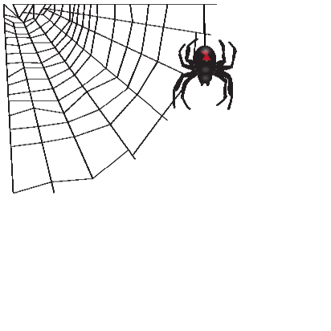
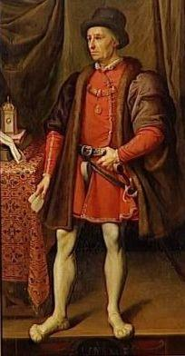
Louis XI: The Spider King (r. 1461-83)
Large royal army
Ruthless with nobles, people, & Estates-General
Increased taxes
Power over the clergy
Economic Growth
Promoted industries
Merchants to immigrate
Commercial treaties with England, Portugal, & Hanseatic League
The Prince?

Slide 7
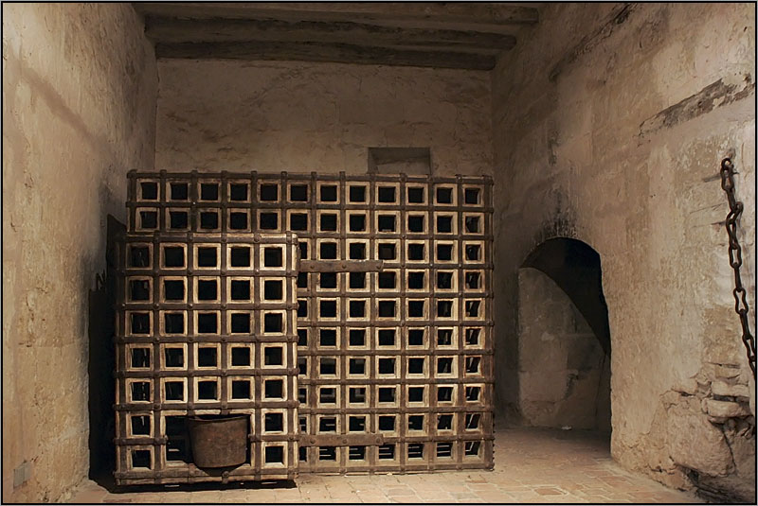
Supposedly, when Cardinal Balue defied Louis, he was sentenced to live in a cage
Help me!

Slide 8
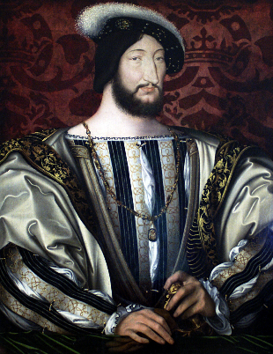
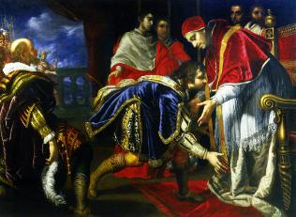
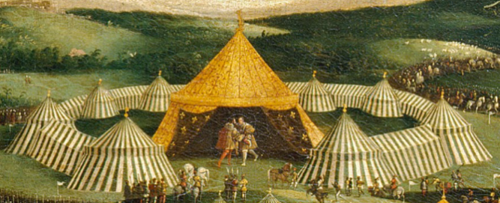
Francis I (r. 1515-1547)
Concordat of Bologna (1516)
King has power to appoint bishops
Taille: direct tax on land and property
Extravagant Court
Rivals with Henry VIII of England

Slide 9
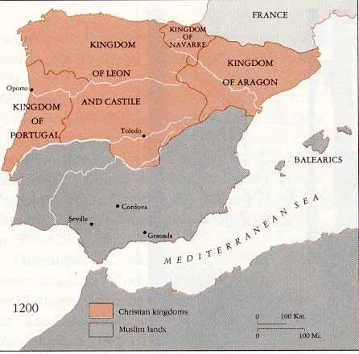
Spain

Slide 10
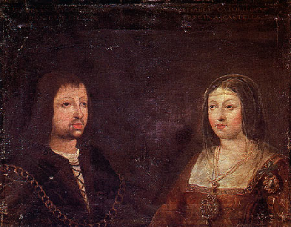
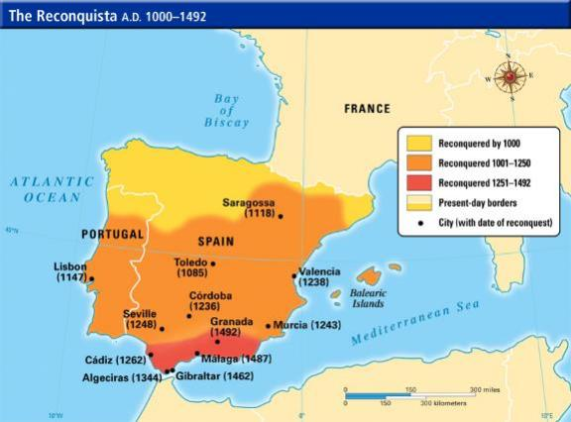
Reconquista
Spain is not unified
Marriage of Ferdinand of Aragon (r. 1478-1516) & Isabella of Castile (r.1474-1504)
Goal: Christianize Spain
Expulsion of the Jews & Muslims (Moors)
Decline of Spanish Middle Class

Slide 11
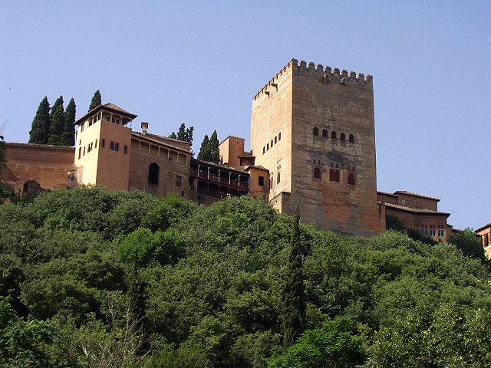
Aljafería Palace

Slide 12
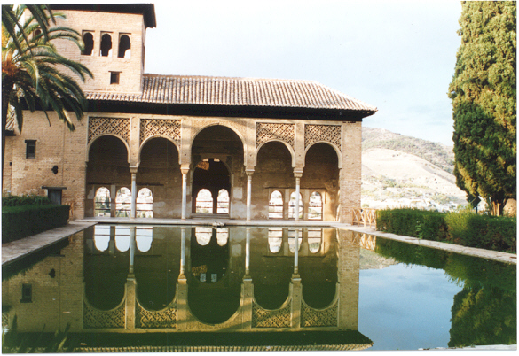

Slide 13
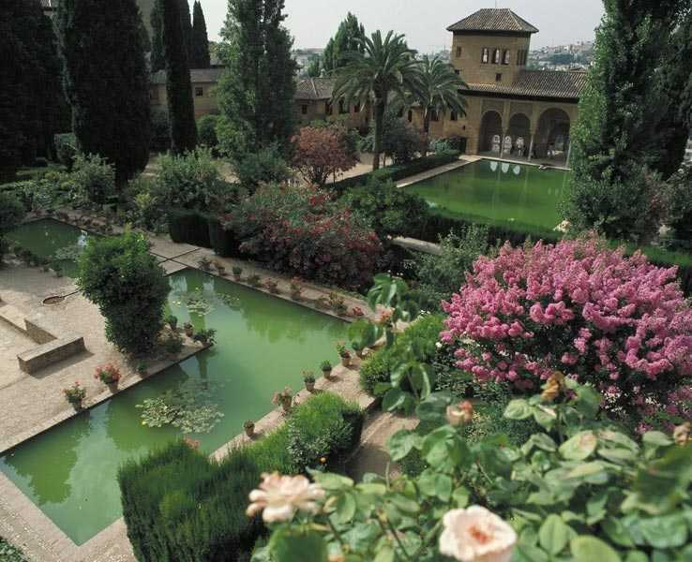

Slide 14
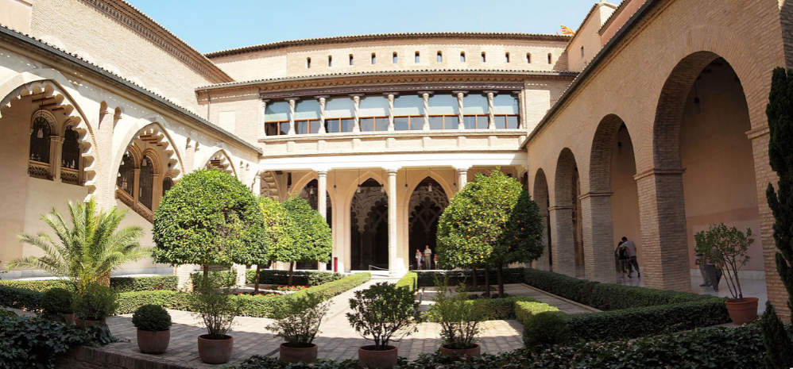
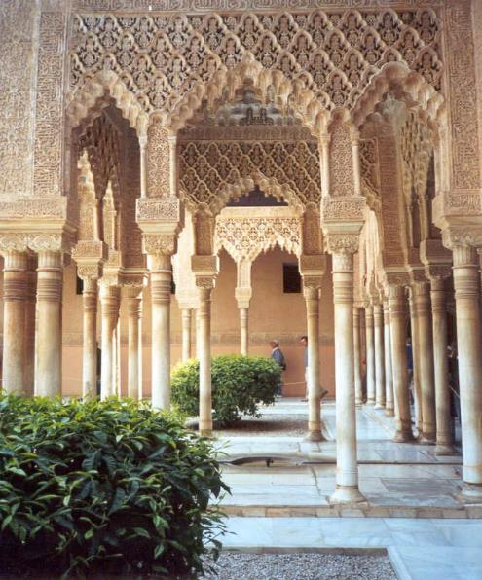

Slide 15
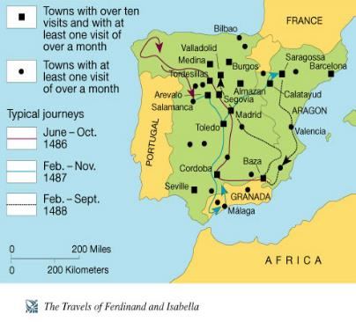
Ferdinand & Isabella
Hermandades: alliances of cities
Travel throughout Spain
Inquisition
National Church
Tomás de Torquemada
Targets conversos
Leads to anti-Semitism throughout Europe
Cardinal Ximenes: cleaned abuses & reformed Spanish church
Financed Columbus: begin Age of Exploration

Slide 16
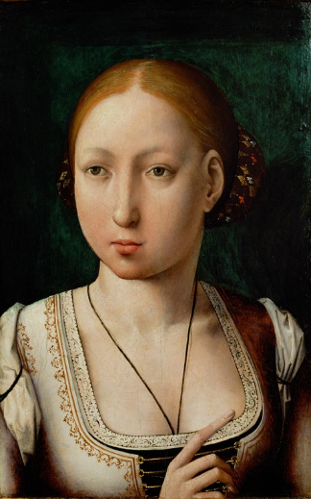
Juana La Loca
Inherited Castile & Aragon (united under one monarch)
Marries Hapsburg Philip the Handsome
Son of HRE
Have son Charles
Her father, husband, & son consider her insane and she is confined
When Philip dies she refused to bury the body
Charles takes over her rule

Slide 17
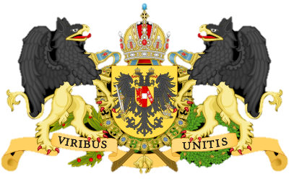
Holy Roman Empire: The Hapsburgs

Slide 18
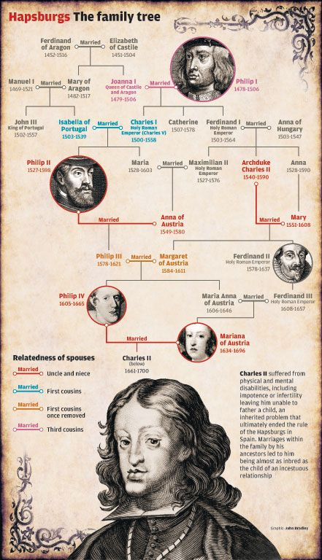
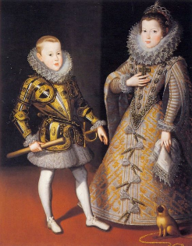
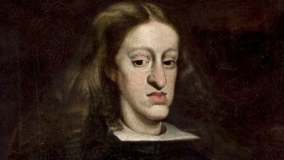
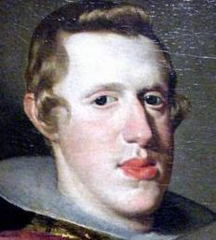
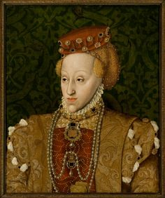
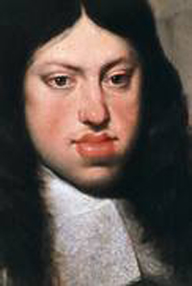
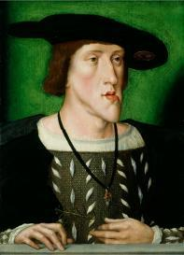
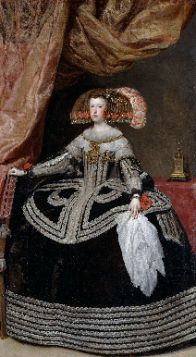
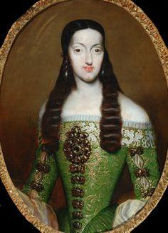
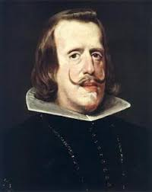
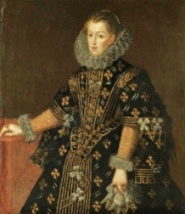

Slide 19
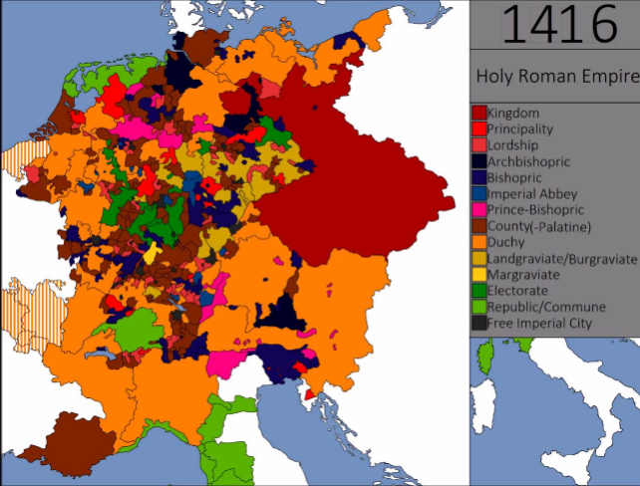
The Non-Holy, Non-Roman, Non-Imperial, HRE
Apx 300 semi-autonomous German states
Individual foreign policies, wars, etc
Center of Hapsburg power in Austria
Eventually a branch of Hapsburgs rule Spain
NOT a “New Monarchy”
No centralized control
Couldn’t levy taxes/raise armies

Slide 20
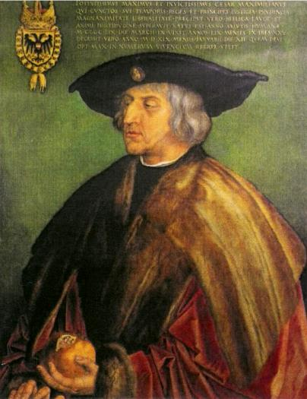
Maximilian I (r. 1493-1519)
Gained territory near France by marriage to Mary of Burgundy (Valois)
Sparks dynastic struggle b/w Hapsburgs & Valois

Slide 21
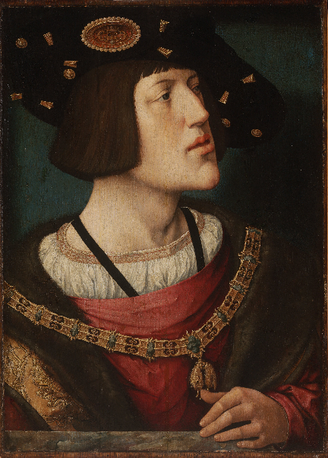
Charles V (r. 1519-1556)
Most powerful 16th C. European ruler
Heir to Valois-Burgundy, Hapsburgs, & Spanish Empire
Grandson of Ferdinand & Isabella, Son of Juana
Grandson of Maximillian I
1527: armies sacked Rome, symbolically ending Italian Renaissance
Hapsburg-Valois Wars: Control over Burgundy, ends 1559
Attempts to prevent Protestant Reformation

