Slide 2
RENAISSANCE ART

Slide 3
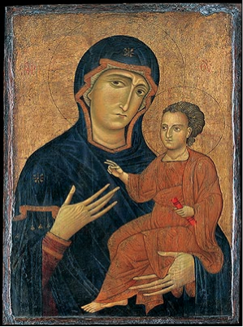
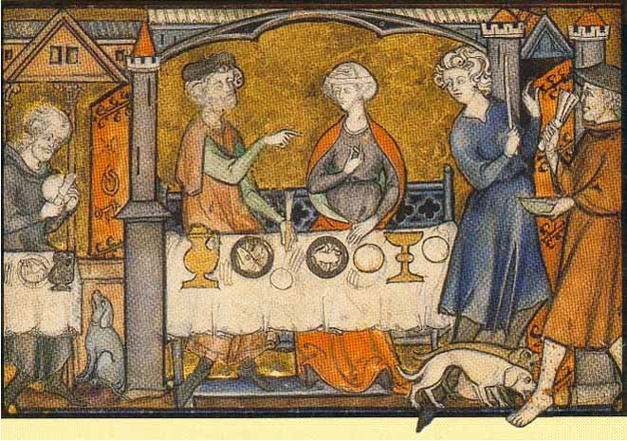
MEDIEVAL ART

Slide 4
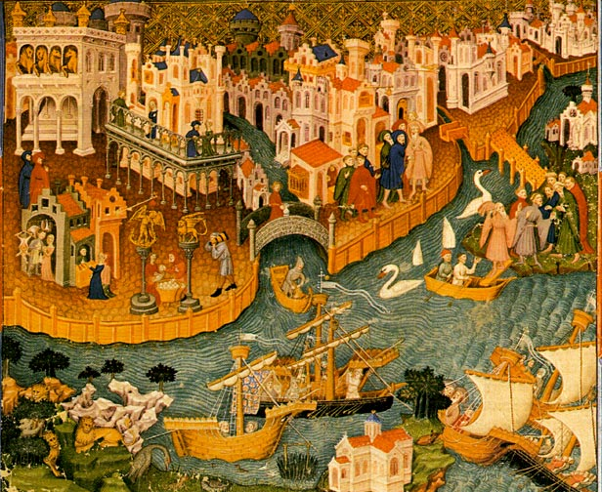
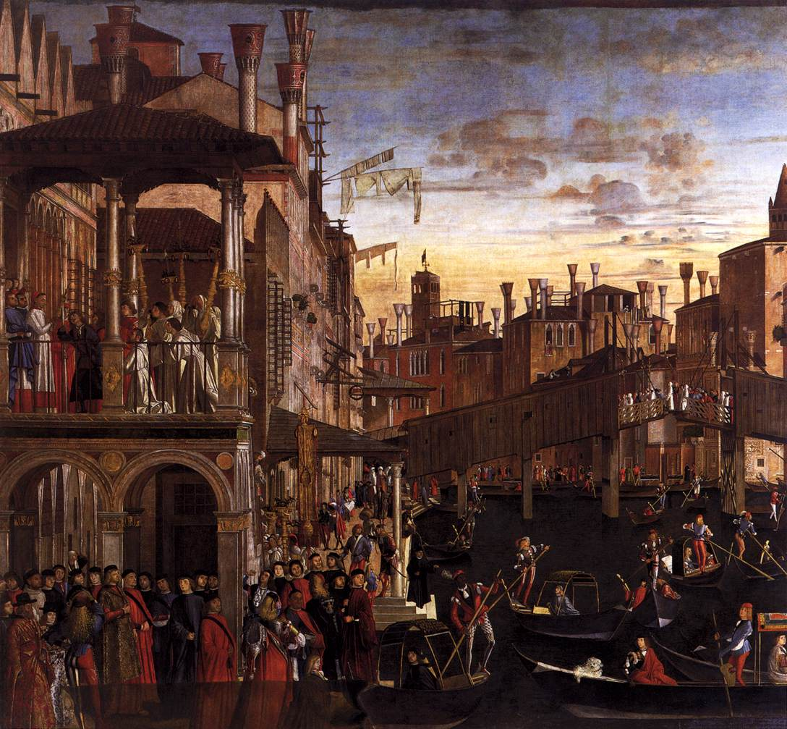
Notes:
Two different portraits of Venice, the first from the Middle Ages, the second from The Renaissance. Shows the differences in MA & Rena art. Perspective, colors, realism, sizes of figures, etc.

Slide 5
CHARACTERISTICS OF RENAISSANCE ART
Realism & Expression
Perspective
Classicism
Emphasis on the individual
Geometric arrangements
Light, Shadowing

Slide 6
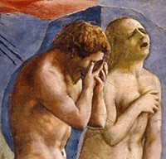
REALISM & EXPRESSIONISM

Slide 7
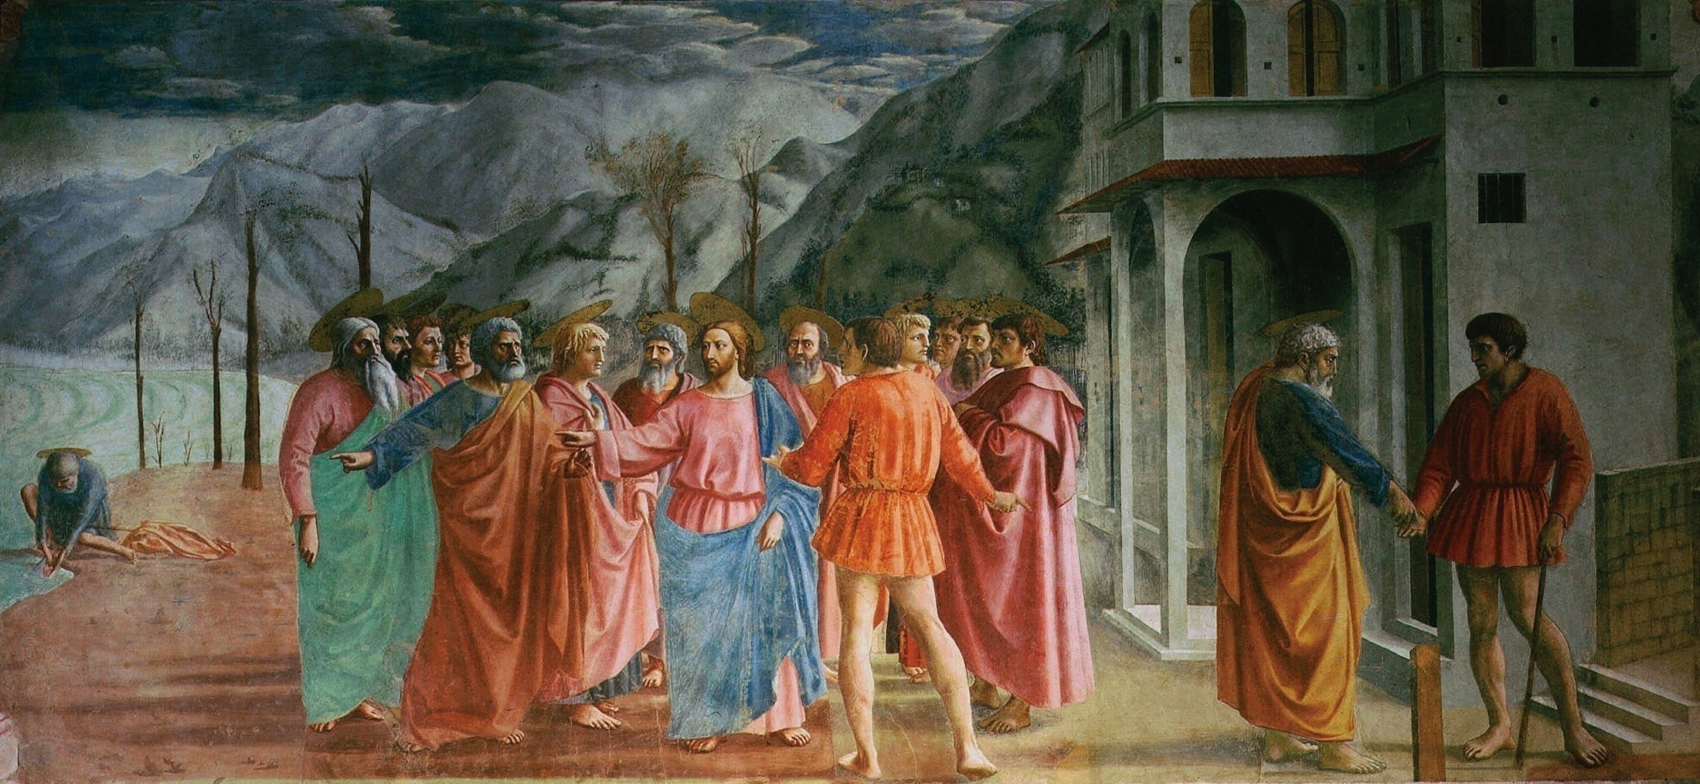
PERSPECTIVE

Slide 8
CLASSICISM

Slide 9
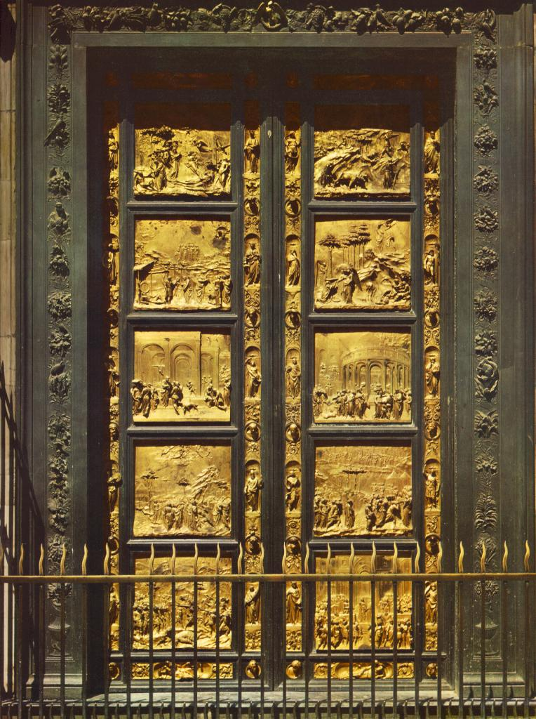
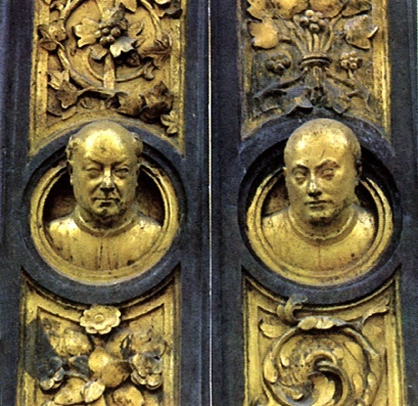
INDIVIDUALISM
Ghiberti

Slide 10
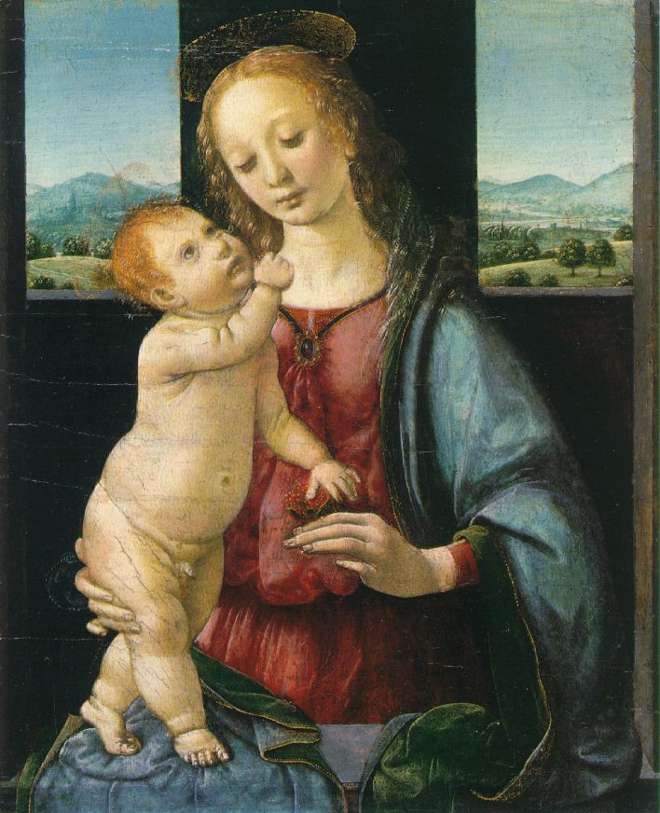
GEOMETRIC ARRANGEMENTS

Slide 11
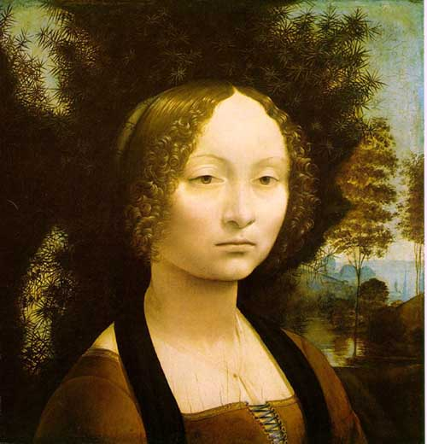
LIGHT AND SHADOWING
Chiaroscuro
Sfumato

Slide 12
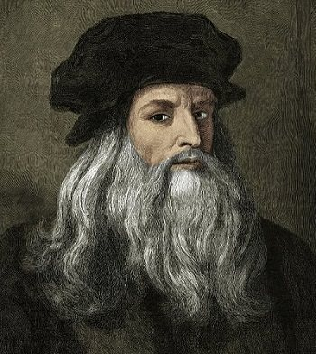
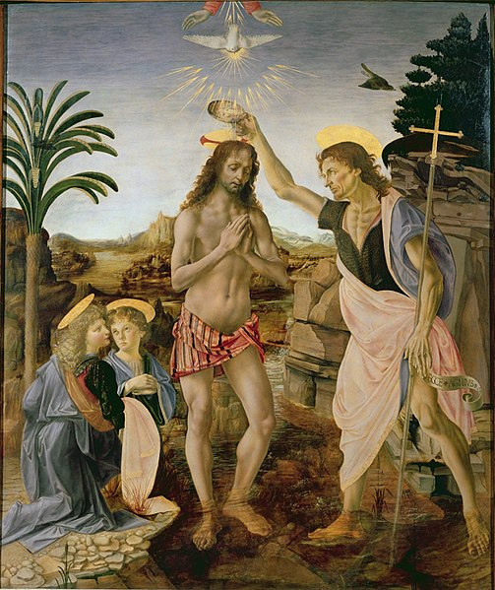
The Renaissance Man: Leonardo da Vinci
Illegitimate son, 1466: apprenticed to Verrocchio
Patronized by the Borgias in Milan
Professional rivalry with Michelangelo
Scientist, painter, engineer, architect, musician, sculptor, inventor
Later life hired by French King Francis I, died in France

Slide 13
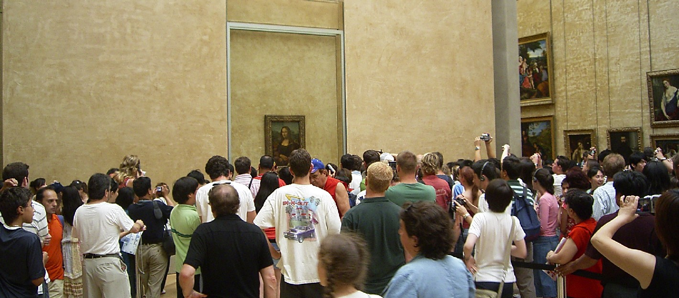
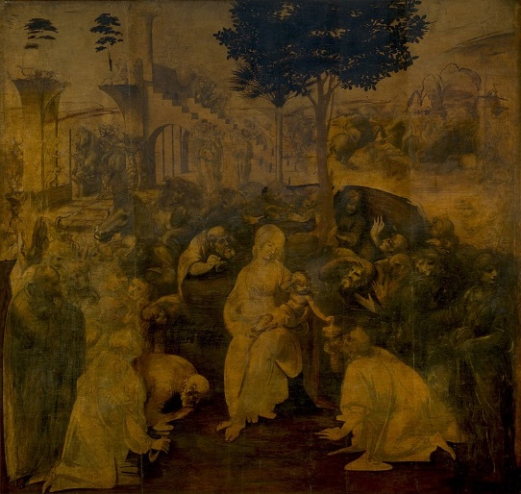
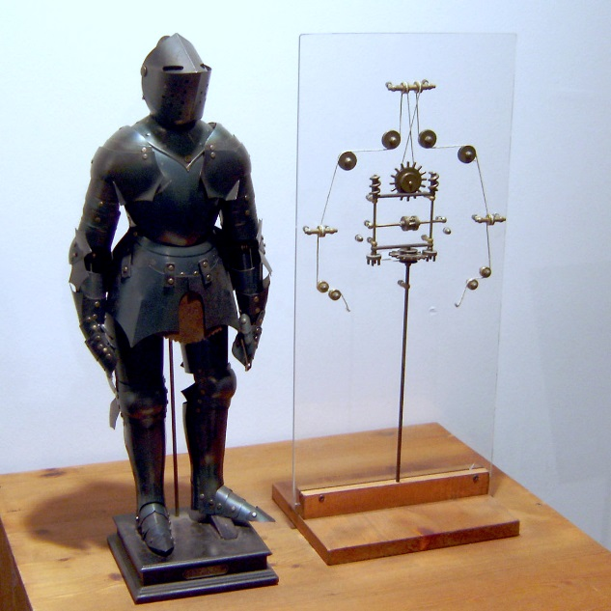
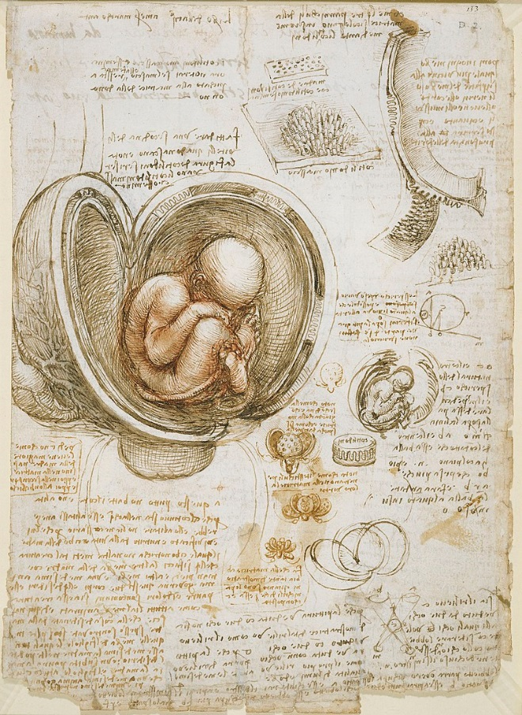
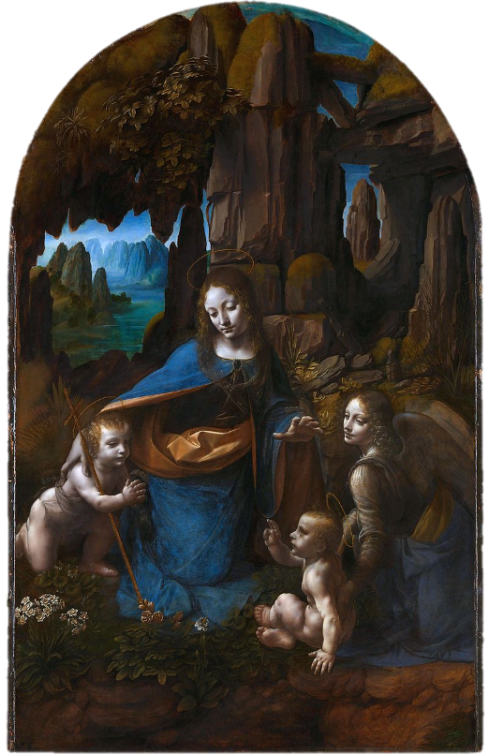
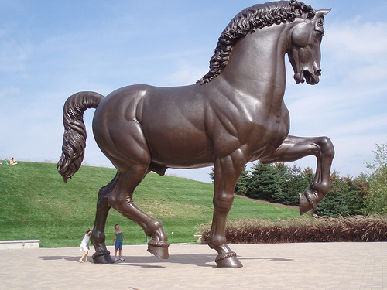
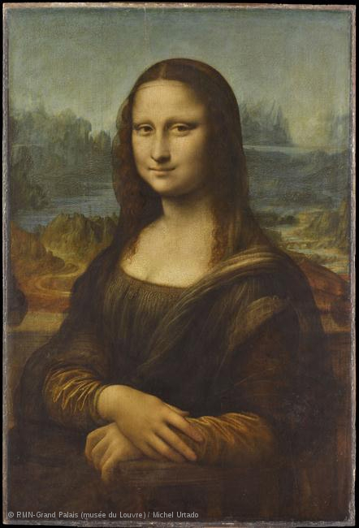
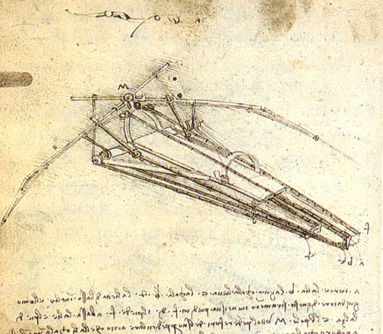
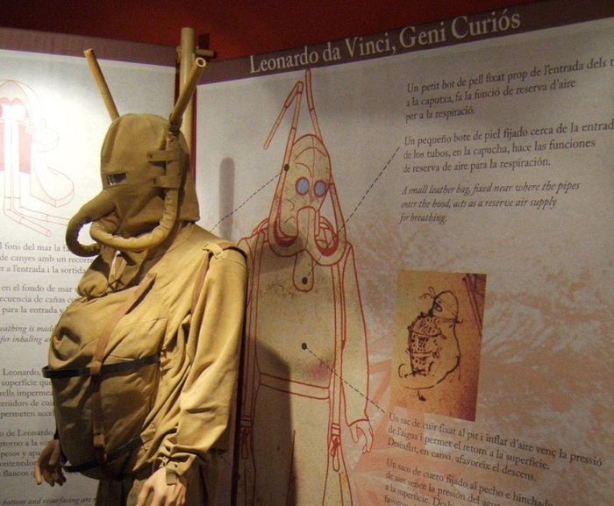

Slide 14
Northern Renaissance
Gradual spread northward
late 15th – 16th centuries
Wealthy patrons importing Italian culture

Slide 15
Characteristics of Northern Renaissance Art
Attention to detail
Realism & naturalism
Less emphasis classical
More landscapes
Middle-class and peasant life
Domestic interiors
Portraiture
Religious Conflict

Slide 16
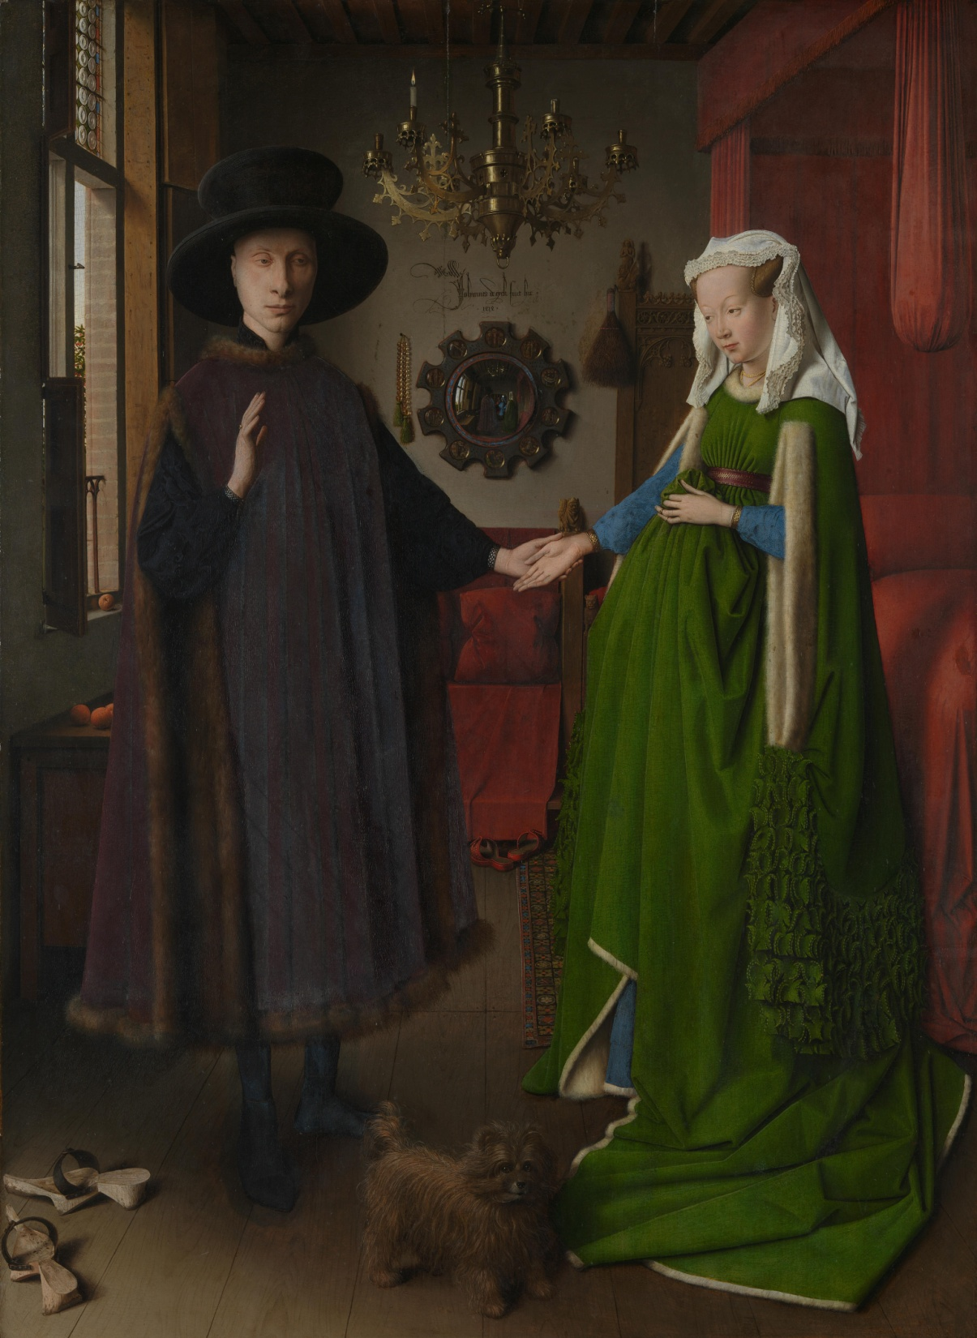

Slide 17
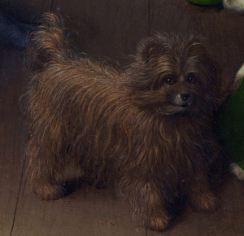

Slide 19
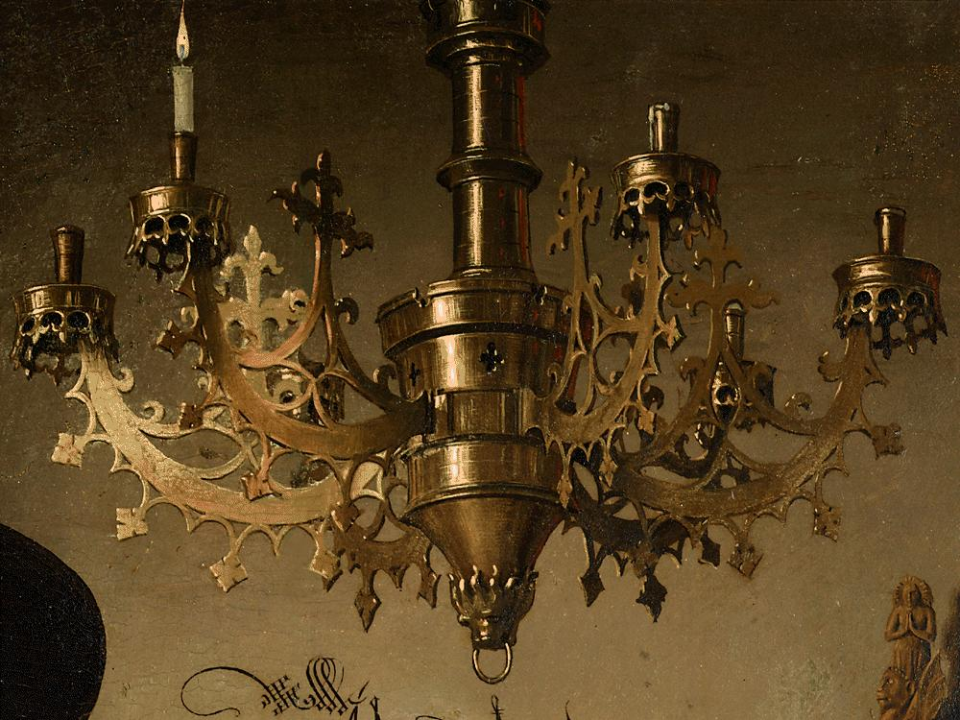

Slide 21
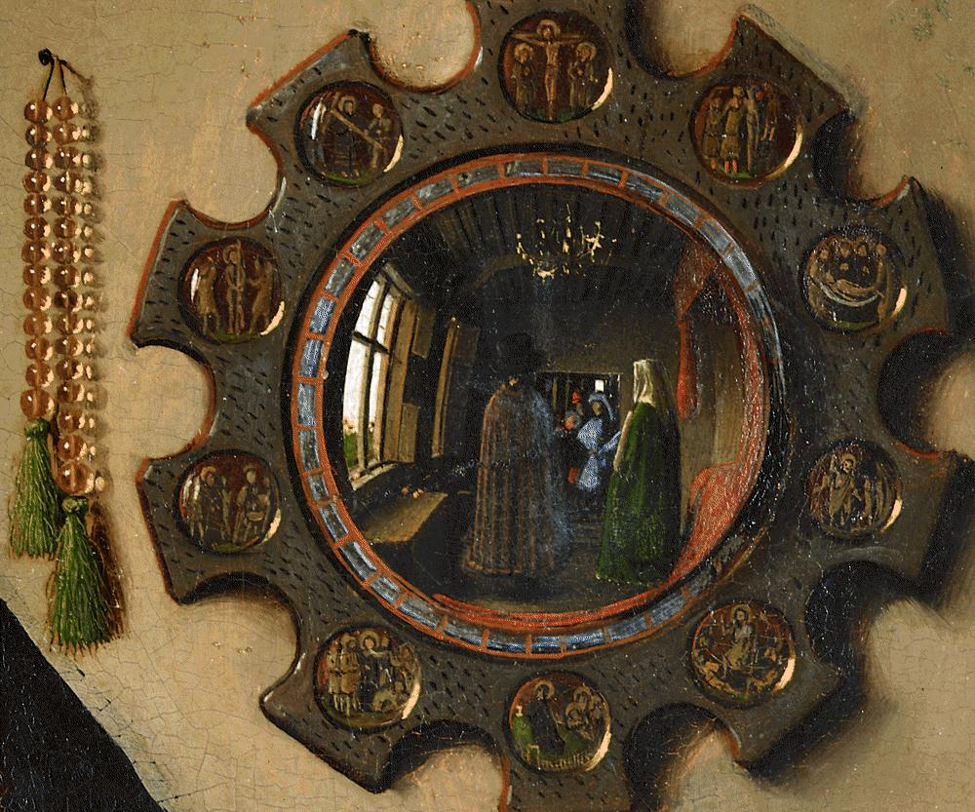

Slide 23
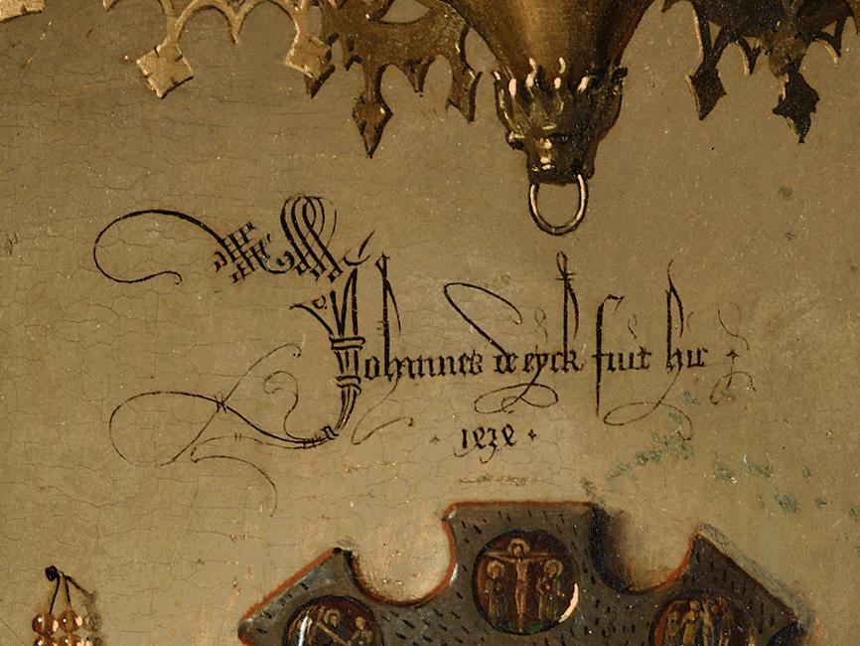

Slide 24
OPTIC
Observe?
Parts?
Title?
Interpretations?
Conclusions?
Arnolfini Portrait, 1434, Van Eyck

