Slide 1
Revolution, Rebuilding, and New Challenges: 1985 to Present
The Decline of Communism in Eastern Europe
USSR still oppressive through Brezhnev Era.
Thus the Soviet Union eventually crushed the Solidarity movement in Poland, the powerful peaceful challenge to Communist rule in Poland in the early 1980’s” McKay 1020
“And then Mikhail Gorbachev burst on the scene. The new Soviet leader opened an era of reform that was as sweeping as it was unexpected.” McKay 1020
Gorbachev wanted to revived communism, but it was failing throughout the Soviet Bloc.

Slide 2
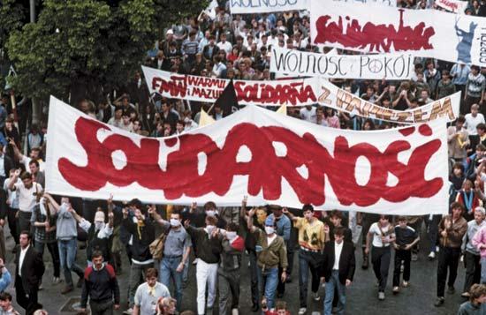
Revolution, Rebuilding, and New Challenges: 1985 to Present
Solidarity in Poland
Unruly satellite from the beginning.
Never able to collectivize Polish and remove the Catholic Church.
History of riots and protests—1956 and 1970.
Lack of good economy.
Election of Pole Karol Wojtyla as Pope John Paul II—focus on human rights.
Economic crisis became moral and spiritual.

Slide 3
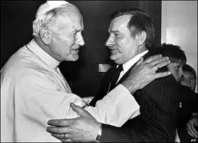
Revolution, Rebuilding, and New Challenges: 1985 to Present
JPII and Walesa– The Nine Day Pilgrimage

Slide 4
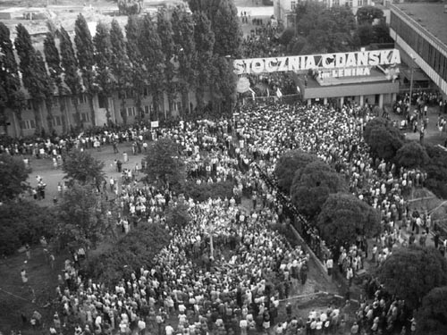
Revolution, Rebuilding, and New Challenges: 1985 to Present
Origins of Polish Revolt
August 1980, workers at the Lenin Shipyard in Gdansk (Danzig) occupied the plant.
Other workers joined in Solidarity.
Rights demanded—Unions, freedom of speech, release of political prisoners, economic reform.
The Gdansk Agreement—Gov. met demands.

Slide 5
Revolution, Rebuilding, and New Challenges: 1985 to Present
Solidarity
“Led by feisty Lenin shipyards electrician and devout Catholic Lech Walesa, the workers proceeded to organize their free and democratic trade union. They called it Solidarity.” McKay 1020
Became the trade union of the nation.
9.5 million members by 1981.
Published its own newspaper.
Threatened general strike to keep negotiations.

Slide 6
Revolution, Rebuilding, and New Challenges: 1985 to Present
Solidarity

Slide 7
Revolution, Rebuilding, and New Challenges: 1985 to Present
Solidarity cont.
“Self-limiting Rev.” to avoid USSR intervention.
But “In December 1981, Communist leader Gen. Wojciech Jaruzelski suddenly struck, proclaiming martial law, arresting Solidarity’s leader, and ‘saving’ the nation.” McKay 1021
Driven underground but alive.
Showed desire of Eastern Europe’s for freedom and national self-determination.

Slide 8
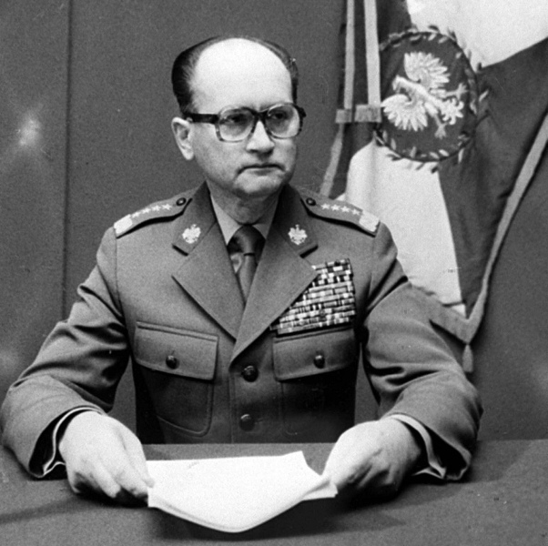
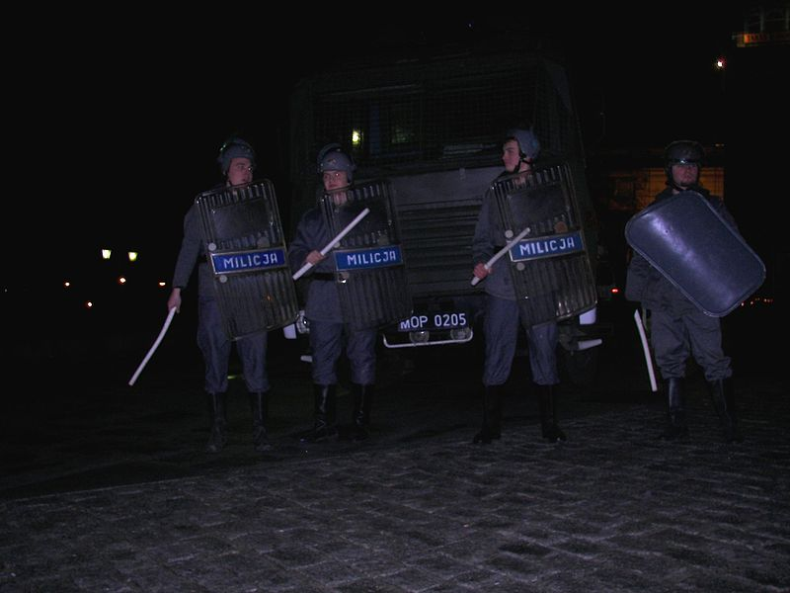
Revolution, Rebuilding, and New Challenges: 1985 to Present
Wojciech Jaruzelski and Martial Law in Poland

Slide 9
Revolution, Rebuilding, and New Challenges: 1985 to Present
Gorbachev’s Reforms in the Soviet Union
“Yet the massive state and party bureaucracy was a mixed blessing. It safeguarded the elite, but it promoted apathy in the masses.” McKay 1022
Transition from Brezhnev to Gorbachev—failure of Yuri Andropov.
Realized they were falling behind—save communism though reforms.
Stop of arms race with West to pay for improvement at home—better relations with West.
Attacked incompetence and corruption.

Slide 10
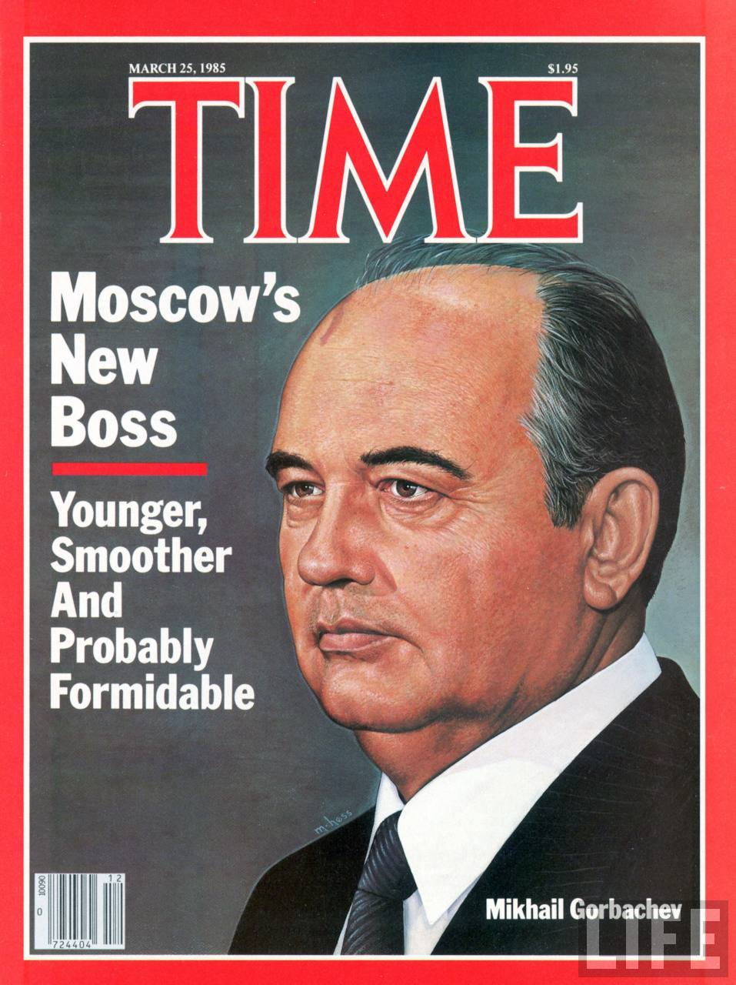
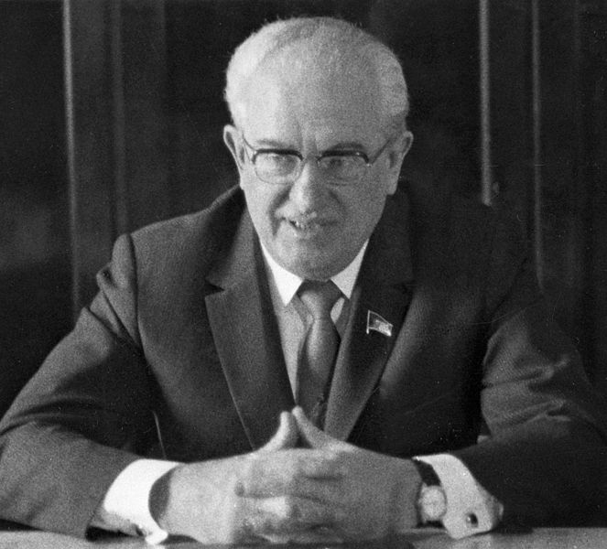
Revolution, Rebuilding, and New Challenges: 1985 to Present
Andropov to Gorbachev

Slide 11
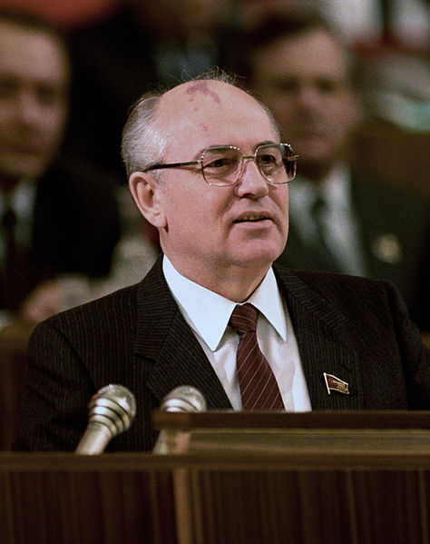
Revolution, Rebuilding, and New Challenges: 1985 to Present
Gorbachev and Perestroika
“Restructuring”
Created to transform Soviet economy.
Easing of Gov. price controls, more independence for state enterprises, and the setting up of profit-seeking private cooperatives to provide personal services for consumers.
Little improvement, still widespread consumer dissatisfaction in 1988.

Slide 12
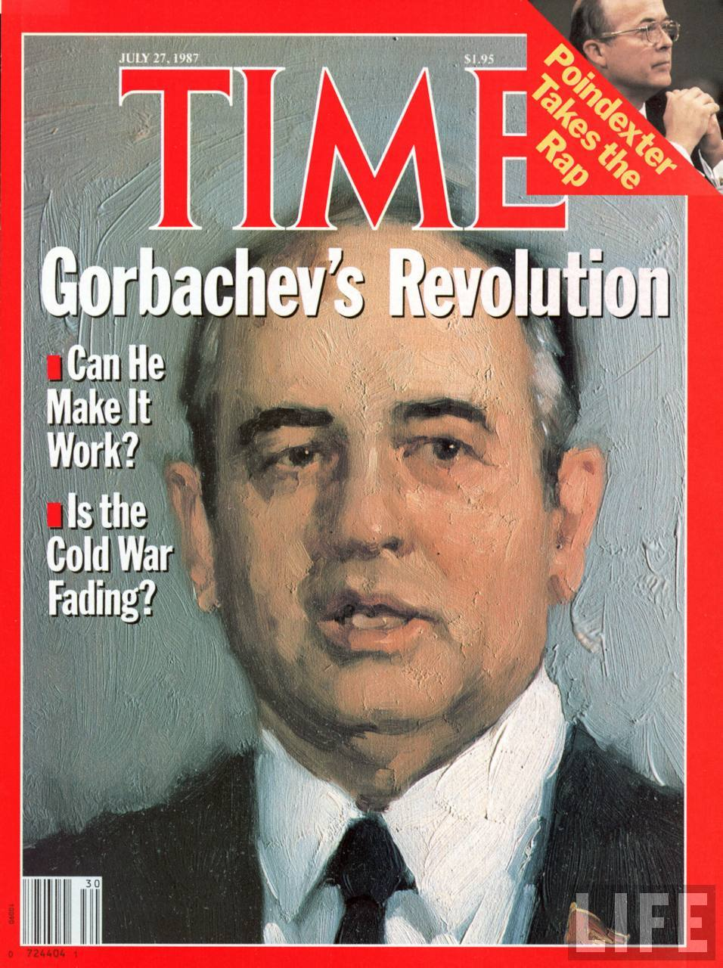
Revolution, Rebuilding, and New Challenges: 1985 to Present
Gorbachev and Glasnost
“Openness”
“Openness of the government and the media marked astonishing break with the past.” 1022
Went further and Gorbachev thought—led to something approaching free speech and free expression, a cultural revolution.

Slide 13
Revolution, Rebuilding, and New Challenges: 1985 to Present
Democratization
Attack on corruption led to first free elections.
Independents elected in 1989 to a revitalized Congress of People’s Deputies. Gorbachev and party still in control.
Open Debate.
“The result was a new political culture at odds with the Communist Party’s monopoly of power and control.” McKay 1024

Slide 14
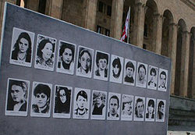
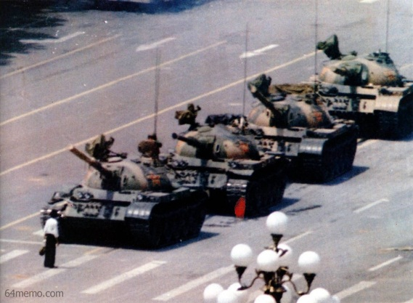
Revolution, Rebuilding, and New Challenges: 1985 to Present
The Non-Russian Territories
Democratization ignited demands for national autonomy—especially in the Baltic and Caucuses.
Repression and Pullback—Georgia in 1989 to China’s Tiananmen Square in 1989.

Slide 15
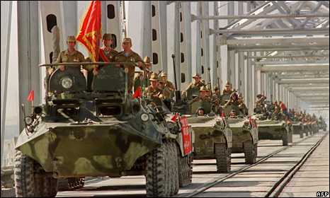
Revolution, Rebuilding, and New Challenges: 1985 to Present
“New Political Thinking”
Withdrawal from Afghanistan.
Ease East-West Tensions.
Arms reduction—1987 agreement with Reagan to eliminate all land-based intermediate-range missiles in Europe.
Repudiated the Brezhnev Doctrine and allowed reforms of the people in Eastern Europe.

Slide 16
Revolution, Rebuilding, and New Challenges: 1985 to Present
The Revolutions of 1989
A series of largely peaceful revolutions across Eastern Europe.
“The revolutions of 1989 had momentous consequences. First the peoples of eastern Europe joyfully re-entered the mainstream of contemporary European life and culture, having been conquered and brutalized by Nazis and communists for almost sixty years. Second, Gorbachev’s reforms boomeranged, and a complicated anti-communist revolution swept through the Soviet Union, as the multinational empire broke into a large Russia and fourteen other independent states...

Slide 17
Revolution, Rebuilding, and New Challenges: 1985 to Present
The Revolutions of 1989
“...Third, West Germany quickly absorbed its East German rival and emerged as the most influential country in Europe. Finally, the long Cold War came to and abrupt end and the United States suddenly stood as the world’s only superpower.” McKay 1024

Slide 18
Revolution, Rebuilding, and New Challenges: 1985 to Present
The Collapse of Communism in Eastern Europe
Solidarity and the Polish people led the way.
Under pressure, the communist Gov. of Poland legalized Solidarity in 1989, allowed for a minority of reps to parliament be elected.
Polish Solidarity won nearly all of those seats.
Solidarity introduced revolutionary changes. No secret police, no communist minsters, got rid of Jaruzelski.
Shock Therapy—Quick transfer to free-market capitalism.

Slide 19
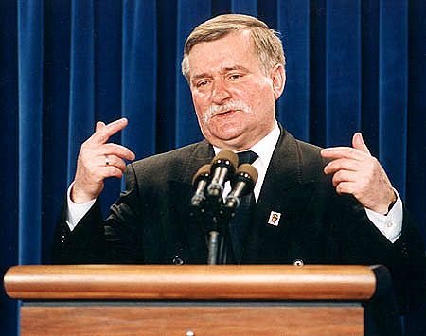
Revolution, Rebuilding, and New Challenges: 1985 to Present
Lech Walesa became president of Poland from 1990-1995

Slide 20
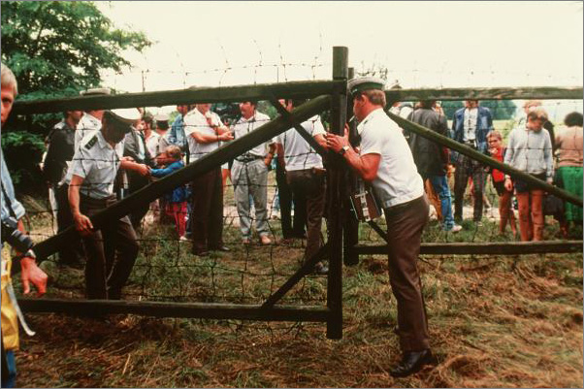
Revolution, Rebuilding, and New Challenges: 1985 to Present
Hungary in 1989
Replacing of Janos Kadar.
Hungarian Communist Party agreed to hold free elections in early 1990.
Western investment allowed.
Multiple parties allowed.
Barriers torn down along Austrian border.
Opened borders to E. German “vacationers” who then moved to W. Germany.

Slide 21
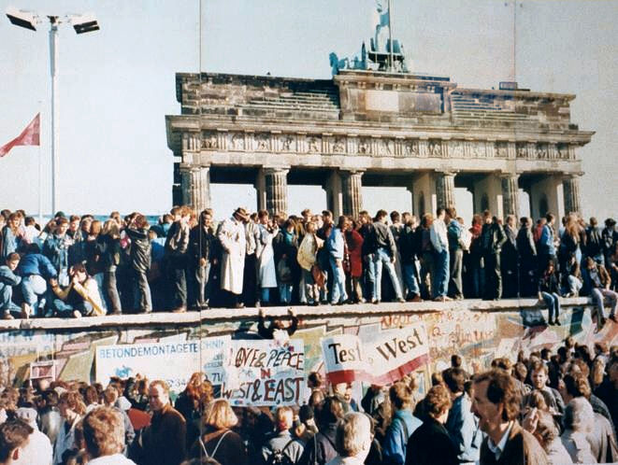
Revolution, Rebuilding, and New Challenges: 1985 to Present
East Germany in 1989
Flight of East Germans led to homegrown protest movement.
Led by intellectuals, environmentalists, and Protestant ministers. Called for democratic socialism.
“Stayers” could not convince “Leavers.”
Attempted to stabilize the situation by opening the Berlin Wall in Nov. 1989, led to the quick fall of East German Gov.

Slide 22
Revolution, Rebuilding, and New Challenges: 1985 to Present
Jennings on the Berlin Wall
fall of Communism

Slide 23
Revolution, Rebuilding, and New Challenges: 1985 to Present
Czechoslovakia: “The Velvet Revolution”
“In Czechoslovakia, communism died quickly in November-December 1989 in an almost good-humored ousting of communist bosses. The so-called Velvet Revolution grew out of popular demonstrations led by students, intellectuals, and a dissident playwright turned moral revolutionary named Vaclav Havel.” McKay 1025
Protests led to power sharing, which led to the resignation of communist leaders.
In 1988, Havel was elected president.

Slide 24
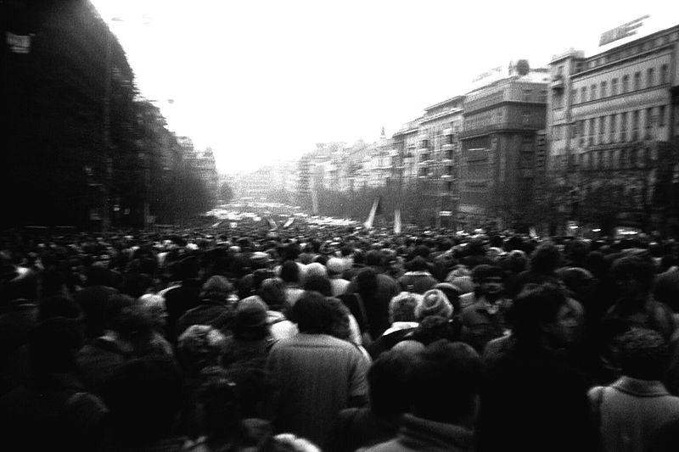
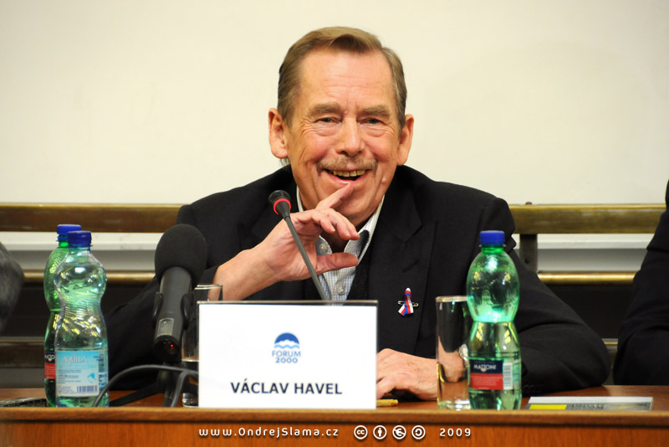
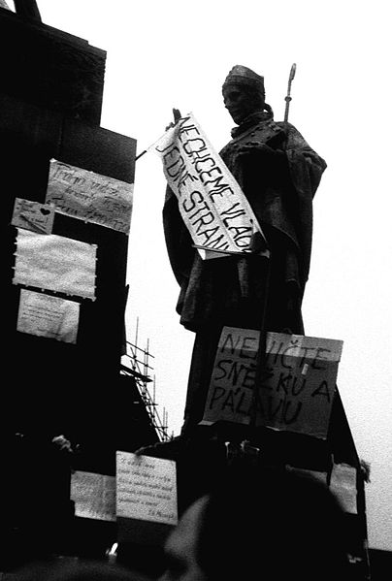
Revolution, Rebuilding, and New Challenges: 1985 to Present
The Velvet Revolution

Slide 25
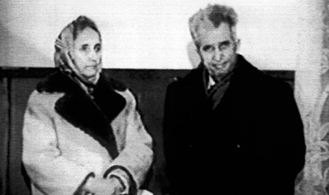
Revolution, Rebuilding, and New Challenges: 1985 to Present
Romania in 1989
Only the Romanian revolution was violent and bloody.
Communist dictator Nicolae Ceausescu.
Ordered his security forces to slaughter thousands of protestors.
Armed uprising occurred.
He and his wife were eventually captured and executed.

Slide 26
Revolution, Rebuilding, and New Challenges: 1985 to Present
The Disintegration of the Soviet Union
“As 1990 began, revolutionary changes had triumphed in all but two Eastern European states—tiny Albania and the vast Soviet Union.” McKay 1026
Feb. 1990, nationalists in the non-Russian republics demanded autonomy and independence and the Communist Party suffered crippling defeats in local elections.
Lithuanian Parliament declared independence. Gorbachev embargoed them but refused to send in troops.
Gorbachev abolished the Communist Party’s monopoly and was elected president of the Soviet Universal without universal suffrage.
Yeltsin strengthened.

Slide 27
Revolution, Rebuilding, and New Challenges: 1985 to Present
Boris Yeltsin
Reform communist who embraced democratization.
Pushed for “Independence of Russia.”
President of Russian Federation Parliament.
Gorbachev tried to convert the Soviet Union into a loose confederation, but 15 republics rejected it.
“Opposed by democrats and nationalists, Gorbachev was also challenged again by the communist old guard.” McKay 1028

Slide 28
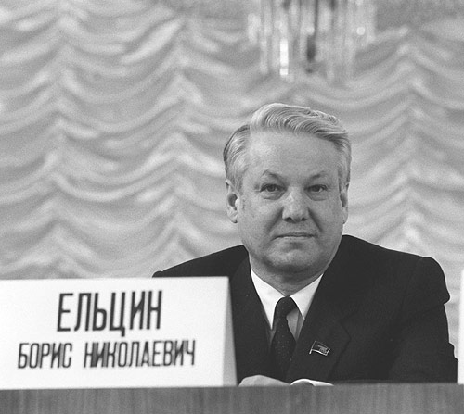
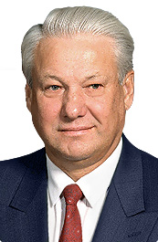
Revolution, Rebuilding, and New Challenges: 1985 to Present
Boris Yeltsin

Slide 29
Revolution, Rebuilding, and New Challenges: 1985 to Present
The Attempted Coup—1991
Defeated by the party congress and on vacation with his family, party hardliners kidnapped Gorbachev and tried to seize power in August 1991.
Failed and popular resistance rallied around Yeltsin. Yeltsin declared the “Re-birth of Russia.”
Communist party was outlawed.
The Soviet Union—and Gorbachev’s job—ceased to exist on December 25, 1991.
“Commonwealth of Independent States” in the 1990s.

Slide 30
Revolution, Rebuilding, and New Challenges: 1985 to Present
Attempted Coup of 1991
Coup Ends

Slide 31
Revolution, Rebuilding, and New Challenges: 1985 to Present
German Unification and the End of the Cold War
Reformers in East Germany argued for a “Third Way”. Closer ties but preserve socialism and East Germany.
Failed and East Germany was absorbed into West Germany.
Factor One- ½ of East Germans had left for West Germany. Although most returned, they were exposed to wealth of the west.
Factor Two- Chancellor Helmut Kohl and the formation of “The Alliance for Germany”. Promise of one East Mark for one West Mark.

Slide 32
Revolution, Rebuilding, and New Challenges: 1985 to Present
German Unification and the End of the Cold War Cont.
The Alliance beat communists in free elections in East Germany in 1990.
Gorbachev/ Kohl Deal, July 1990—Loans and promise of no German WMD’s.
October 1990, Germany re-unified.

Slide 33
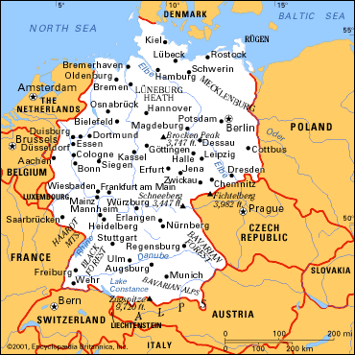
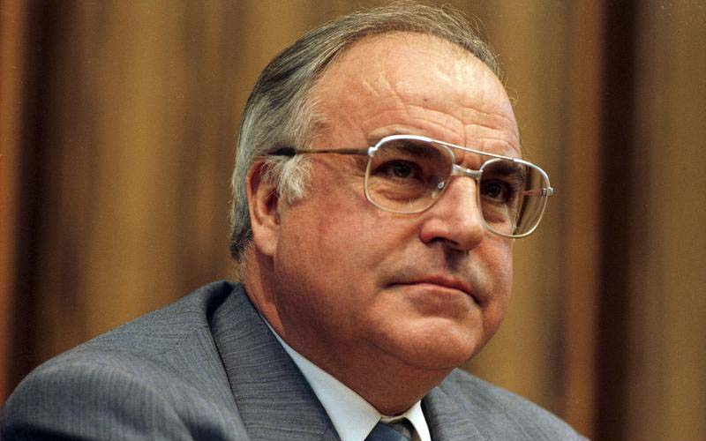
Revolution, Rebuilding, and New Challenges: 1985 to Present
Chancellor Kohl and Unified Germany

Slide 34
Revolution, Rebuilding, and New Challenges: 1985 to Present
The Paris Accord
Nov. 1990.
Delegates from 22 countries met with the US and USSR.
Agreed to scaling down armed forces.
Recognized new borders of Europe.
“The Paris Accord was for all practical purposes a general peace treaty, bringing an end to World War II and the Cold War that followed.” McKay 1030
Bush’s concept of the “New World Order.” 1991

Slide 35
Revolution, Rebuilding, and New Challenges: 1985 to Present
Building a New Europe—Common Problems in the 1990’s
Eastern Europe shifted to free market capitalism.
Growth of a Globalized Capitalist Economy.
Technology played a role in growth of globalization.

Slide 36
Revolution, Rebuilding, and New Challenges: 1985 to Present
Resistance to Globalization
“The emergence of a freer global economy, probably did speed up world economic growth as enthusiasts invariably claimed, but it also had powerful and quite negative social consequences.” McKay 1031
Unions, Socialists, Supporters of Gov. Programs.
Damaged workers in poor and rich countries .

Slide 37
Revolution, Rebuilding, and New Challenges: 1985 to Present
The Triumph of Liberal Democracy
Europe had seen the expansion of Liberal Democracy.
The Vote, Civil Liberties.
Nationalism and National History. Although re-emergence of nationalism led to ethnic conflict.

Slide 38
Revolution, Rebuilding, and New Challenges: 1985 to Present
How did the founding of the EU in 1993 prevent the spread of ethnic conflict?

Slide 39
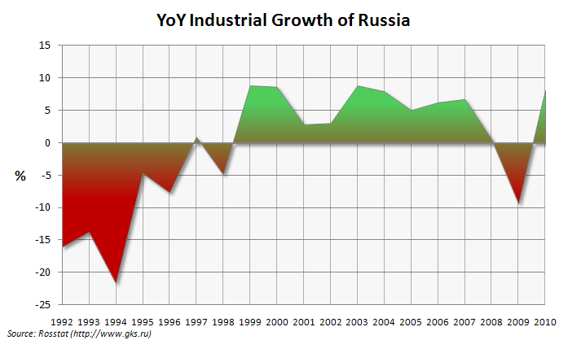
Revolution, Rebuilding, and New Challenges: 1985 to Present
Recasting Russia
President Yeltsin pushed “breakneck” liberalization.
Freeze prices, encourage private industry.
“Shock Therapy” could bring economic success. However, prices still rose uncontrollably and production fell.
“In 1996, the Russian economy produced at least one-third and possible as much as one-half less than in 1991.” McKay 1033

Slide 40
Revolution, Rebuilding, and New Challenges: 1985 to Present
Why did Russian Economic Liberalization Fail
State monopolies became private monopolies.
New capitalist elites gained great wealth while many fell into poverty.
Corruption of officials as well. (most wealth concentrated in Moscow)
Savings of commoners lost value.
Dramatic decrease in life expectancy—male 69 to 58 in five years.
Yeltsin seen as in the hands of big business and put down opposition.

Slide 41
Revolution, Rebuilding, and New Challenges: 1985 to Present
Russians Lose Faith in Democracy
“Many Russians came to equate “democracy” with the corruption, poverty, and national decline they experienced throughout the 1990’s.” McKay 1034

Slide 42
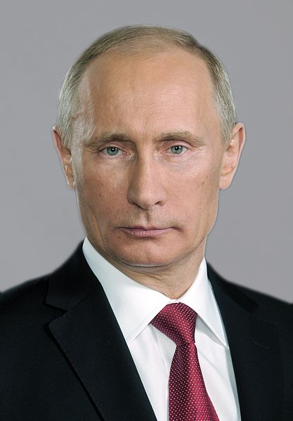
Revolution, Rebuilding, and New Challenges: 1985 to Present
Vladimir Putin
“Managed Democracy”
Elected President in 2004.
Free Markets with Semi-Authoritarian Rule.
Liberals in retreat, conservative grew strong.

Slide 43
Revolution, Rebuilding, and New Challenges: 1985 to Present
Progress in Eastern Europe
Many similar problems with shift to capitalism.
Growth of nationalism in opposition to communism.
Similarities to WWI—Nationalism and Collapse of Empire.
Poland, Czech Republic, and Hungary most successful with transition—Joined NATO.
1993 “Velvet Divorce”- Split Czech Republic and Slovakia.
Romania and Bulgaria lagged behind.

Slide 44
Revolution, Rebuilding, and New Challenges: 1985 to Present
Tragedy in Yugoslavia
Break-up had origins in death of Tito in 1980.
Revolutions of 1989 increased break-up.
President Slobodan Milosevic wanted to unite all Serbs in a greater Serbia.
Milosevic abolished self rule in Kosovo where Albanians were majority.
June 1991, Slovenia and Croatia declared independence led to attack from Serbia.
1992, fighting spread to Bosnia-Herzegovina were they declared Independence. Serbs refused to live under the rule of a Muslim majority.
Bosnian Civil War broke out.

Slide 45
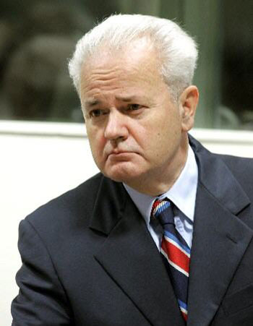
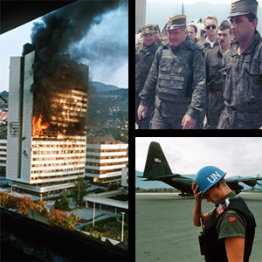
Revolution, Rebuilding, and New Challenges: 1985 to Present
Milosevic and the Bosnian Civil War

Slide 46
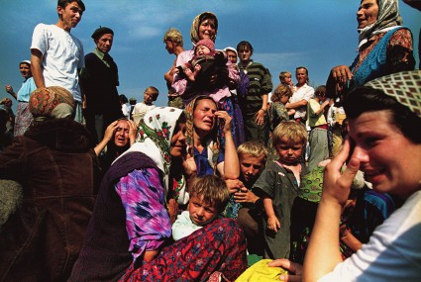
Revolution, Rebuilding, and New Challenges: 1985 to Present
The West and the Bosnian Civil War
The West dragged their feet until 1995 Srebrenica attack.
NATO acted and bombed Serbian military targets.
Compromise split land between Muslim Croats and Bosnian Serbs.

Slide 47
Revolution, Rebuilding, and New Challenges: 1985 to Present
Srebrenica Massacre/ Genocide
BBC

Slide 48
Revolution, Rebuilding, and New Challenges: 1985 to Present
Kosovo
Albanian Muslims in Kosovo gained nothing from Bosnian agreement.
Kosovo Liberation Army (KLA) formed in 1998.
Serbians attacked KLA militants and civilians.
250,000 refugees.
Milosevic refused to give Kosovo self rule.
1999 NATO bombed Serbian targets.

Slide 49
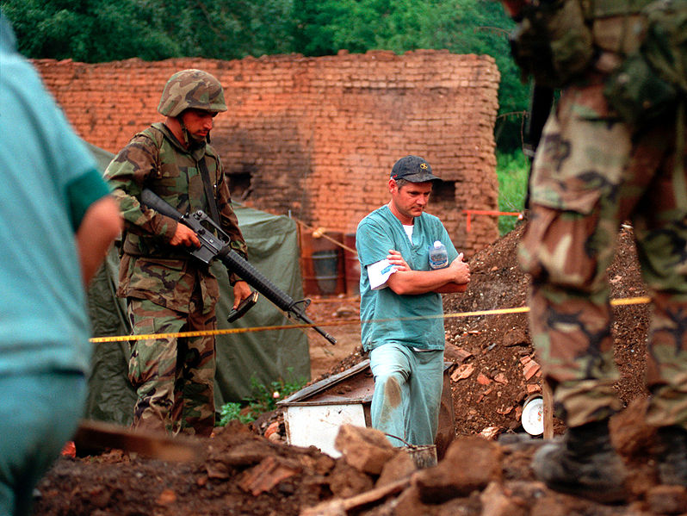
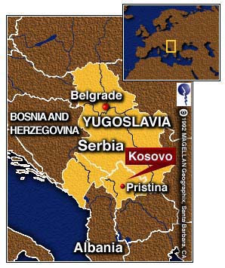
Revolution, Rebuilding, and New Challenges: 1985 to Present
The Kosovo War

Slide 50
Revolution, Rebuilding, and New Challenges: 1985 to Present
Kosovo and the Humanitarian Crisis
780,000 more Kosovars became refugees.
NATO eventually forced them out.
Crimes of “Ethnic Cleansing” had occurred against ethnic Albanians in Bosnia and Kosovo.
Milosevic was put on trial at the Hague for crimes against humanity.

Slide 51
Revolution, Rebuilding, and New Challenges: 1985 to Present
Unity and Identity – The European Union and the Eurozone
The Single European Act of 1986.
European Community renamed itself the European Union in 1993.
December 1991, member states met a Maastricht, Netherlands.
Maastricht Treaty—Set economic standards and the goal of a common currency.

Slide 52
Revolution, Rebuilding, and New Challenges: 1985 to Present
The European Union and the Eurozone
“Battles over budgets and high unemployment throughout the European Union in the 1990’s raised profound questions about the meaning of European identity.” McKay 1040
May 1, 2004—EU expanded to 25 countries.
2004 failure of a EU constitution.

Slide 53
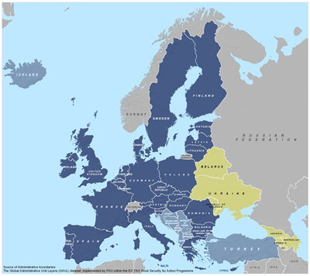
Revolution, Rebuilding, and New Challenges: 1985 to Present
The European Union

Slide 54
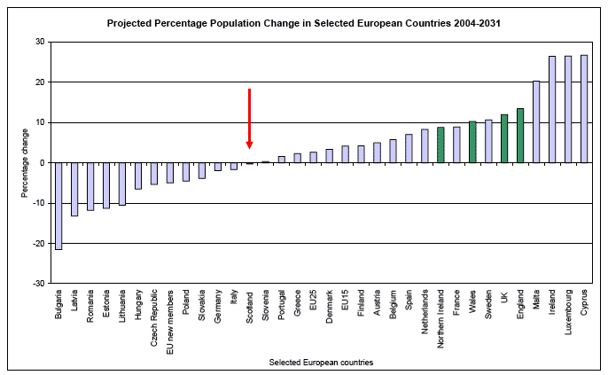
Revolution, Rebuilding, and New Challenges: 1985 to Present
The Prospect of Population Decline
21st century “Baby Bust”.
Birthrate in Europe dropped below 2 children per mother.
Could have huge impacts of social security and pension problems.

Slide 55
Revolution, Rebuilding, and New Challenges: 1985 to Present
The Growth of Immigration
Asia, Africa, and Eastern Europe to West Europe.
East Europe collapse of communism and Balkan Crisis.
Some legal, much illegal, more than U.S. undocumented immigration.
EU opening borders made immigration easier.
Trafficking of E. European women a problem.
W. Europeans resisted immigration especially Muslims from N. Africa and the Middle East.

Slide 56
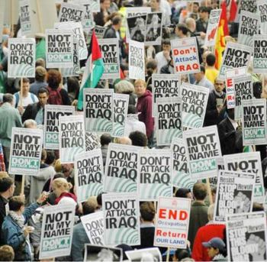
Revolution, Rebuilding, and New Challenges: 1985 to Present
The West and the Islamic World
Post 9-11 world and suspicion of and invasions in the Middle East.
Unified over Afghanistan but not Iraq.

Slide 57
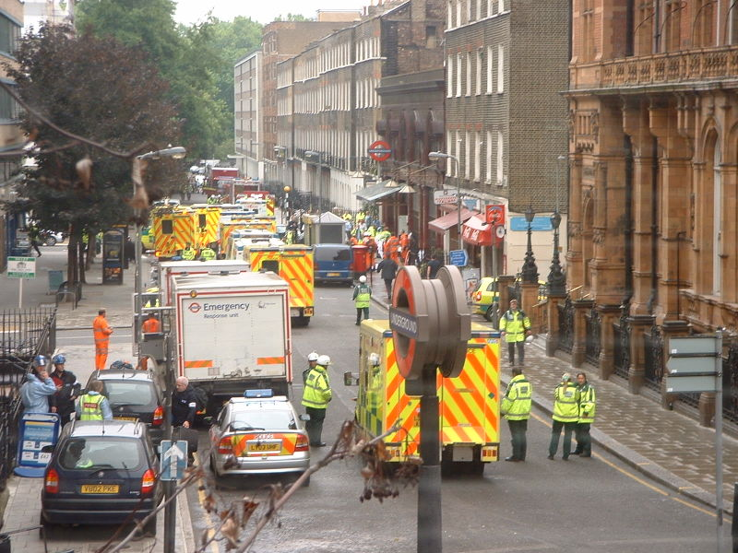
Revolution, Rebuilding, and New Challenges: 1985 to Present
The West and its Muslim Citizens
2004 and 2005, Madrid and London bombings created fear.
Murder of Theo van Gough created fear of loss of “freedoms.”
Europeans reacted against immigration. Sense of loss of security and Enlightenment tradition.
Muslim immigrants have unequal share of poverty.

Slide 58
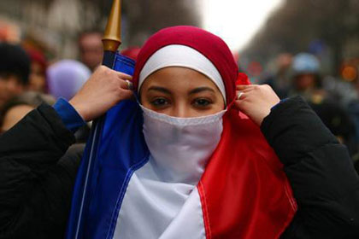
Revolution, Rebuilding, and New Challenges: 1985 to Present
French Veil Law Controversy

