Slide 1
Rococo Art

Slide 2
Characteristics
Originated in France
From world rocaille (pebble)
Smaller/more intimate
Ornate details, decorative, lighter, pastels
Aristocratic lifestyle, fairy tale like, playful
Artists: Watteau, Boucher , Fragonard , Gainsborough
Musicians: Vivaldi, Bach

Slide 3
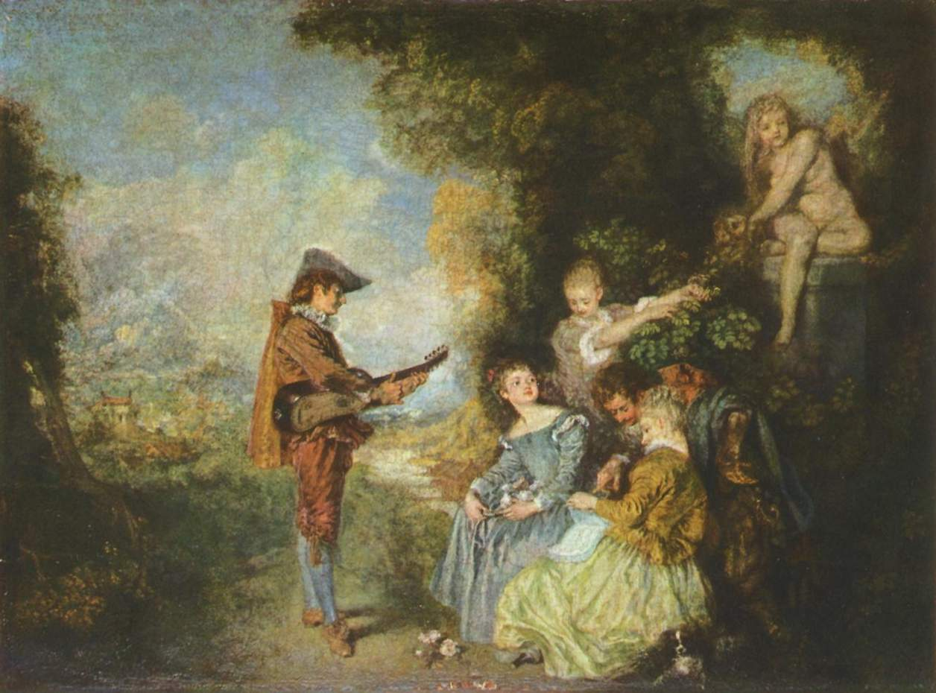

Slide 4
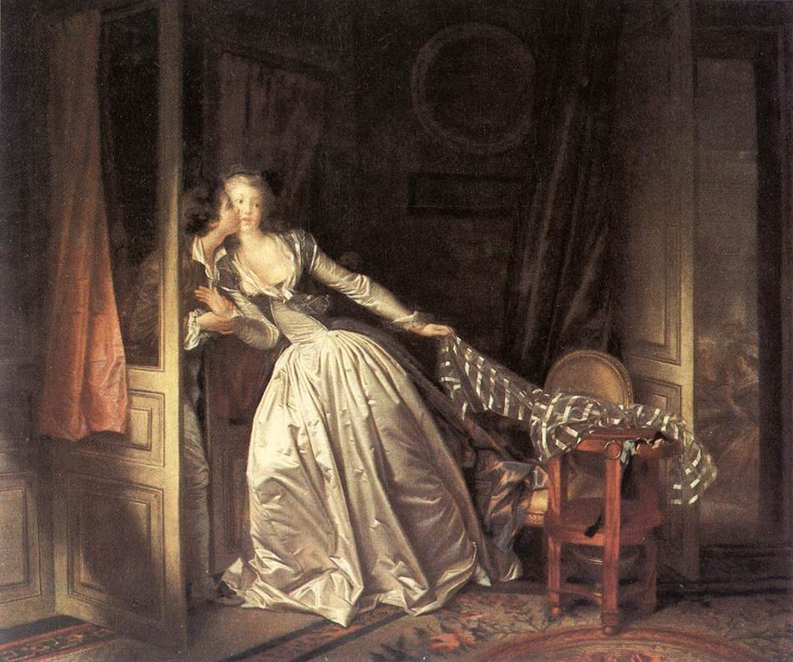

Slide 5
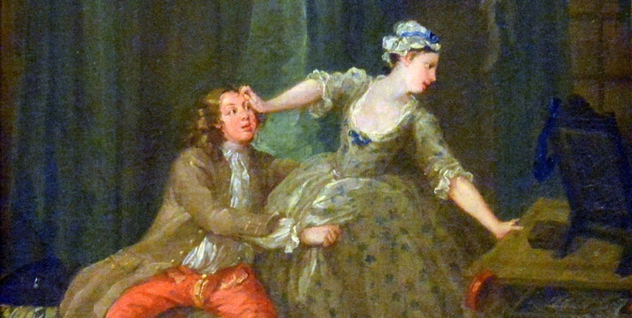

Slide 6
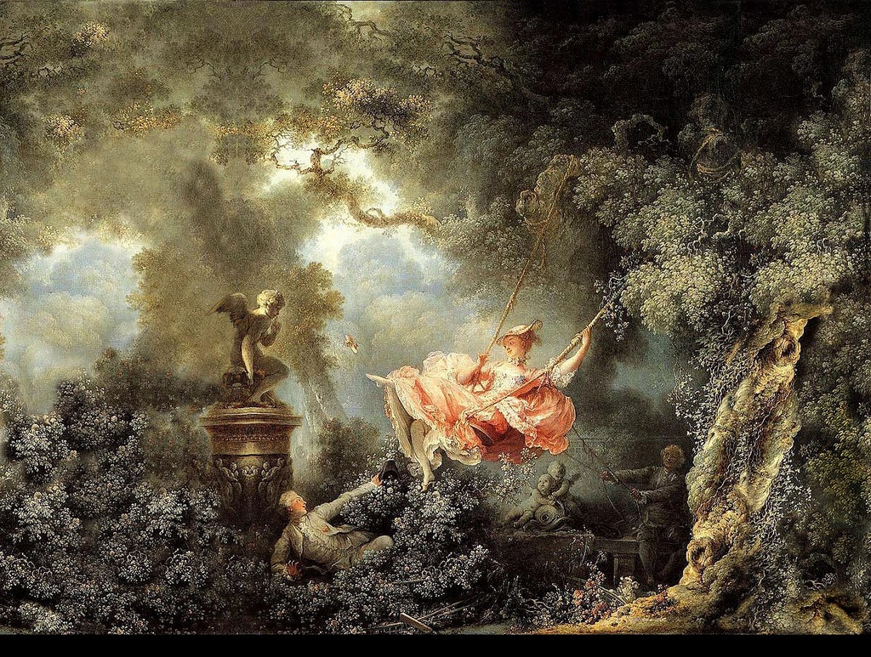

Slide 7
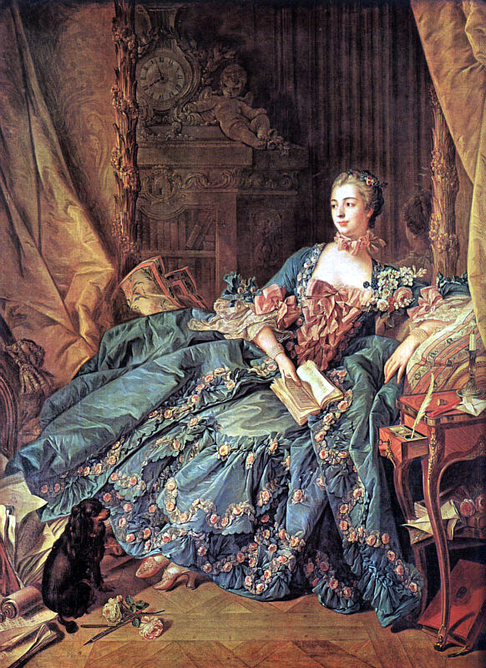

Slide 8
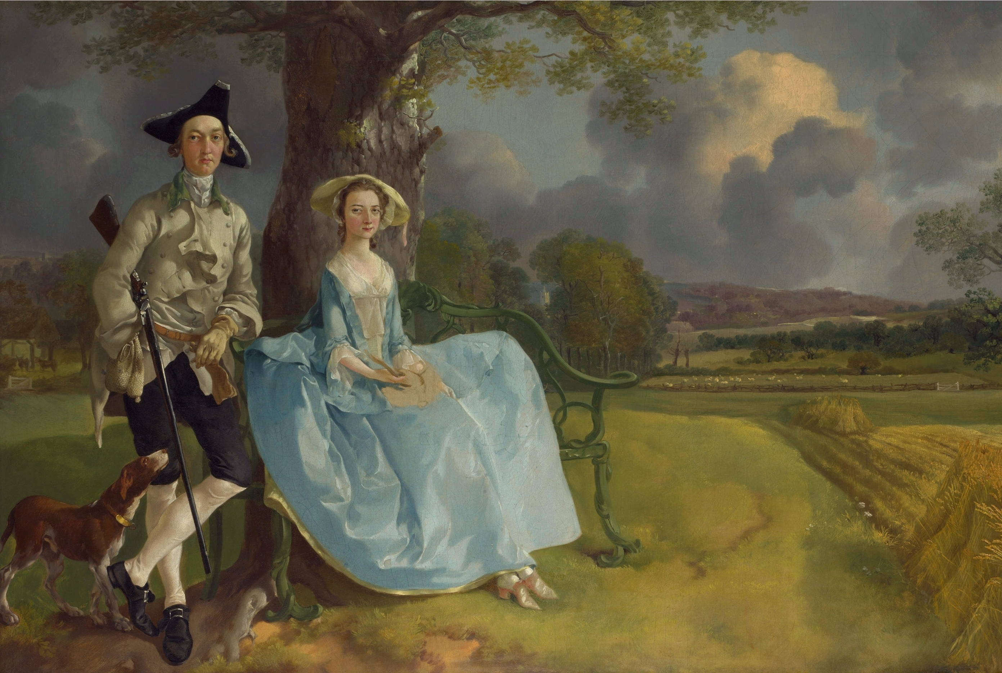

Slide 9
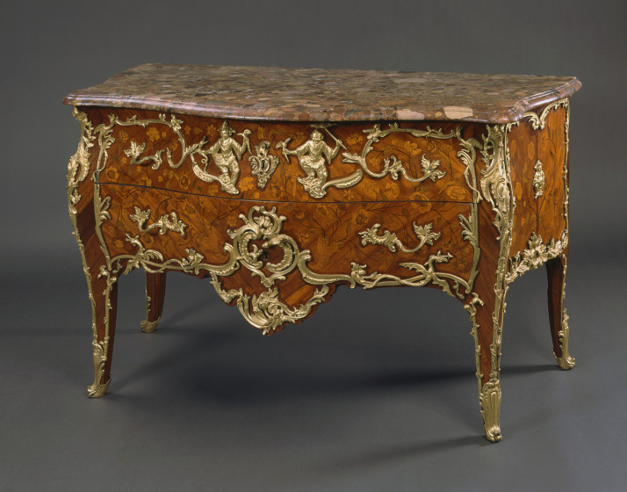

Slide 10
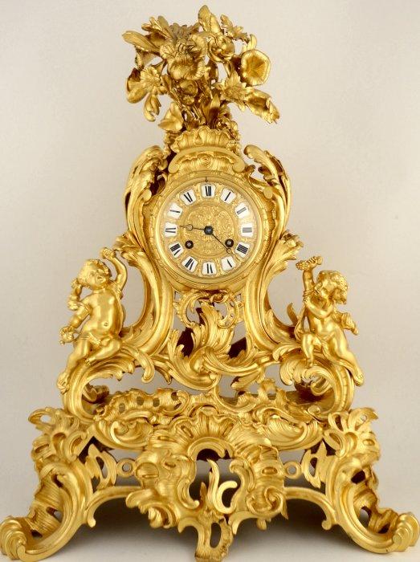

Slide 11
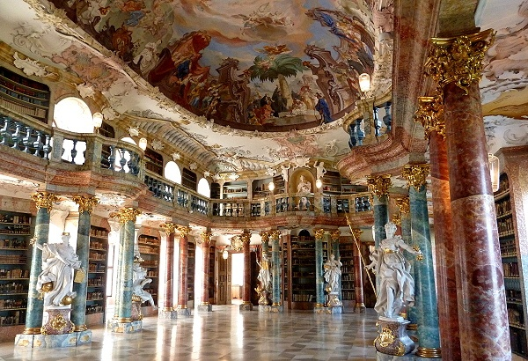

Slide 12
