Slide 1
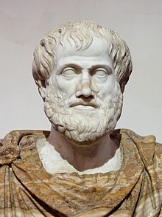
What Aristotle Believed…
How you doing?
Heavy things fall faster than lighter things
The earth is the center of the universe
Women have fewer teeth than men
Some people are biologically programed to be slaves
Fossils are fish that turned into stone.
The brain is not a very important organ
The heart is where thoughts came from
The human testicles determine the pitch of your voice
Eels (and some other animals) don’t reproduce…they naturally respawn

Slide 2
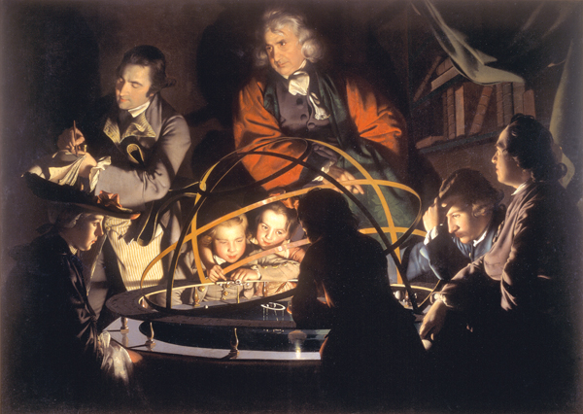
Scientific Revolution

Slide 3
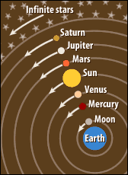
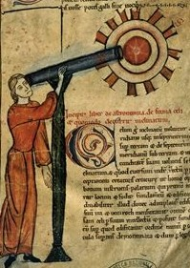
Back in the day…
My EYES!! It burns!!
Superstition
Geocentric universe (Ptolemy)
Aristotle knew everything
Religious views of the world—science is a branch of theology
Start with the conclusion and find evidence to prove it (Deductive Reasoning)

Slide 4
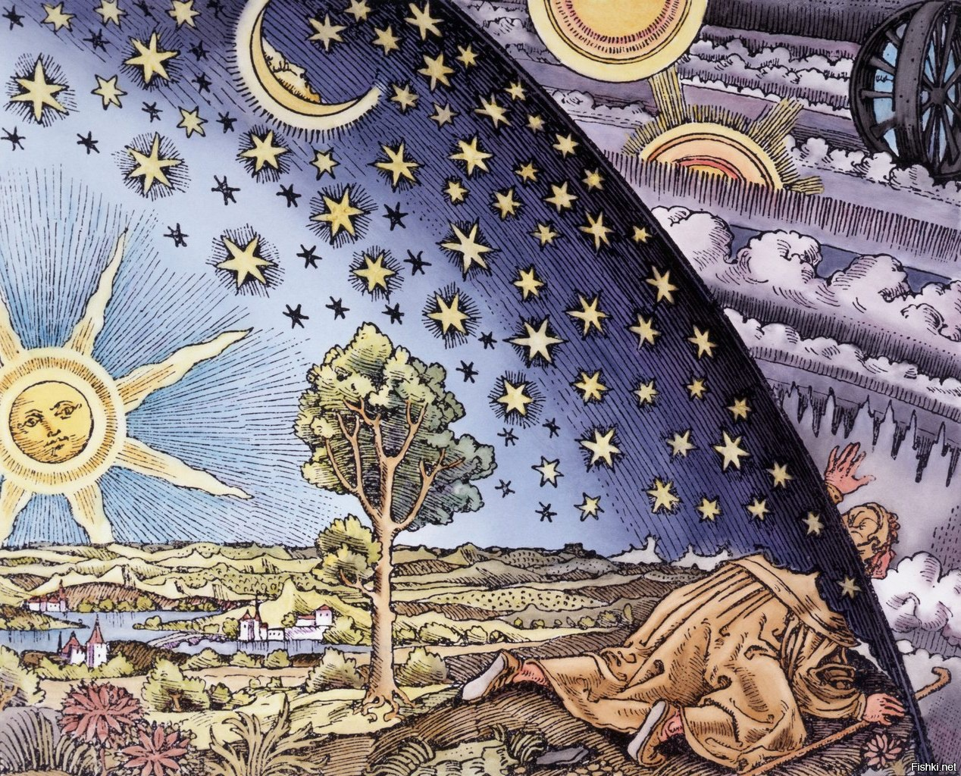
Natural Philosophy
Universities establish mathematics, astronomy, and physics within philosophy departments
New scientific methods: Bacon, Descartes
Inductive Reasoning: Observation, hypothesis to conclusion
Exploration leads to need for scientific advancement
Challenge ancient authorities
Renaissance patronage

Slide 5
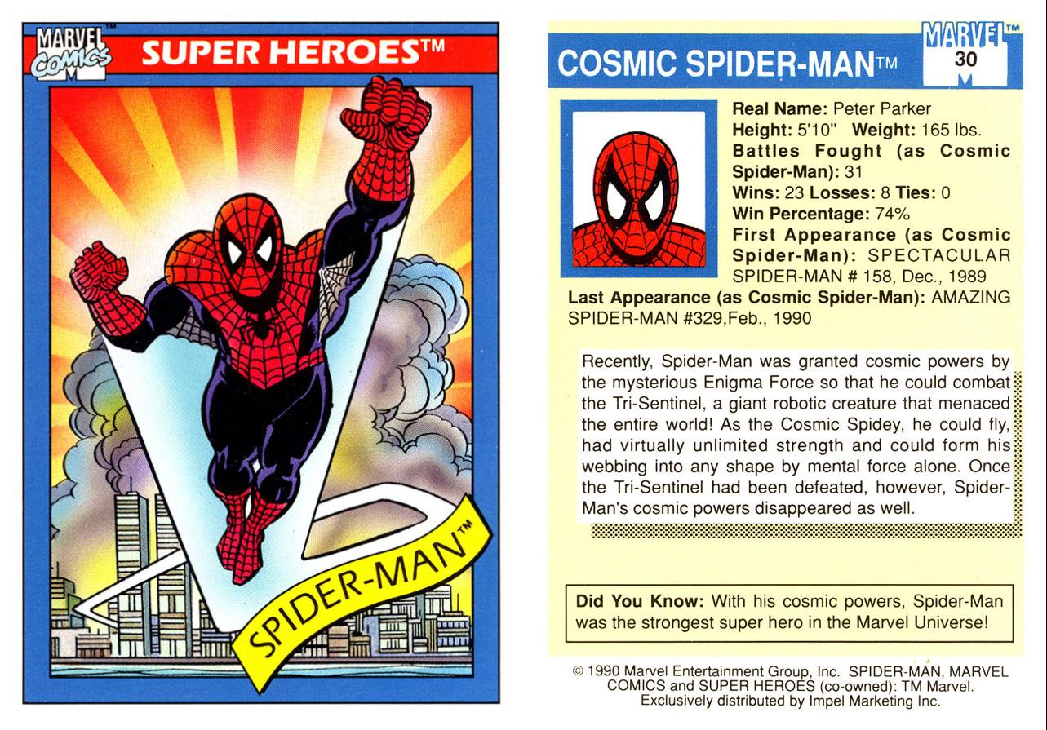
Scientific Revolution Trading Cards
On the Front include
Their picture
Name and decorated to represent their ideas
On the Back include:
Biographical info
Major Achievements/Ideas
Any Published material
Maria Winkelmann
Robert Boyle
William Harvey
Maria Sibylla Merian
Blaise Pascal
Andreas Vesalius
Nicholas Copernicus
Tycho Brahe
Johannas Kepler
Galileo Galilei
Isaac Newton
Francis Bacon
Rene Descartes
Margaret Cavendish

