Slide 1
Stewart Dynasty
100 years and a 180 change

Slide 2
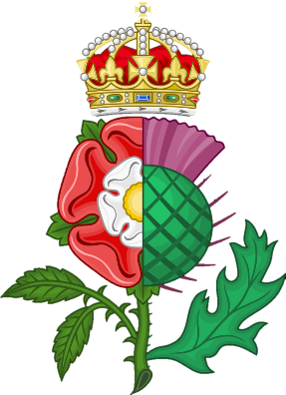
Death of Elizabeth I
1601: England begins correspondence with James VI of Scotland
Son of Mary Queen of Scots
Named king of Scotland at 13 months old in 1567
1603: Elizabeth dies and James named Heir
Unifies England, Ireland, & Scotland in name

Slide 3
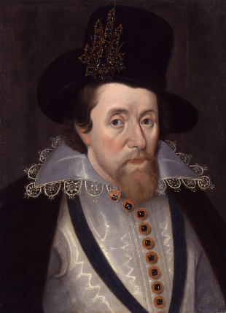
James I: Not what we expected
Firm believer in Divine Right of Kings
“kings are not only God’s lieutenants upon earth, and sit on God’s throne, but even by God himself they are called gods.”
Inherited massive debt
Levied custom duties called “impositions” without Parliament
Puritan parliament urges purification of Church of England
James opposed them, believed that church and monarchy were linked: “no bishops, no king.”
Religious dissenters begin leaving England
Increased tension between King and Parliament
Peace with Spain in 1604 & Hesitant to help in 30 Year’s War
Seen as Pro-Catholic

Slide 4
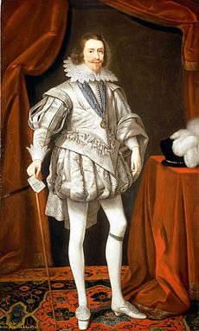
Scandalous!
Favored George Villiers Duke of Buckingham
Controlled patronage
Seen as having too much power over the king
Maybe they were a little TOO close…

Slide 5
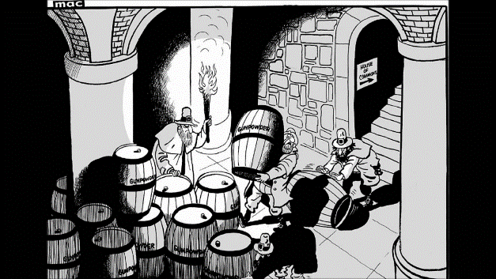
Remember, Remember
Gunpowder Plot: Guy Fawkes & team plan to blow up Parliament & the king

Slide 6
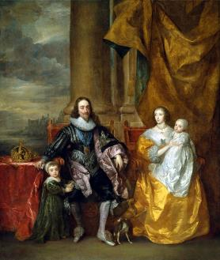
Charles I (1625-49)
James dies in 1625, leaving his son Charles to throne
Inherited daddy’s parliament problems
Married to Henrietta Maria, sister of Louis XIII (French Catholic) & too fond of Daddy’s friend Buckingham
Back and forth with Parliament
Calls to ask for money
They refuse
He dissolves them
Happens 4 times

Slide 7
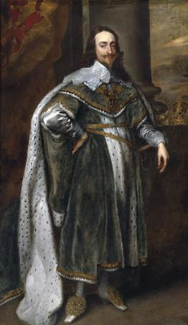
Petition of Right
Called parliament 1628, asked for taxes
Was forced to sign Petition of Right
No taxation w/o Parliament’s consent
No imprisonment w/o just cause (Habeas Corpus)
No quartering soldiers w/o subjects’ consent
Signed Petition, got $, dissolved Parliament
Ruled without Parliament next 11 years

Slide 8
War is coming!
Puritans angry at Charles for trying to make them Anglican
Threaten to invade
Calls Parliament
Again attempt to limit his power
January, 1642 – Charles I tried to arrest the leaders of Parliament, but they got away
Mob gathered outside of the palace
Charles I fled to the north of England and raised an army of Irish Catholics

Slide 9
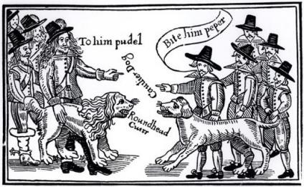
English Civil War (1642-1651)
Charles I’s supporters – Royalists (a.k.a. Cavaliers)
Parliament’s supporters – Puritans (a.k.a. Roundheads or Parliamentarians)
Led by John Pym & Oliver Cromwell and his New Model Army
1647 – took Charles I prisoner
1649 – Charles I brought to trial and beheaded for treason against Parliament
Dramatic challenge to concept of absolute monarchy
Monarch was not “the state” because he/she was subject to the laws of the state
Charles (son of Charles I) goes against Cromwell
defeated by New Model Army
Lived in exile in Europe until 1660

Slide 10
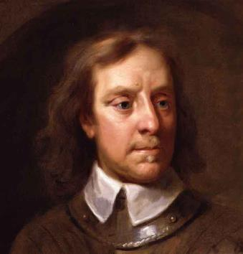
Commonwealth (1649-1660)
1649-1660 – period during which the Stuarts were out of power in England (Interregnum)
Parliament was dismissed
Cromwell becomes “Lord Protector”
Republican Constitution
But was it really?
Military districts, rips up the new Constitution

Slide 11
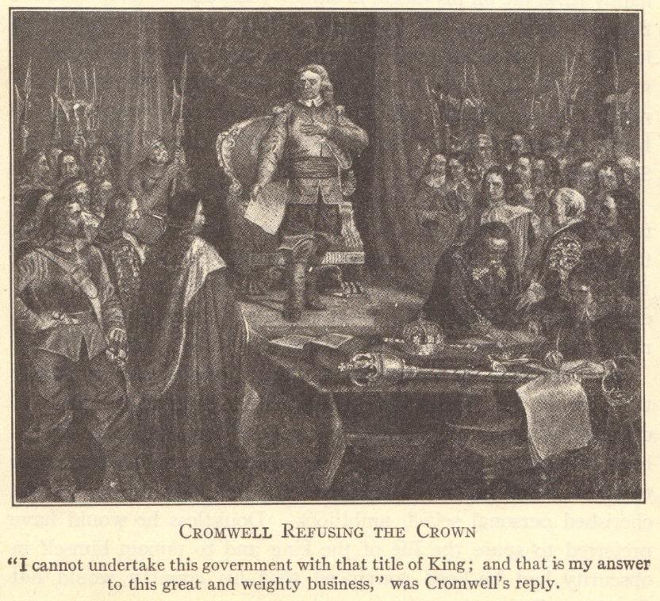

Slide 12
Cromwell & the Puritan Revolution
Tried to create a Puritan society in England by banning “sinful” activities
Brothels
Alehouses
Cursing
Theater
Dancing
Sports
Basically…fun
Some religious toleration
Protestants were tolerated; Catholics were not tolerated
Jews expelled in 1290; Cromwell let them back into England

Slide 13
Conquest of Ireland
English had ruled and colonized Ireland for over 500 years
But Irish disliked and fought against foreign rule
Most Irish were Catholic and opposed to Protestant Puritan reforms
Cromwell was extremely anti-Catholic
Irish rebelled against Cromwell
Cromwell’s New Model Army landed in Ireland in 1649
Fighting was bitter and violent
Forcibly evicted civilians and destroyed food supplies, sparking a large famine
Act of Settlement (1652)
Cromwell’s forces won
Catholic land confiscated
Circa 12,000 soldiers were paid with confiscated Irish lands
The class of Catholic landowners was destroyed in Ireland
Irish came to work as tenant farmers on their ancestral lands

Slide 14
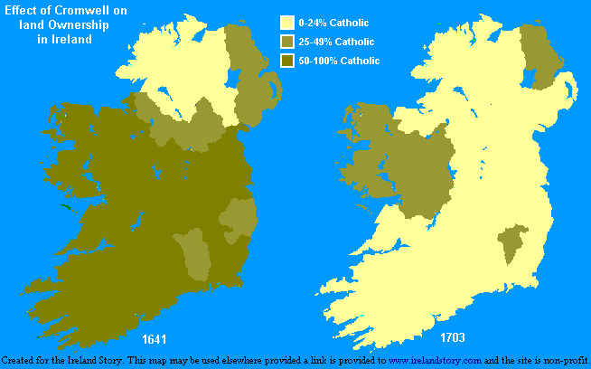

Slide 15
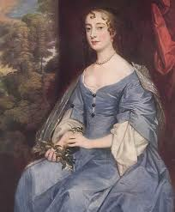
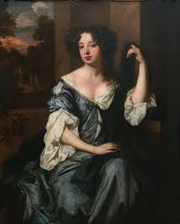
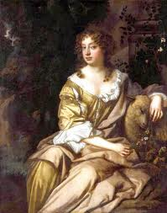
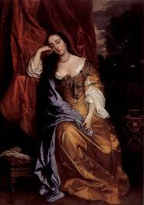
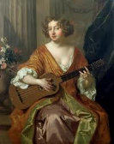
Restoration
Oliver Cromwell died in 1658
His son, Richard Cromwell, briefly ruled after his death
Parliament invited Charles I’s son Charles II to be king
Nicknamed “the Merry Monarch”
Restored theatres (dirty comedies), sporting events, and dancing (… basically, fun)
Liked to have fun with the ladies (Scandals!)
Had the body of Cromwell disinterred, hanged, and beheaded in 1661.

Slide 16
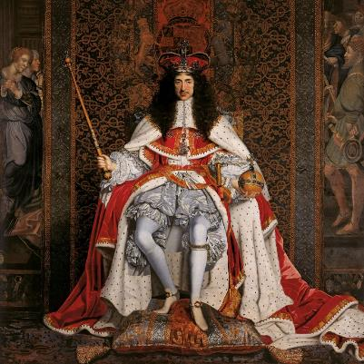
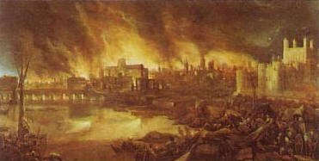
Restoration: Charles II
The Clarendon Code (1661-1665)
Restored Anglicanism as the established religion
The Test Act 1673 imposed stiff penalties on nonconformists
Anglo –Dutch Wars→ who controls maritime commerce
Great Fire of London (September 2-March, 1666-7)
Destroyed 2/3 of the buildings of London.
Sir Christopher Wren, architect

Slide 17
Political Parties Develop
Charles II died in 1685
He had no legitimate son (though plenty illegitimate)
Converts to Catholicism at death
First political parties in Parliament debated who’d be heir to the throne
Tories
Supported Charles II’s brother, James, who was a Catholic
Whigs
Did not want a Catholic monarch
James II came to the throne in 1685 when his brother, Charles II, died

Slide 18
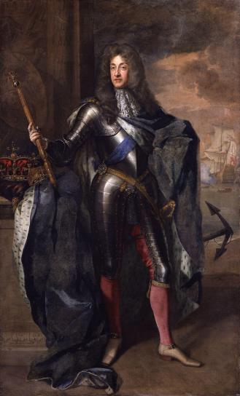
Reign of James II (1685-1688)
James II put Catholics in power
He dissolved Parliament when it objected
Wife – Anne Hyde
Daughters Anne and Mary raised as Protestants
Mary marries cousin Prince William of Orange (Dutch)
Second wife – Mary of Modena – Catholic
Gave birth to son, James Francis Edward Stuart

Slide 19
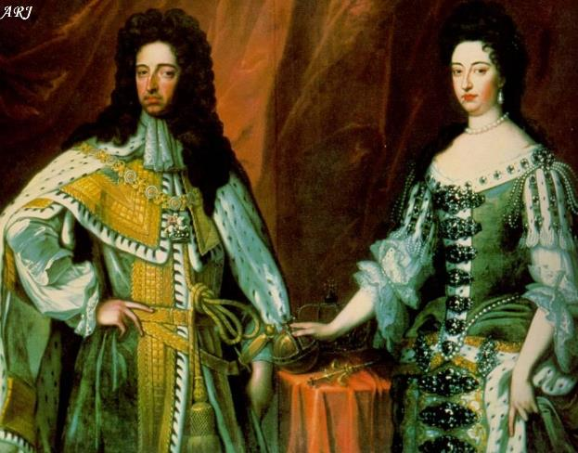
Glorious Revolution
William of Orange & Mary invited to co-rule
James II flees to France
“The Old Pretender”

Slide 20
English Bill of Rights (1689)
England became a constitutional monarchy
Monarch’s power limited by laws
William and Mary consented to these changes
English Bill of Rights
No taxation without consent of Parliament
Monarch could not suspend the laws of Parliament
Freedom of speech for parliamentary debates
Citizens free to petition the monarch regarding grievances
Act of Settlement (1701)
Prevented heirs of James II from succeeding
Triennial Act (1694)
Required that a new Parliament should meet at least once every three years

Slide 21
Cabinet System
Dilemma
1688 – no monarch could hold the throne without Parliament’s consent
But Parliament needed the monarch’s permission to rule
18th century (1700s)
Representatives of the majority party formed a cabinet
Cabinet worked closely with the monarch
Leader of the cabinet – Prime Minister
Prime minister and cabinet are head of government
Role of the monarch has weakened
Now, ceremonial head of state

Slide 22
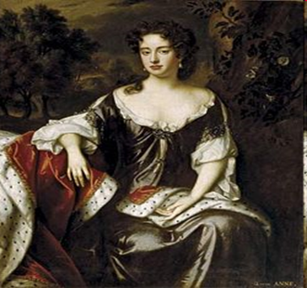
ANNE I: 1702-1714
William & Mary have no children
Sister of Mary (daughter of James II)
Last of the Stuart Dynasty
Anne adored husband, George of Denmark.
No children survived to adulthood
Constant ill health, overweight
Enjoyed cards and gossip as distractions

Slide 23
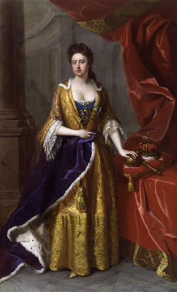
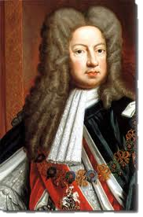
ANNE I
Aimed at improving her people’s welfare and they loved her
Last monarch to preside over cabinets and veto parliamentary legislation
England and Scotland united – United Kingdom of Great Britain
Died on August 1, 1714
She was succeeded by cousin George I of the House of Hanover

