Slide 1
The Dutch Republic

Slide 3
The emergence of Dutch power:
Anti Spanish & Anti Hapsburg resistance

Slide 4
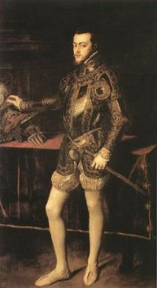
1581: Dutch Constitution
“As it is apparent to all that a prince is constituted by God to be ruler of a people, to defend them from oppression and violence as the shepherd his sheep…and when he does not behave, on the contrary, oppresses them, seeking opportunities to infringe their ancient customs and privileges, then he is no longer a prince but a tyrant, and the subjects are to consider him in no other view”

Slide 5
Chronology: The Rise
1602: Founding of Dutch East India Co.
1609: 12 Years’ Truce recognizes an independent Dutch state; founding of the Bank of Amsterdam
1612: Manhattan Island settled; New Amsterdam
1621: The Dutch West India Co. is Created; Dutch prepare for war against Spain (30 Years’ War)

Slide 6
Chronology: The Height
1652: Portuguese South Africa turned over to VOC; Afrikaaners language
1640s-1660’s: Series of Navigation Acts passed by British against
1670’s: French issue first mercantilist policies against the Dutch and English

Slide 7
Chronology: The Decline
1670’s – 1710’s: Series of commercial wars weaken economy & govt (v. English & French)
1688: The Glorious Revolution in England William III of Orange (Dutch) and Mary assume the crown of England.
1715: Treaty of Utrecht. British mercantile power eclipses the Dutch.

Slide 8
Why a Golden Age?
SOCIAL: Protestant but religious tolerant, women relatively equal, bourgeoisie dominate

Slide 9
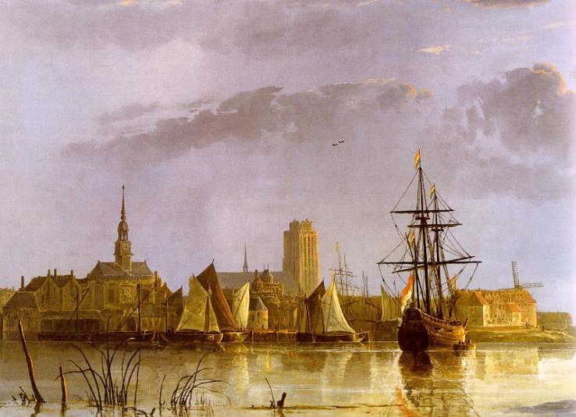
View of Doerdrecht Aelbert Cuyp, 1650s

Slide 10
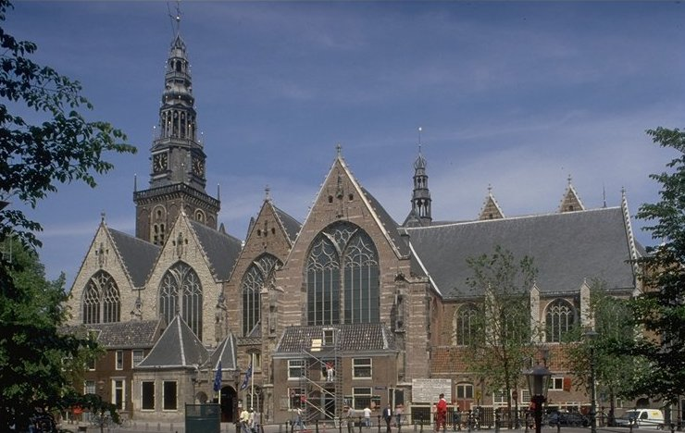
Oude Kerk [Old Church], Amsterdam
First built in 1300

Slide 11
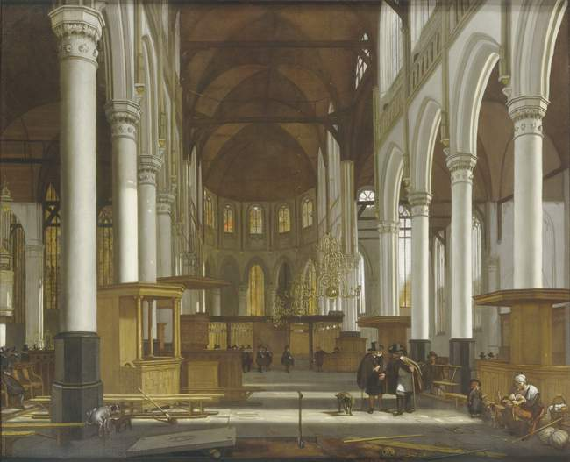
Interior of the Oude Kerk in Amsterdam - Emmanuel De Witt

Slide 12
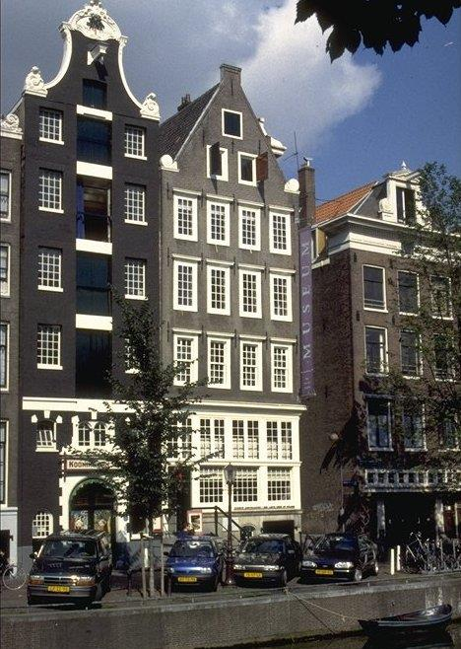
Catholic “Hidden” Church in the Attic, Amsterdam, 1630s

Slide 13
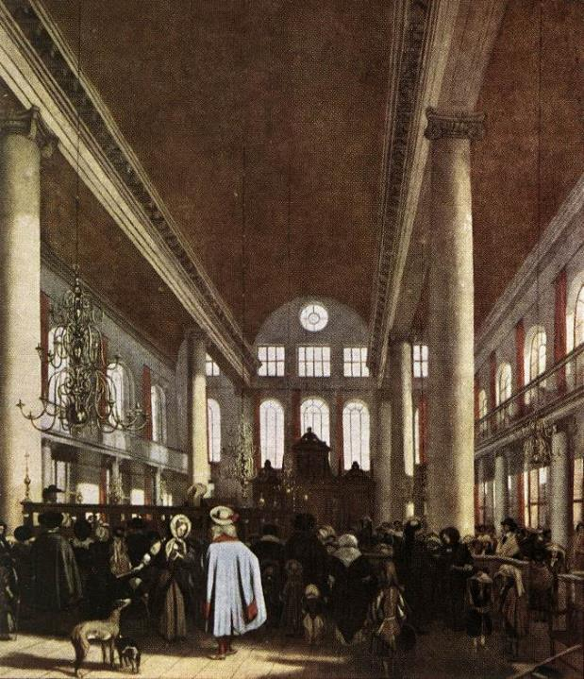
Interior of a Portuguese Synagogue in Amsterdam – Emmanuel De Witte

Slide 14
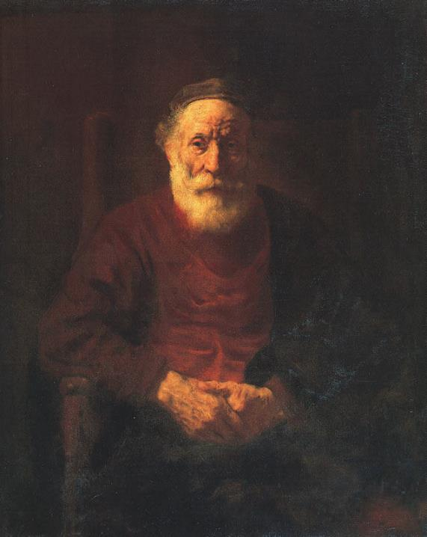
Portrait of an Old Jewish Man Rembrandt, 1654

Slide 15
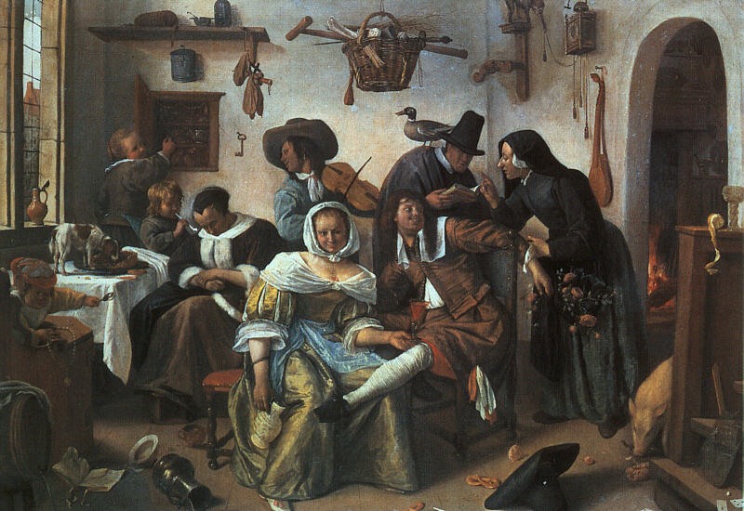
Beware of Luxury – Jan Steen

Slide 16
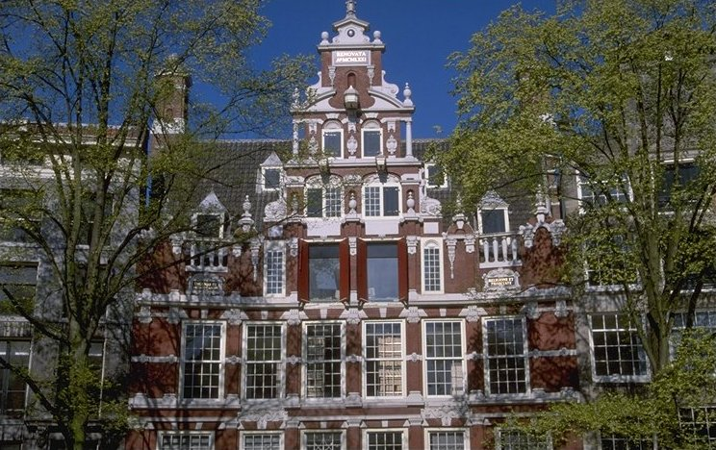
Upper-class Homes, Amsterdam Early 1600s

Slide 17
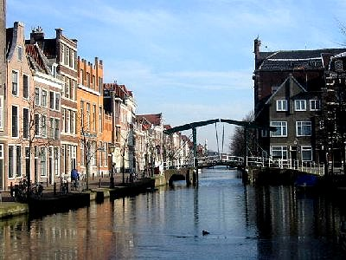
Patrician Houses Along the Canal in Leiden

Slide 18
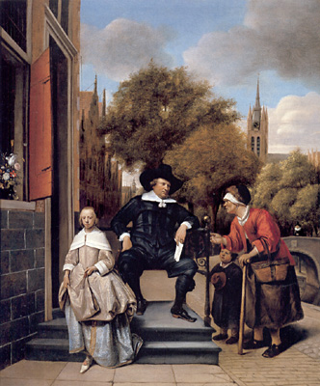
The Burgher of Delft & His Daughter – Jan Steen

Slide 19
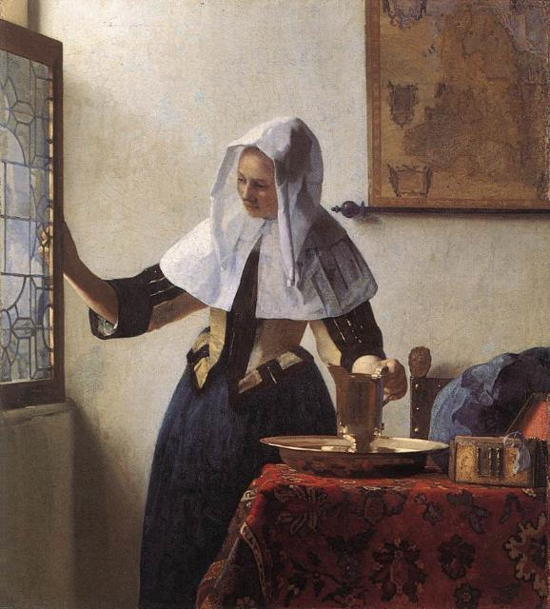
A Young Woman with a Water Jug - Jan Vermeer, 1662

Slide 20
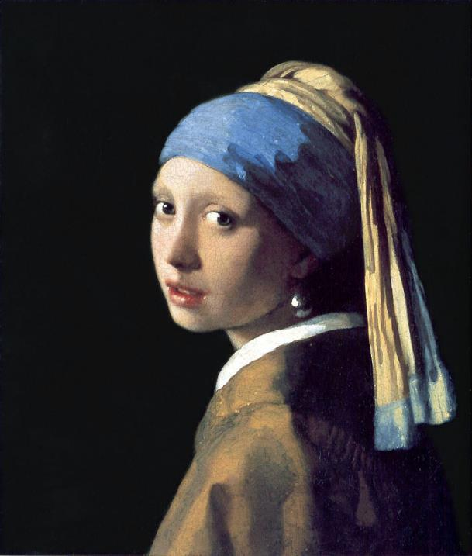
Girl with a Pearl Earring Jan Vermeer, 1665

Slide 21
Why a Golden Age?
SOCIAL: Protestant but religious tolerant, women relatively equal, bourgeoisie dominate
ECONOMICS: High Wage, Financial & Shipping Power

Slide 22
Dutch Economy
Exported diamonds, linens, pottery.
Low inflation.
“Carrying trade” (lowest shipping rates)

Slide 23
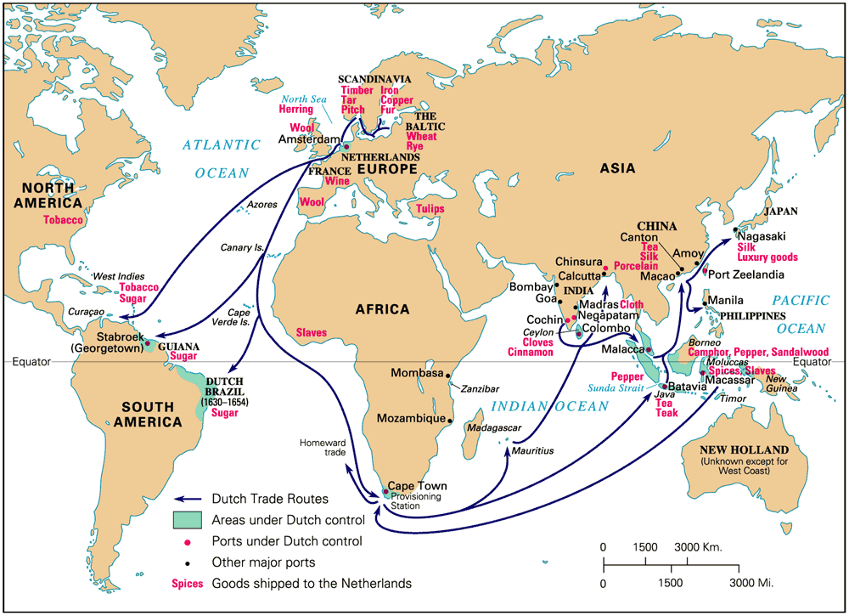
17c Dutch Global Commerce

Slide 24
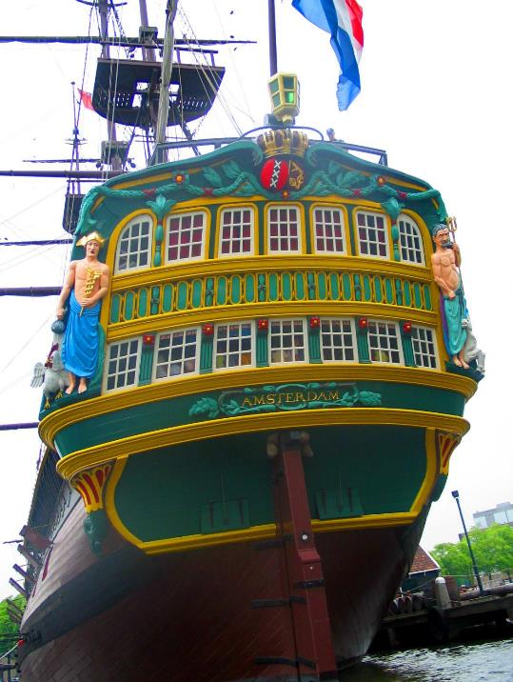
Dutch East India Ship, mid-17c

Slide 25
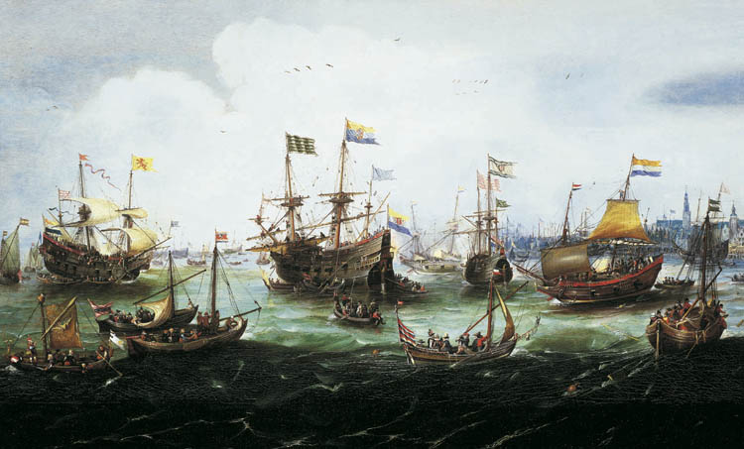
Return of the Dutch East India Fleet, 1599

Slide 26
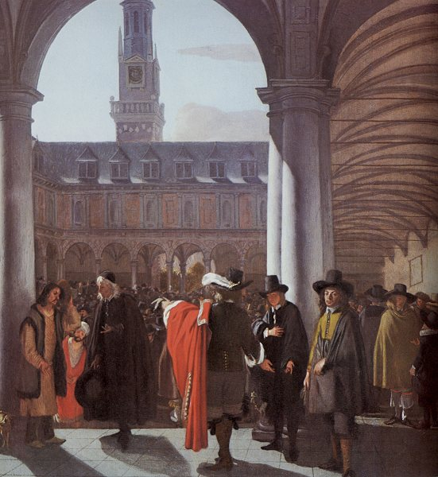
Amsterdam Stock Market (Bourse) Emmanuel De Witte, 1653

Slide 27
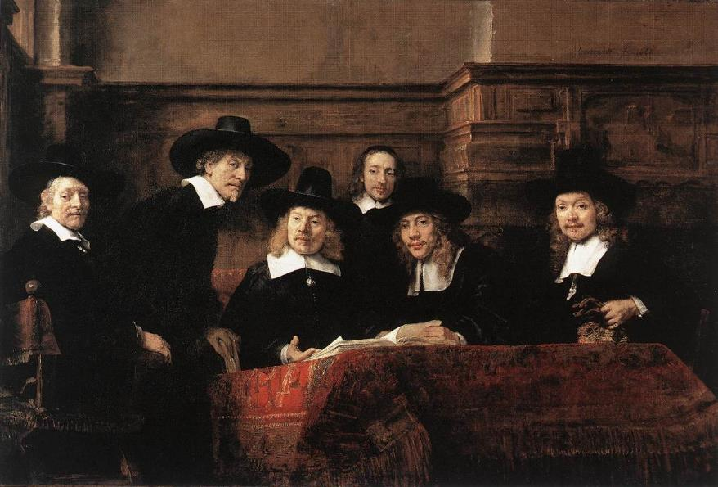
Sampling Officials of the Drapers Guild – Rembrandt - 1662

Slide 28
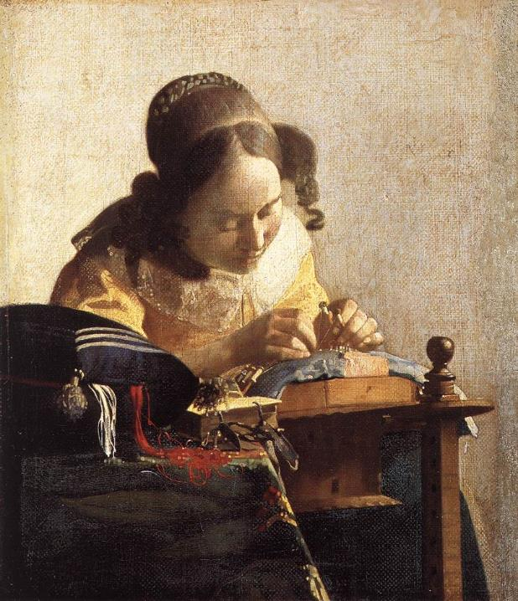
The Lace Maker Jan Vermeer, 1669-1670

Slide 29
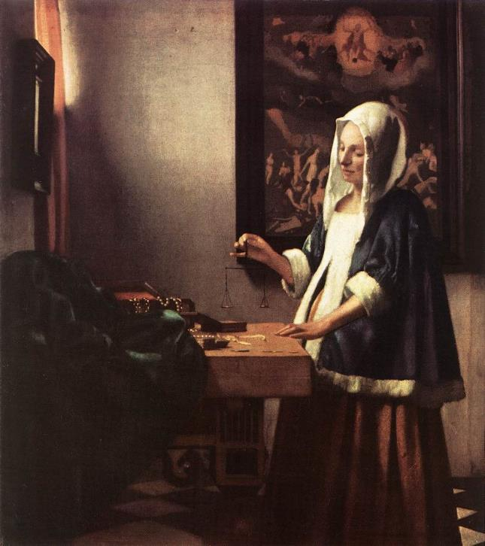
A Woman Holding a Balance Jan Vermeer, 1662

Slide 30
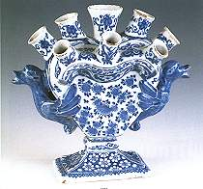
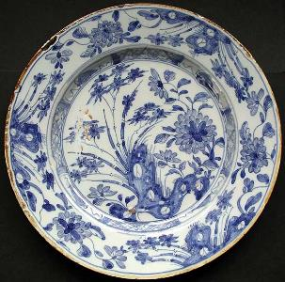
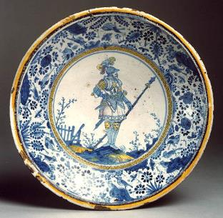
Dutch Delftware
English Delftware

Slide 31
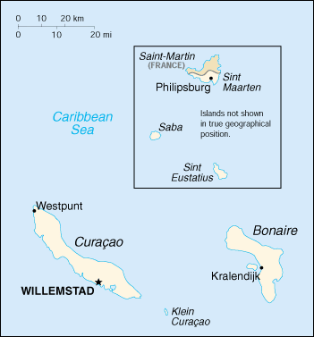
Dutch West India Company, 1621
Netherland Antilles

Slide 32
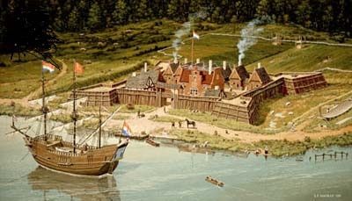
Fort Orange (Albany, NY) in New Netherlands

Slide 33
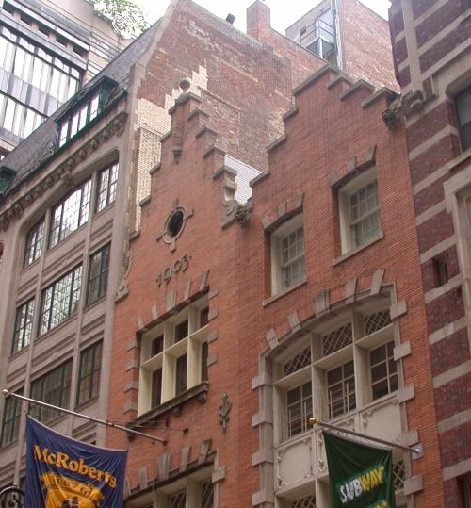
New Amsterdam (NYC)

Slide 34
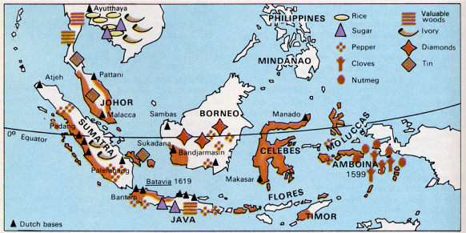
Dutch East India Company1602

Slide 35
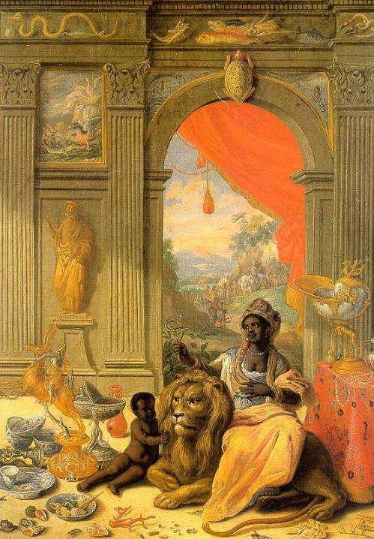
“Africa” Center Panel Jan van der Heyden, 1664-66

Slide 36
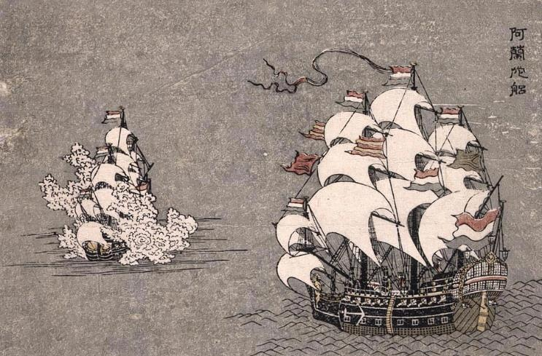
The Dutch in Japan, 18c

Slide 37
Why a Golden Age?
SOCIAL: Protestant but religious tolerant, women relatively equal, bourgeoisie dominate
ECONOMICS: High Wage, Financial & Shipping Power
INTELLECTUAL & CULTURE: Scientific Revolution and Enlightenment begin here, Dutch masters – painting

Slide 38
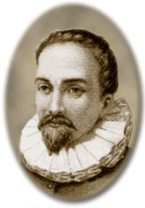
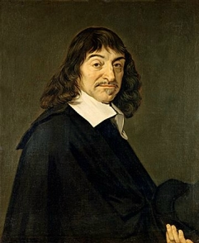
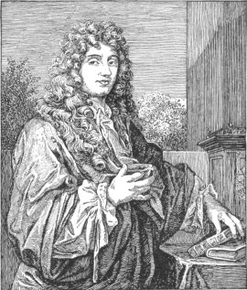
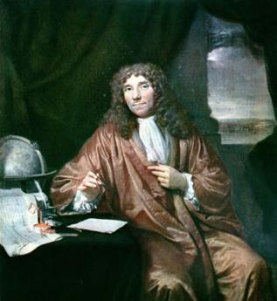
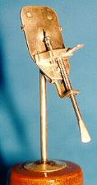
Philosopher: Rene Descartes
Telescope: Hans Lippershey
Astronomer Christiaan Huygens
Anton van Leeuwenhoek: The Microscope & the Discovery of Micro-Organisms

Slide 39
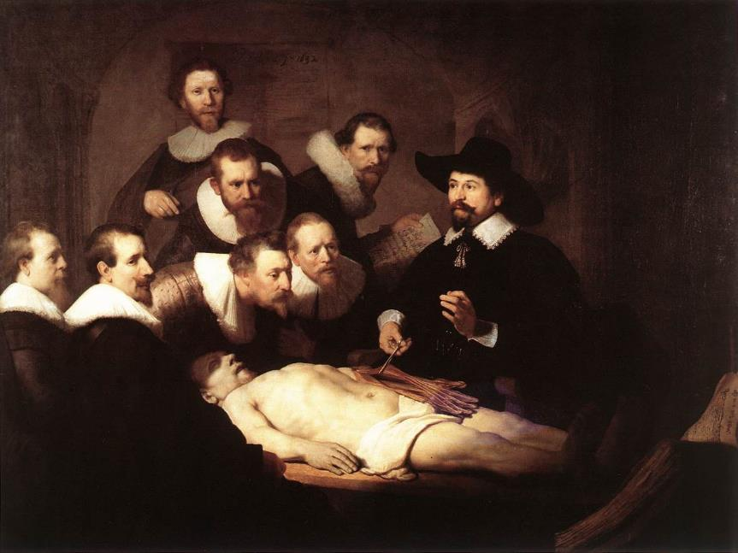
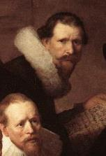
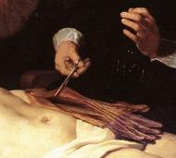
Anatomy Lecture of Dr. Nicolaes Tulp – Rembrandt, 1632
This isn’t geography class…

Slide 40
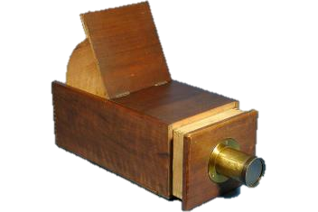
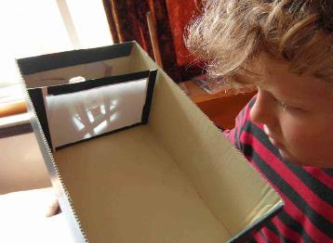
Vermeer and Optics
Questions surrounding his painting: too much detail, too much realism…basically, they are too good.
New discoveries in optics?
Lenses to project images on canvas?

Slide 41
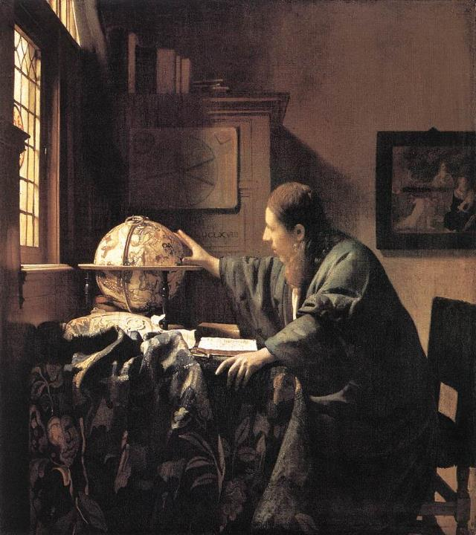
The Astronomer Jan Vermeer, 1668
It is argued that van Leeuwenhoek was the model for his painting

Slide 42
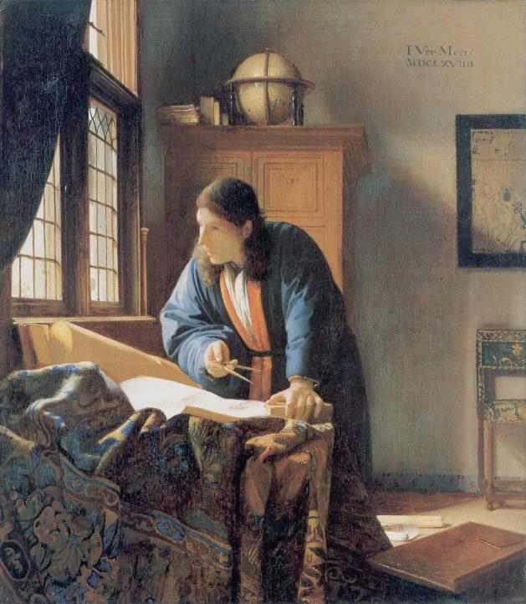
The Geographer Jan Vermeer, 1668-1669

Slide 43
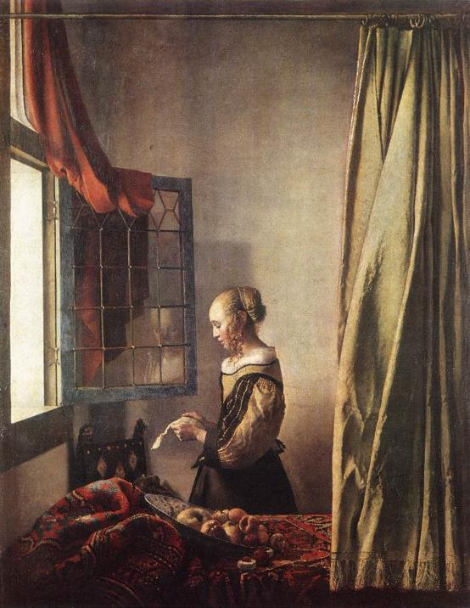
Girl Reading a Letter with the Window Open - Jan Vermeer, 1657

Slide 44
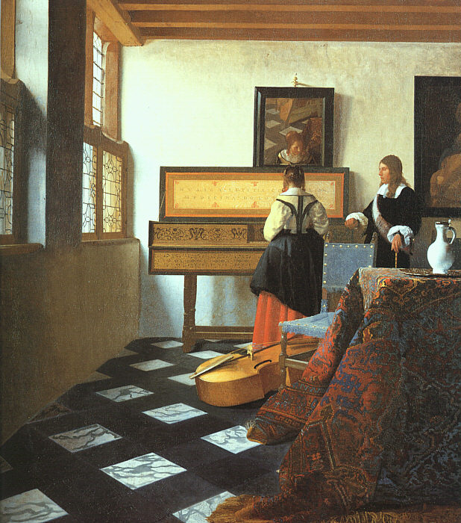
The Music Lesson Jan Vermeer, 1662-1665

Slide 45
Why a Golden Age?
SOCIAL: Protestant but religious tolerant, women relatively equal, bourgeoisie dominate
ECONOMICS: High Wage, Financial & Shipping Power
INTELLECTUAL & CULTURE: Scientific Revolution and Enlightenment begin here, Dutch masters – painting
POLITICAL: Mercantile oligarchy balanced by the House of Orange “stadtholder”; relative political freedom

Slide 46
The Dutch ConFederation
REGENTS (Local)
- provincial level
- held virtually all the power
- strong advocates of local independence
STADHOLDER
- States General representative from each province
- responsible for defense and order
STATES GENERAL (Federal)
- federal assembly, met in The Hauge
- foreign affairs (war)
- all issues had to be referred to the local Estates

Slide 47
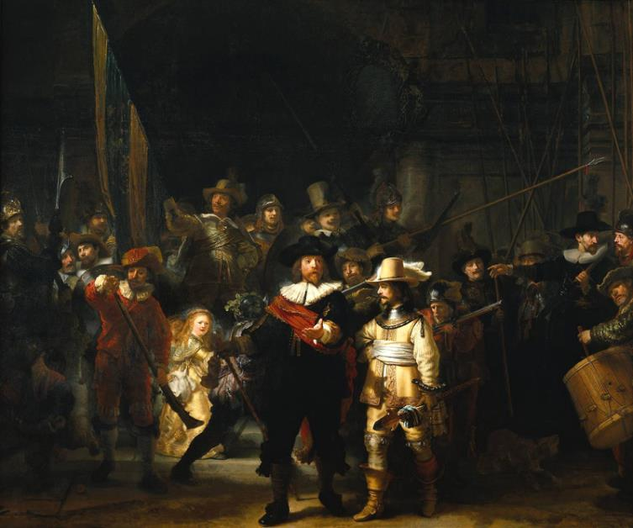
The Night Watch – Rembrandt, 1642

Slide 48
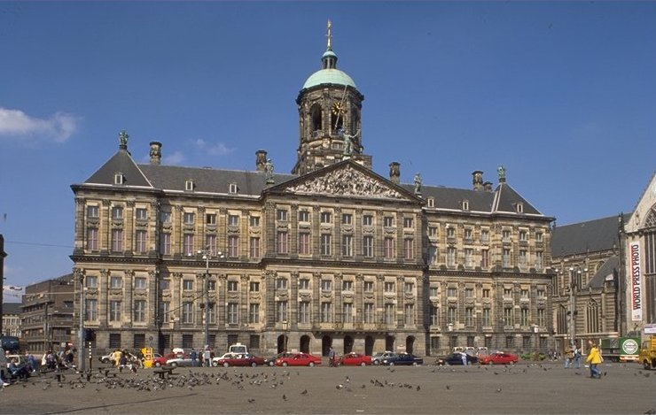
The Dutch Royal Palace, Amsterdam

Slide 49
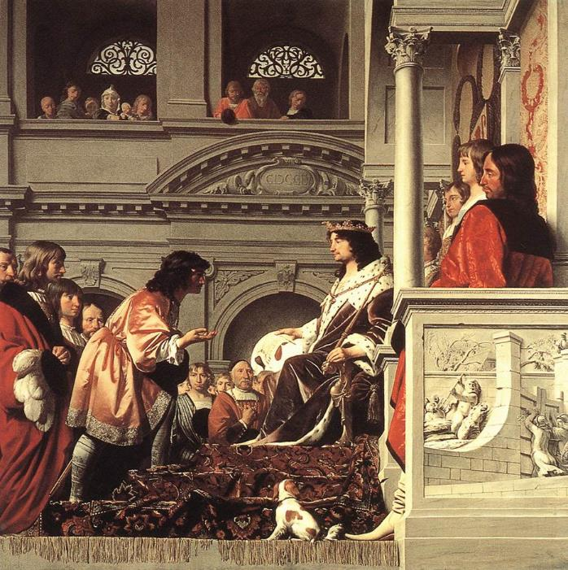
Count William II Granting Privileges Cesare van Everdingen, 1654

