Slide 1
A New Era: The Tudor Dynasty

Slide 2
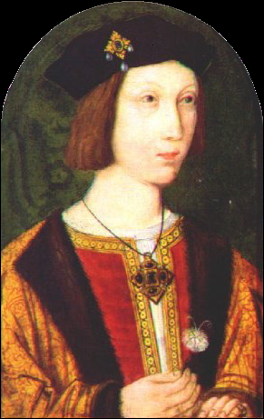
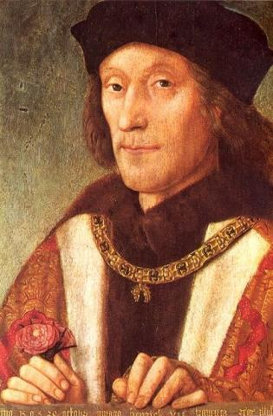
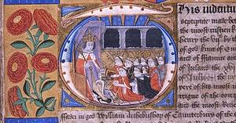
Henry VII
Henry VII rules 23 years
Claim to the throne is shaky AT BEST
Cracked down: No rebels here!
  Prohibited nobility to have armies
  King has ultimate authority
Star Chamber
Parliament still had taxing power
Notes:
Henry VIII was always described as a vivacious and handsome boy, who always seemed to want to be the center of attention. Henry VII ended up being a pretty frugal king, so when H VIII becomes king he loves to throw parties and be pretty extravagant.
The key to remember about Henry VIII is that he knows from personal experience how important an heir is. He is raised on stories of the War of the Roses and civil war, and knows that one son isn't enough (his older brother died before becoming king). This is what fuels his obsession for having an heir.

Slide 3
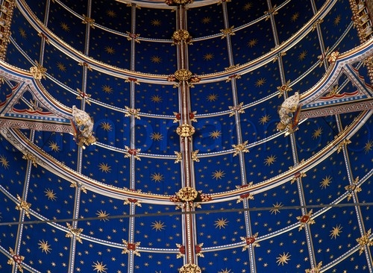

Slide 4

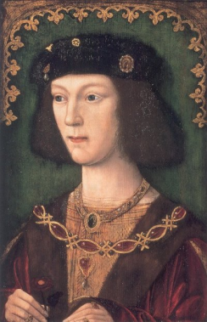
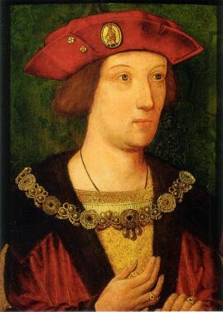

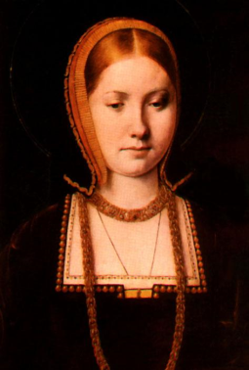
The Heir & The Spare
Has 2 sons: Arthur (destined to be king) and Henry (destined for the church)
Arthur marries Spanish princess Catherine of Aragon (daughter of Ferdinand and Isabella)
  He dies not long after
  1509: Henry marries her
  Have one living child: Mary
Notes:
Henry VIII was always described as a vivacious and handsome boy, who always seemed to want to be the center of attention. Henry VII ended up being a pretty frugal king, so when H VIII becomes king he loves to throw parties and be pretty extravagant.
The key to remember about Henry VIII is that he knows from personal experience how important an heir is. He is raised on stories of the War of the Roses and civil war, and knows that one son isn't enough (his older brother died before becoming king). This is what fuels his obsession for having an heir.

Slide 5
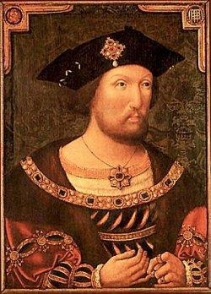
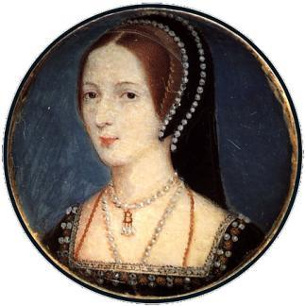
How Henry VIII Changes the English Church
1521—Henry criticizes Luther & is called “Defender of the Faith” by the pope
1525—Meets Anne Boleyn & asks the pope to annul his marriage; the pope refuses
1529—Parliament puts king over the English church instead of the pope
1533—Henry divorces Catherine and marries Anne; Elizabeth is born
1534—Act of Supremacy: Henry is “the only supreme head on Each of the Church of England.” Many are executed, including Henry’s friend Thomas More.

Slide 6
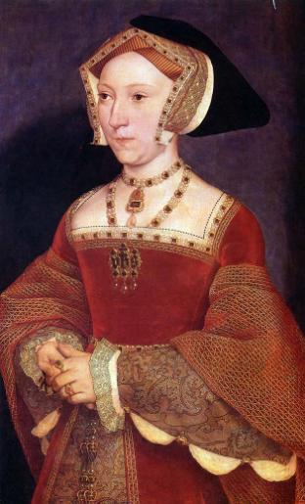
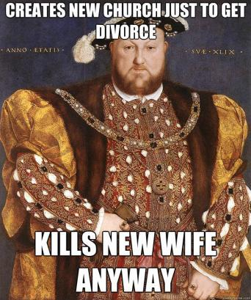
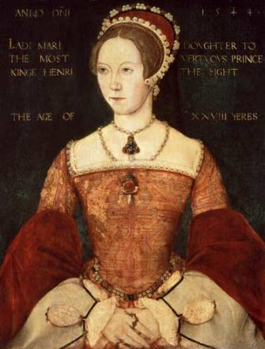
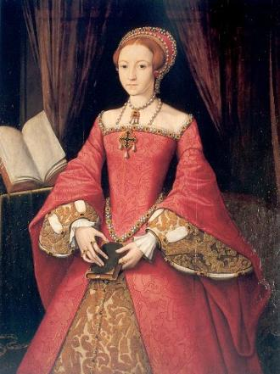
But what’s the problem?
Neither the Princess Elizabeth nor Princess Mary is an heir…
Henry tires of Anne & becomes suspicious—she is beheaded for treason when Elizabeth is 4
One Week Later: Henry marries Jane Seymour
  She will give birth to a son BUT dies in childbirth

Slide 7
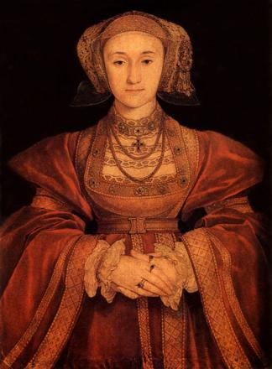
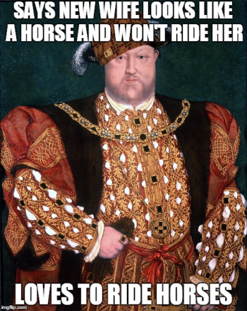
So What Does Henry Need?
A new wife!
Agrees to marry a German princess, Anne of Cleves, based on this portrait:
Unfortunately for Henry,
the artist was generous
to Anne
He divorces her
Notes:
Famously, Henry was so anxious to meet her he rode his horse to meet her and was so disgusted by her looks that he insulted her outright, and could not consummate the marriage
After their diverse, she's given the title "sister of the king", her own household and allowance, and becomes good friend with the king and his children. She never remarries and it could be argued that she ended up better off that any of Henry's other wives.

Slide 8
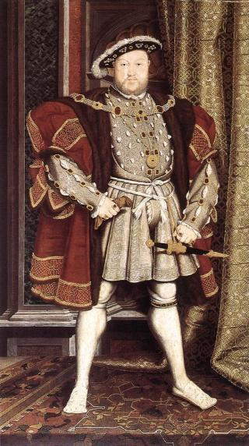
Keep this in Mind: Henry VIII is 49 & Looks A Bit Like This By This Point
Oh yeah,
And one of his legs was injured in a jousting accident that never healed and leaked puss, blood, and stench for the rest of his life
So overall, not pleasant

Slide 9
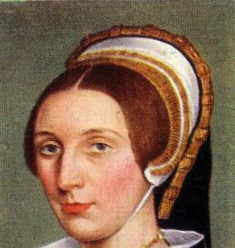
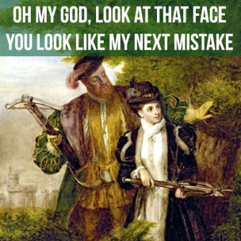
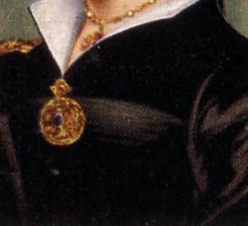
Then Henry Meets Katherine Howard
Katherine is beautiful, flirtatious…
and 17
Henry ’s Katherine
Katherine ’s Other Men
Henry finds out and she is beheaded

Slide 10
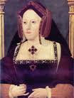
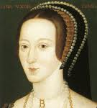
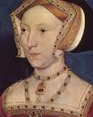
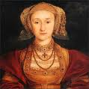

So Thus Far We Have
Divorced (Catherine of Aragon)
Beheaded (Anne Boleyn)
Died (Jane Seymour)
Divorced (Anne of Cleves)
Beheaded (Katherine Howard)
So next must be…

Slide 11
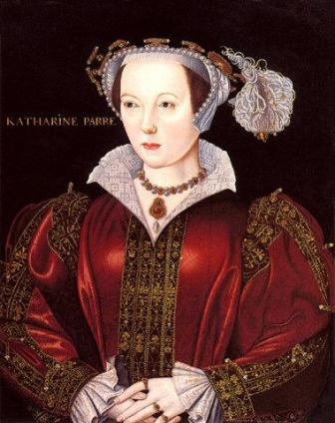
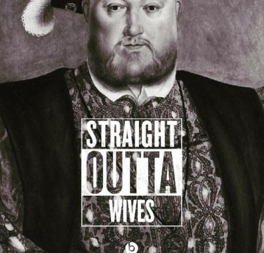
Survived!
Henry marries Catherine Parr
Serves as a nurse and friend until Henry’s death
Notes:
You would think Katherine’s life would have been happier, as she survived Henry, however, her 2nd marriage ended in disaster when her husband (whom she’d married for love) cheated on her and she lost their child. She possibly suffered from manic depression. She died very unhappily.

Slide 12
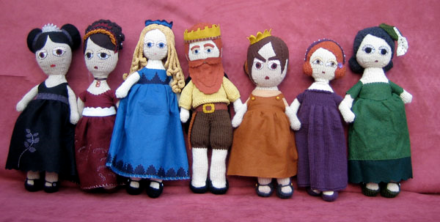
The Six Wives of Henry VIII

Slide 13
Oh while we’re at it..
Henry spent most of time doing 4 things:
  Sucking up to and also going to war with France
  Burning monasteries and taking their land/wealth
  Putting down rebellions
  Executing people
Notes:
Let’s not forget Henry did other things besides trying to get a son! He became increasingly paranoid as he grew older and executed many who did not support his (often changing and contradictory) decision.

Slide 14
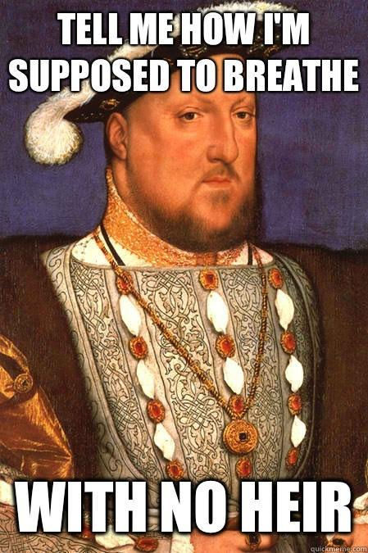
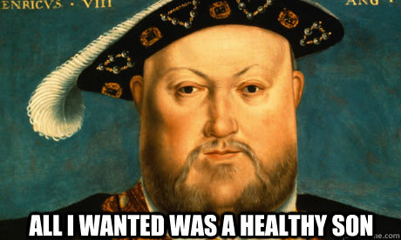
Henry’s Heirs
Notes:
Edward VI is super Protestant, influenced by his uncles (mother's brothers) when he dies young, this is the reason they choose his cousin Lady Jane to take the throne over the catholic Mary. Jane had no say and was forced into it by her father and uncles. In the end, 16 year old Jane only lasted as queen for nine days before Mary came into London with support. Jane was put in the Tower and executed for treason

Slide 15
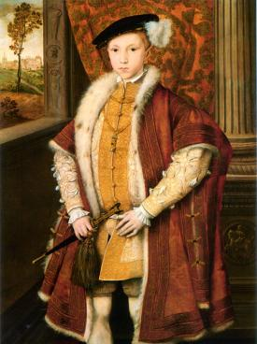
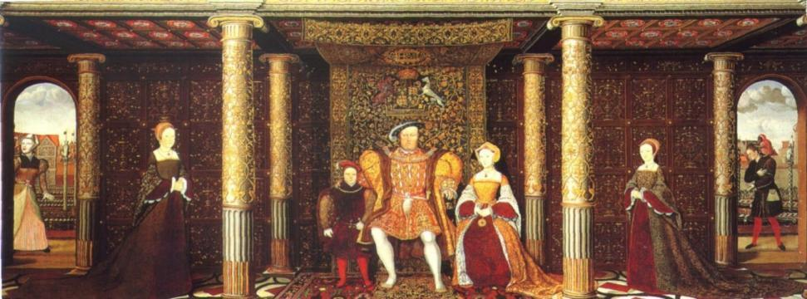
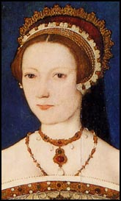
Henry’s Heirs
1547—Henry VIII dies; his son Edward VI becomes king & makes protestant reforms
Edward VI dies
Mary Tudor (His older sister) is unpopular, so his cousin, Lady Jane Grey is made queen for 9 days, she is executed
Notes:
Edward VI is super Protestant, influenced by his uncles (mother's brothers) when he dies young, this is the reason they choose his cousin Lady Jane to take the throne over the catholic Mary. Jane had no say and was forced into it by her father and uncles. In the end, 16 year old Jane only lasted as queen for nine days before Mary came into London with support. Jane was put in the Tower and executed for treason

Slide 16
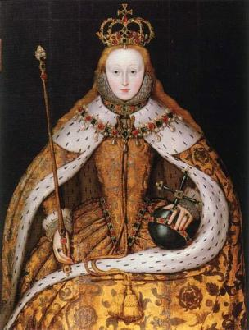
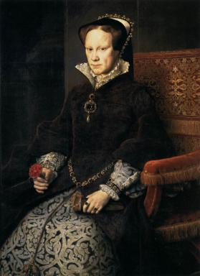
Henry’s Heirs
Mary Tudor becomes queen. Restores Catholicism, marries Phillip II of Spain & burns protestants at the stake “Bloody Mary”
1558—Mary Tudor dies; Elizabeth I becomes queen.
Notes:
Mary is older when she takes the throne and marries the younger king Phillip II of Spain. She thinks she gets pregnant but after after a year there is no child and she still looks pregnant. She probably had ovarian or stomach cancer. During her reign she had Elizabeth placed in the Tower (never liked her, remember her mother was set aside for Anne Boleyn; she also feared Elizabeth's supporters would try to put her on the throne). Elizabeth always pretended to be Catholic while Mary was on the throne, but secretly practiced Anglicanism—frankly, she was lucky to survive her sister’s reign.

Slide 17
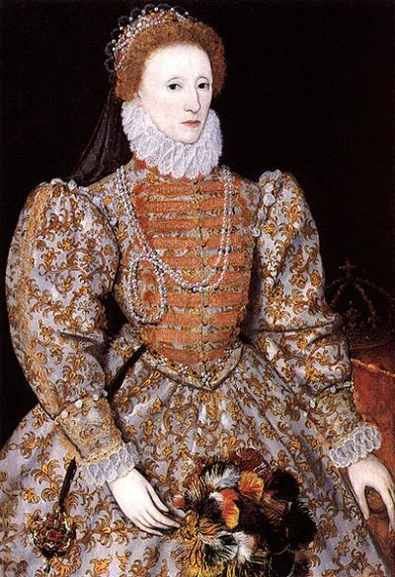
Elizabeth I: Gloriana
Notes:
Gloriana was a nickname for Elizabeth representing her amazingness and represents the golden age of England.
It's also interesting to note that Elizabeth really never should have been queen she was not only a woman, but a third child. Had Edward lived and had a child, then that child would have been heir. Once he died, Mary should have lived longer, and might have even had a child herself. Arguably, she was the best of the Tudor children and should never really have been queen.

Slide 18
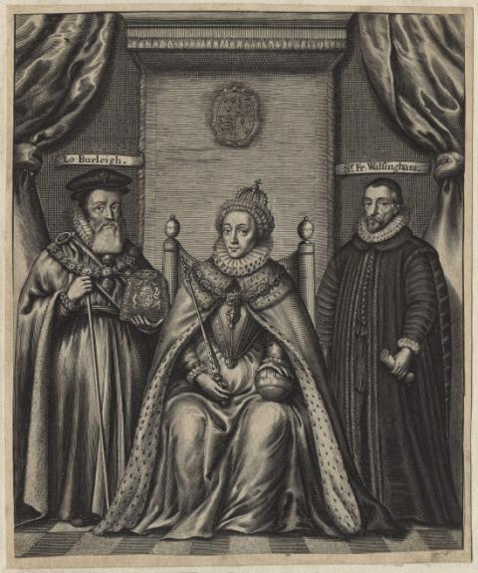
Elizabeth I: Gloriana
Now what?
Needs good council
  William Cecil: devoted government official
  Francis Walsingham: spymaster
Combines political savvy & good advice

Slide 19
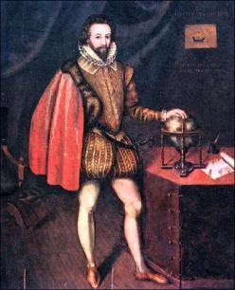
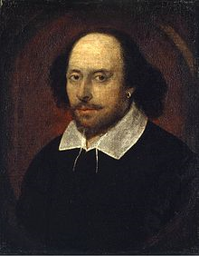
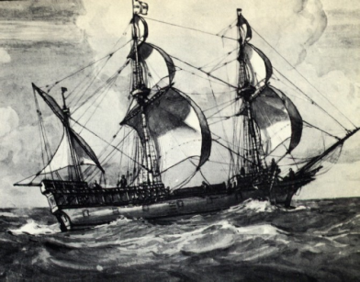
Elizabeth I: Gloriana
Under Elizabeth I England has a Golden Age
  Time of prosperity, learning, and exploration
She never marries; uses marriage as a political tool
  “I have already joined myself in marriage to a husband, namely the kingdom of England.”
Notes:
Now that England is less worried about civil war, they can focus on other things. This is the height of the English Renaissance: Shakespeare, Francis Drake, colony building, etc
Her personal reason for never marrying isn't known, but she's really good at pretending she's going to marry someone to form alliances or to hold off wars (you're not going fight someone that you're engaged too). She leads on a lot of royal princes, but always finds an excuse not to marry.
It's also important to point out that Elizabeth is know as the Virgin Queen (even by her contemporaries) for this reason. There are rumors that she had lovers, however that was never proven. There was also a rumor that she had a child in secret, however examinations of her body proved that this was not true.

Slide 20
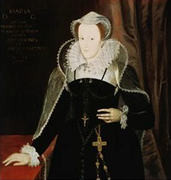
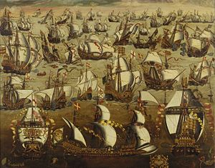
Elizabeth I: Gloriana
Establishes compromises in the church (at first)
  “I do not wish to make windows into men’s souls.”
  Tightens control after catholic cousin Mary, Queen of Scots tried to overthrow her
Conflict with Spain
  King Philip II sends
  fleet of ships called
  the Armada
  Blown off course by a
  storm and fails to attack
Unifies England
Peace WITHIN England almost 45 years
Notes:
Religious issues had controlled England so long that at first Elizabeth said you could practice whatever religion you wanted as long as you didn't flaunt it, although the official church was Church of England; however, after Catholics attempted to overthrow her in place of her cousin Mary, Queen of Scots, she restricts that control (making Catholicism illegal). At first she doesn't want to execute Mary, as she is also a queen and a family member, so she keeps her under house arrest in England for 21 years. She is eventually executed after another attempt at rebellion.
Spain also hates England bc they are not Catholic (and they are colonization rivals). Phillip II sends his armada to attempt an invasion of England, however they are blown off course by a pretty intense storm. Phillip (who is super religious and probably manic depressive) feels that God is punishing him for something and never really gets over it.
The real significance of Elizabeth is that despite her faults and the issues with the Scots and the Spanish, she ends civil war in England and unifies the country around a monarch that most people love and support. After the war of the roses and Henry viii, this was a pretty big deal.

Slide 21
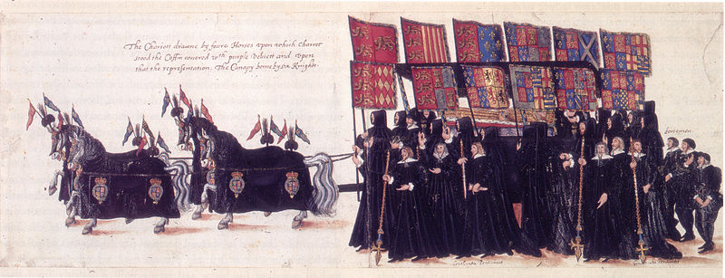
Elizabeth I: Gloriana
Elizabeth died March, 24 1603 at 69 years old
Her cousin, James VI of Scotland (son of Mary Queen of Scots) is named her heir and becomes King James I of England
Notes:
Elizabeth had been very careful not to name an heir until the very end. She finally named the son of Mary Queen of Scots, King James VI of Scotland, and her closest cousin, as heir. This is the beginning of the Stewart dynasty.

