Slide 1
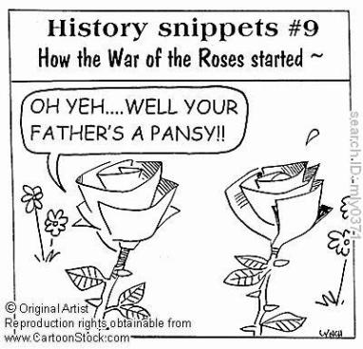
A Game of Thrones: The Wars of the Roses
Or: A long and complicated stint in British History when everyone was named either Edward, Richard, Henry, and Elizabeth.
Notes:
© 2013 Rebecca Jones

Slide 2
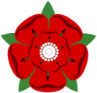
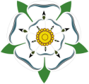
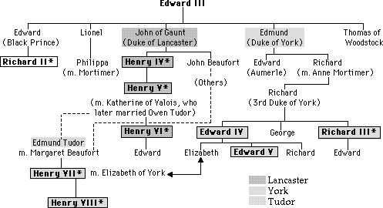
The War of the Roses: The Cousin’s War
King Edward Plantagenet III's two sons the Duke of Lancaster and the Duke of York, and their descendants
Series of Civil Wars over 30 years
Notes:
Gets the name War of the Roses because each House (family) decided to adopt a rose as their symbol. Supporters of the house of Lancaster would wear a red rose in their lapel and York supporters would wear a white. It was never called that until much later. Contemporarily, it was known as the cousin's war. Throughout the PowerPoint I put the correct color rose next to portraits of the people we are talking about so students can track each house.

Slide 3
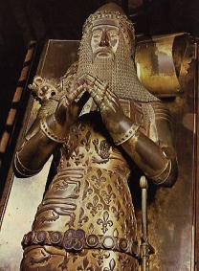
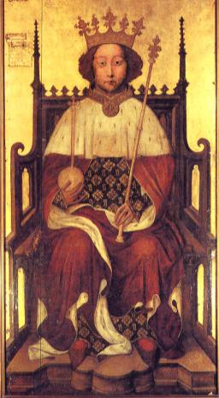
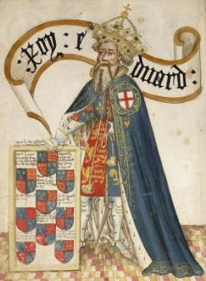
Edward Plantagenet III
5 sons
Edward the Black Prince is heir
Fighting in France (100 Year’s War)
Ed & Ed die within a year of each other
Edward’s son Richard II becomes king at 10

Slide 4
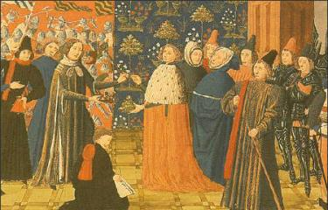
Richard II
Easily manipulated, unpopular
Cousin Henry Bolingbroke led rebellion (Duke of Lancaster)
Richard gives up crown, imprisoned & died
Bolingbroke becomes Henry IV

Slide 5
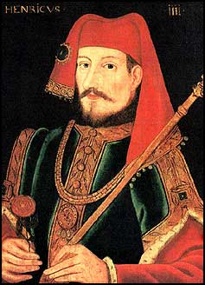
Henry IV
Internal struggles & Scotland
Roger Mortimer
Descended from Lionel, better claim, heirs to R2
Rebellion failed
Daughter Anne cousin Richard of Cambridge (York)
Died 1413, son becomes Henry V

Slide 6
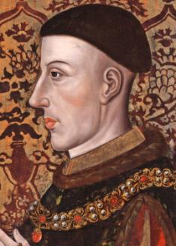
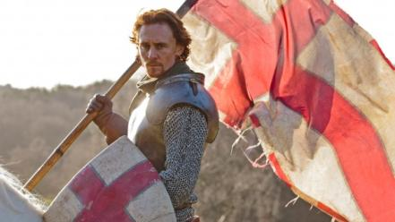
Henry V
Mostly popular
Cambridge Plot: Richard Cambridge (York) rebels
Executed
Son Richard stripped of titles (remember he’s both Mortimer & York)
Fights 100 Years War, marries Katherine of Valois, has son Henry
Dies in France

Slide 7
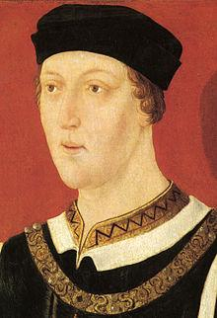
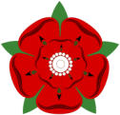
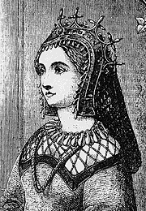
Henry VI
Henry VI becomes 5 yr old king
Controlled by counselors
Strange, quiet, pious child
Marries Margaret of Anjou—very powerful, strong
Have one son
Edward
Rumored to be the son of the Duke of Somerset
Henry VI has a mental breakdown
Notes:
Henry V dies of disease when his son, Henry VI, is just a boy. It is suggested that he inherited mental illness from his grandfather (Katherine's father, Charles, king of France). Margaret of Anjou is a French princess who turns out to be hated by the English. When Henry has his mental breakdown (he goes catatonic for almost a year) she tries to rule as regent. She comes into conflict with some of his main counselors, especially Richard of York.

Slide 8
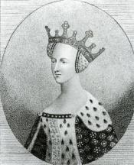
Meanwhile…
Henry VI’s mother, Katherine secretly marries her knight, Owen Tudor
Have two sons:
Edmund Tudor
Jasper Tudor
Edmund marries
Margaret Beaufort,
a cousin of Henry VI
Notes:
Owen Tudor was a minor knight under Henry V. He was from Wales. When they marry (which was a big no no) she is essentially banished from court. Her Grandson will later overthrow the Plantagenet line
Because Edmund marries Margaret Beaufort, their son lays claim to being a Lancaster, but it is a very distant connection.

Slide 9
Richard v. Margaret
Richard, 3rd Duke of York claims throne
Battles for power against Margaret and Henry VI

Slide 10
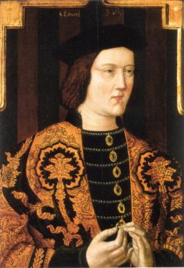
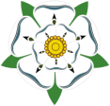
Edward IV
Richard dies in battle, his son Edward takes control
Henry overthrown
Edward becomes King
Married to Elizabeth Woodville
Eldest children: Elizabeth, Edward, & Richard
Notes:
The Duke of York, Richard dies in a battle against the forces of Margret when Henry VI is catatonic. His son Edward takes up his banner and eventually marches into London and is crowned king under the reason that Henry is no longer fit to be king. They also claim that the son of Henry and Margaret is actually a bastard and therefore cannot inherit. Thereby, Edward is next in line. Henry VI is moved into the Tower of London to be kept "for safety"
Now this means there is a York on the throne. Lancasters still believe Henry VI is the rightful king.
Hs marriage to Elizabeth is also controversial. Many believed she tricked him into marriage and that her family is just trying to climb the social ladder. The Lancansters try to use her against Edward. Edward had also been supposedly betrothed to another woman when they married, which made him legally a bigamist. She also does not get along with Edward's younger brother Richard (Duke of Gloucester [Gl-ow-ster] later Richard III) who was very loyal to him.
Elizabeth and Edward had 10 children together, but I only mention these three because they are the children who play important roles.

Slide 11
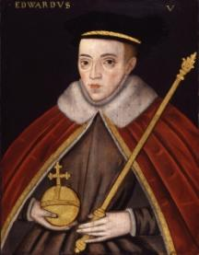
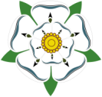
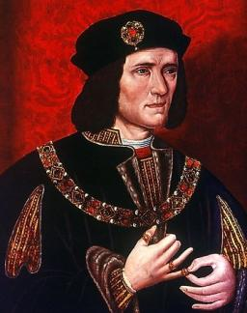
Edward IV
Rebellion in reign, but regains throne
Reigns a total of 20 years, until death
Leaves 12 year old son king Edward V, with Edward IV’s brother Richard as protectorate
Notes:
During Edwards reign there are several rebellions: Margaret of Anjou tries to get her son on the throne (and he is killed), Henry VI gets a following and after an attempted uprising, he is mysteriously killed in the tower (some say by Richard III), Edwards brother George also attempts a rebellion, and is arrested and executed. So the story goes, he was allowed to choose his own manner of execution and was drowned in a giant vat of wine (again, Shakespeare blames Richard III)
Edward IV dies of overindulgence (ate too much food, drank too much, messed around too much)
There some controversy surrounding Richard as protectorate as well: Elizabeth wanted her brother Anthony to take control but Richard essentially met them on the road to London and had Anthony arrested and brought young Edward back to London. Elizabeth and the other children hid in sanctuary.

Slide 12
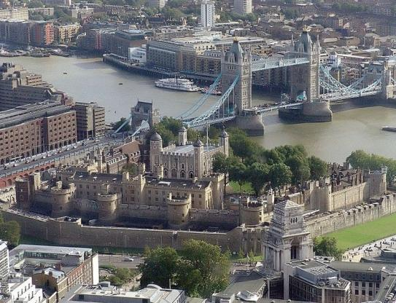
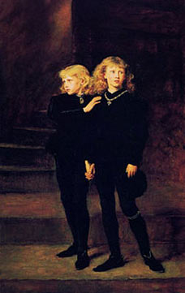
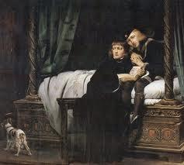
But then there’s Richard
Moves Edward to the Tower of London
Postpones coronation, rumors illegitimacy
Brings young Edward’s 9 year old brother Richard to Tower
By end of 1483…no one sees the young princes in public
Richard is crowned king Richard III
So what happened to the Princes
in the Tower?
Notes:
Richard's arguments: the Tower is the safest place in London for the princes. He also wants to keep them away from Elizabeth's family.
For a while the princes were seen playing in the tower greens, however, they eventually went missing. The mystery is never satisfactorily resolved.
Richard crowns himself king after a rumor that his older brother Edward had been a bastard, and therefore not in the line of Richard of York, making his sons illegitimate. Even if Edward was legitimate, his children would be illegitimate if it was true that he had been betrothed already.
Controversy over whether or not Richard was really a bad guy or if that was Tudor propaganda that came later—most famously by Shakespeare. New revisionist history tries to portray Richard III in a better light. Regardless, there were some pretty mysterious circumstances surrounding the Princes in the Tower

Slide 13
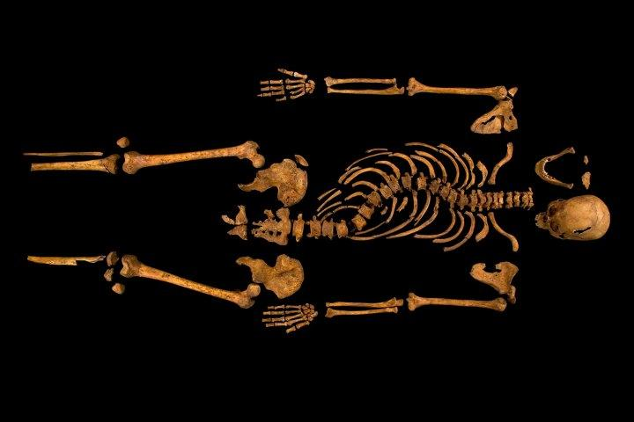
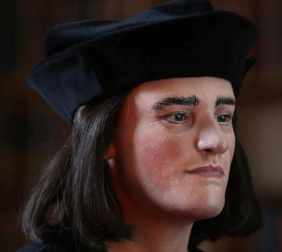
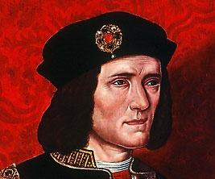
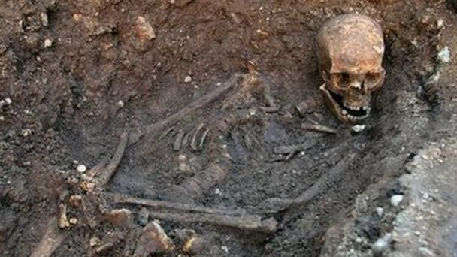
Recent History!!!
Richard III found!
Can see his “hunchback” (Scoliosis)
2 blows to the head, 8 to the body
Buried naked, hands bound
Notes:
2013: found the body of Richard III in a parking lot in northern England. DNA testing of one of his descendants proved it was him. Damage on the body consistent with contemporary reports of the Battle of Bosworth; also proved he did have a slight hunchback (thought to be a Shakespeare invention) due to scoliosis.
They did a facial reconstruction based on the skull and he looked very similar to portraits

Slide 14
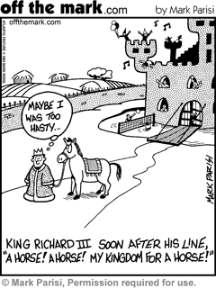
Enter: Henry Tudor
Son of Edmund Tudor & Margaret Beaufort
Leads an army against Richard III’s army
Bosworth Field: So the story goes—kills Richard and takes up his crown from the battlefield
Notes:
Everyone is dead except for Richard III, and Henry Tudor (grandson of Katherine Valois, claims Lancaster heritage through his mother Margaret) and Elizabeth (daughter of Edward IV)
Henry was raised in France by his uncle Jasper Tudor, sensing weakness from Richard III, sails back to England and fights Richard at the Battle of Bosworth Field.

Slide 15
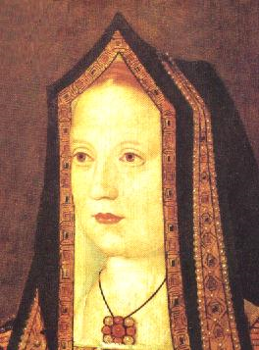
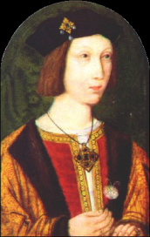
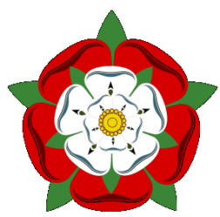
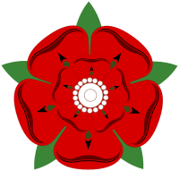
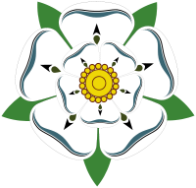
Henry VII
Henry Tudor is crowned Henry VII, King of England
He marries Elizabeth of York, daughter of Edward IV—uniting the Lancaster and York lines under the Tudor name ending the War of the Roses
Notes:
There were at least 7 people who had a better claim than Henry Tudor to the throne of England. He tries to strengthen his claim by marrying Elizabeth, who would have been Edward’s heir after her two brothers. It also linked the two houses of York and Lancaster. Henry never felt completely secure in his claim to the throne, however, he had George’s son killed, as well as a young pretender in Ireland (who claimed to be one of the lost princes, Richard)

