Slide 1
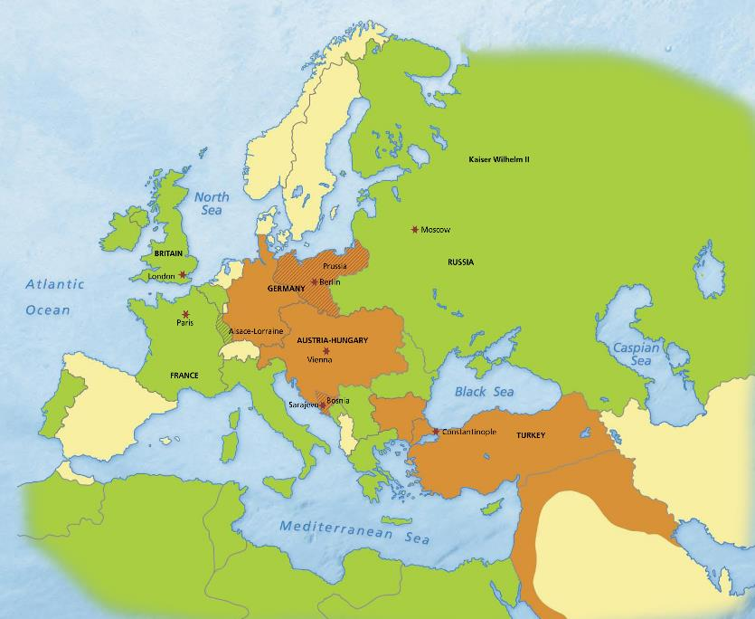
Germany:
Rapid growth in economy and power after 1871 reunification.
Best-trained and equipped army in Europe.
Huge territorial ambition.
Britain:
Largest colonial empire in the world.
Most powerful navy.
Russia:
Largest empire in Europe.
Largest army.
Less advanced industrialisation.
The Ottoman Empire (Ottoman Turkey):
Empire stretched from Europe
to the Middle East and Asia.
Central government too weak to control all parts of its empire.
France:
Resource-rich Alsace-Lorraine was annexed by Germany in the 1871 Franco-Prussian War.
Looked for ways
to recover it.
Austria-Hungary:
Large, unstable and divided empire.
Different ethnic groups often attempted to break away to
form their own nation-states.

Slide 2
Differing Viewpoints
“Family Feud”
“Fall of the Eagles”
“The War to End All Wars”
“The War to ‘Make the World Safe for Democracy’”

Slide 3
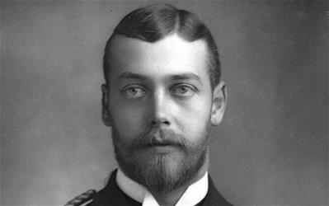
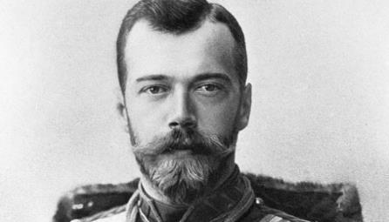
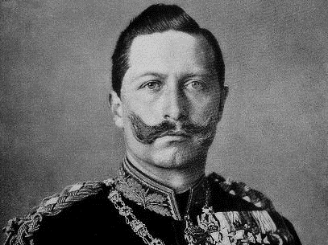
GEORGE v
Nikolas II
Wilhelm II

Slide 4
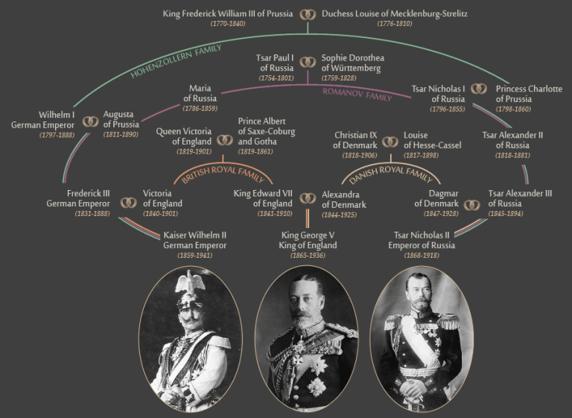

Slide 5
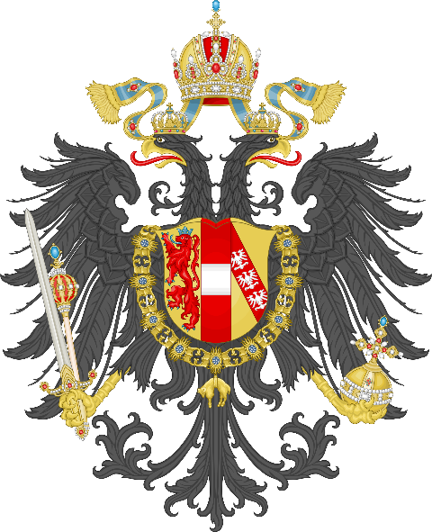
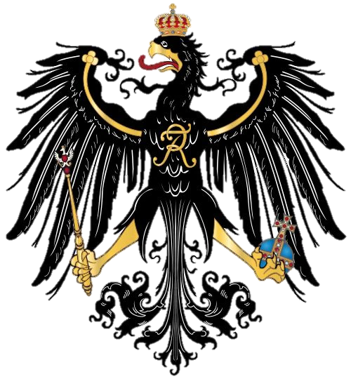

Slide 6
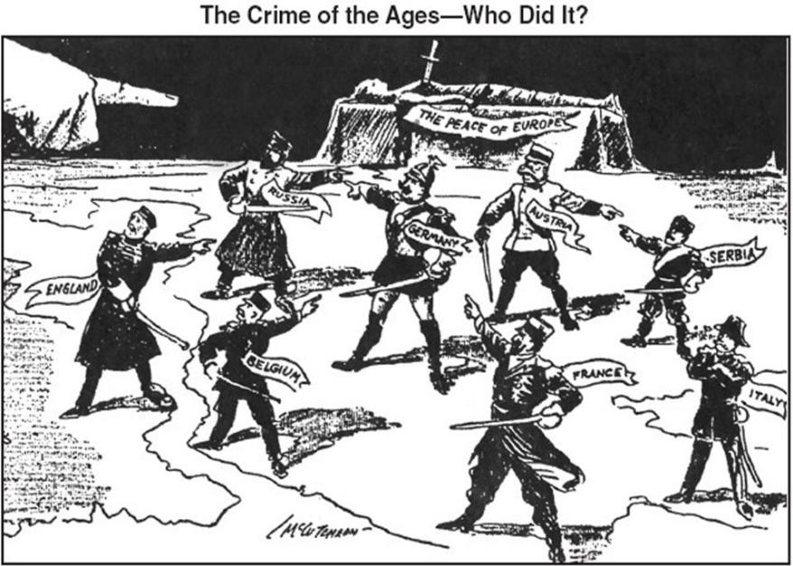

Slide 7
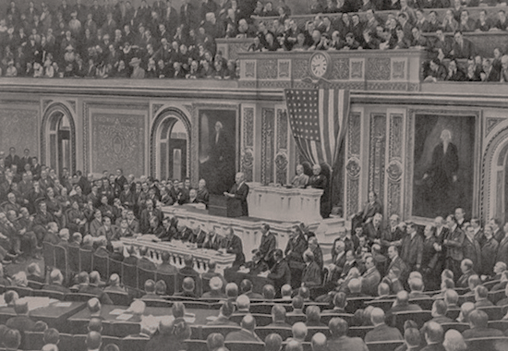
Wilson’s War Message, April 1917
“It is a war against all nations. American ships have been sunk, American lives taken, in ways which it has stirred us very deeply to learn of, but the ships and people of other neutral and friendly nations have been sunk and overwhelmed in the waters in the same way. There has been no discrimination. The challenge is to all mankind. Each nation must decide for itself how it will meet it. The choice we make for ourselves must be made with a moderation of counsel and a temperateness of judgment befitting our character and our motives as a nation. We must put excited feeling away. Our motive will not be revenge or the victorious assertion of the physical might of the nation, but only the vindication of right, of human right, of which we are only a single champion.”

Slide 8
Two Fronts
Western Front
Eastern Front

Slide 9
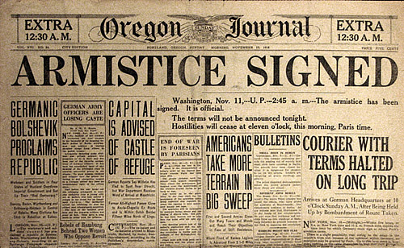
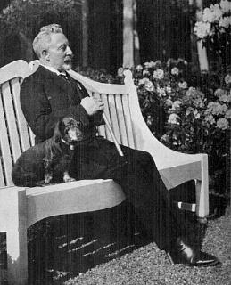
Armistice
Two front war takes it’s toll on Germany
11th Hour of the 11th day of the 11th month (1918)
Kaiser Wilhelm II exiled → Weimar Republic

Slide 10
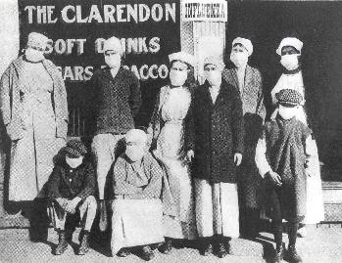
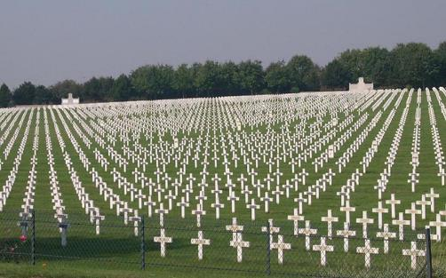
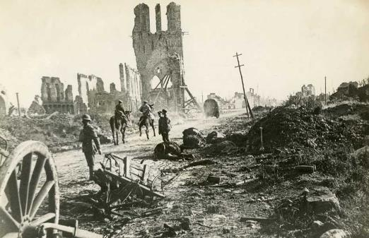
Impact
Total War: 11+ Million Soldiers dead, 7+ million civilians
Europe devastated
1918: Spanish Flu Pandemic 20-40 million killed

Slide 11
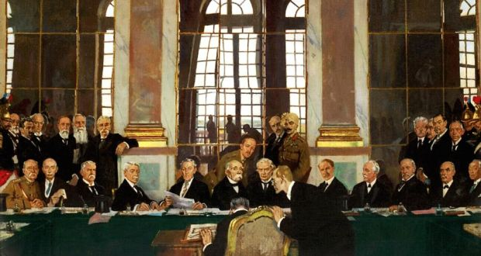
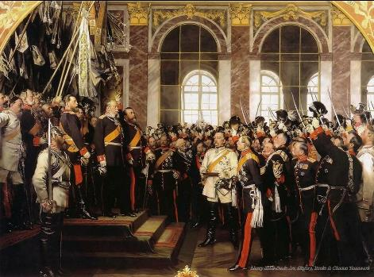
Treaty of Versailles

Slide 12
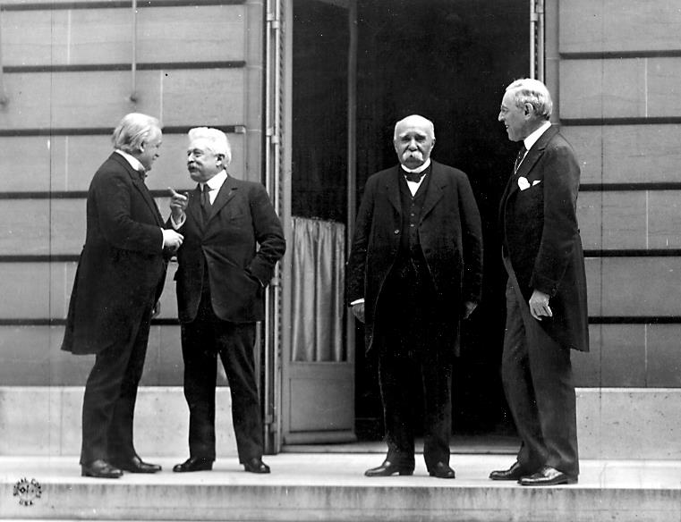
The Big Four
Victor
Clemenceau
Woodrow Wilson
Vittorio Orlando
David Lloyd George

Slide 13
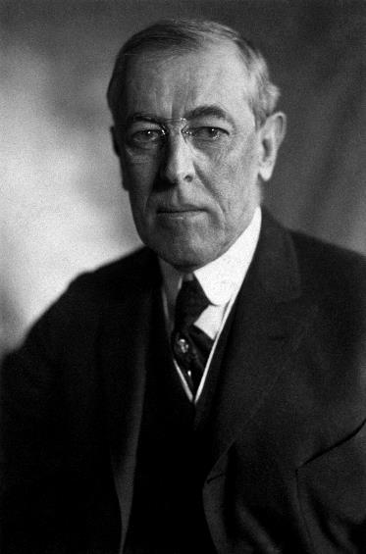
14 Points
Peace without Victory.
Freedom of Seas
Self Determination
Reduction of Arms
Open Treaties
League of Nations

Slide 14
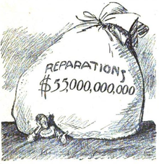
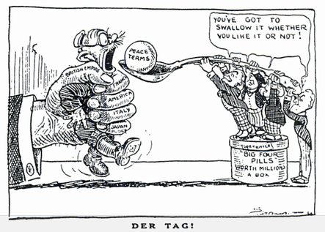
Germany’s Terms: B.R.A.T.
Blame
Reparations
Army
Territory

Slide 15
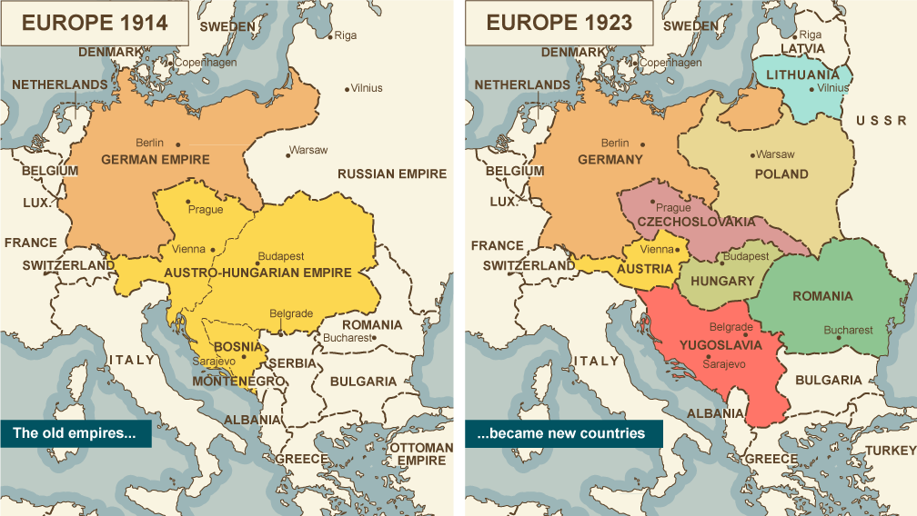

Slide 16
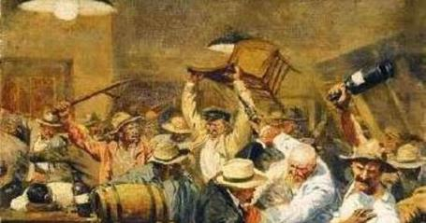
To Summarize…
…If WWI was a Bar Fight

Slide 17
Germany, Austria, and Italy are standing together in the middle of a pub when Serbia bumps into Austria & spills Austria’s pint.

Slide 18
Austria demands Serbia buy it a complete new suit because there are splashes on its trouser leg.

Slide 19
Germany expresses its support for Austria's point of view.

Slide 20
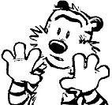
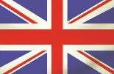
Britain recommends that everyone calm down a bit.

Slide 21
Serbia points out that it can't afford a whole suit, but offers to pay for the cleaning.

Slide 22
Russia and Serbia look at Austria.

Slide 23
Austria asks Serbia who it's looking at.
?

Slide 24
Russia suggests that Austria should leave its little brother alone.

Slide 25
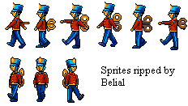
Austria inquires as to whose army will assist Russia in compelling it to do so.
?

Slide 26
Germany appeals to Britain that France has been looking at it, and that this is sufficiently out of order that Britain should not intervene.
?

Slide 27
Britain replies that France can look at who it wants to, that Britain is looking at Germany too, and what is Germany going to do about it?
?

Slide 28
Germany tells Russia to stop looking at Austria, or Germany will render Russia incapable of such action.

Slide 29
Britain and France ask Germany whether it's looking at Belgium.
?

Slide 30
Turkey and Germany go off into a corner and whisper.
When they come back, Turkey makes a show of not looking at anyone.

Slide 31
Germany rolls up its sleeves, looks at France, and punches Belgium.

Slide 32
France and Britain punch Germany.

Slide 33
Austria punches Russia.

Slide 34
Germany punches Britain and France with one hand and Russia with the other.

Slide 35
Russia throws a punch at Germany, but misses and nearly falls over.

Slide 36
Japan calls over from the other side of the room that it's on Britain's side, but stays there.

Slide 37
Italy surprises everyone by punching Austria.

Slide 38
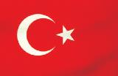
Australia punches Turkey, and gets punched back.
There are no hard feelings because Britain made Australia do it.

Slide 39
France gets thrown through a plate glass window, but gets back up and carries on fighting.

Slide 40
Russia gets thrown through another one, gets knocked out, suffers brain damage, and wakes up with a complete personality change.

Slide 41
Italy throws a punch at Austria and misses, but Austria falls over anyway. Italy raises both fists in the air and runs round the room chanting.

Slide 42
America waits till Germany is about to fall over from sustained punching from Britain and France, then walks over and smashes it with a barstool, then pretends it won the fight all by itself.

Slide 43
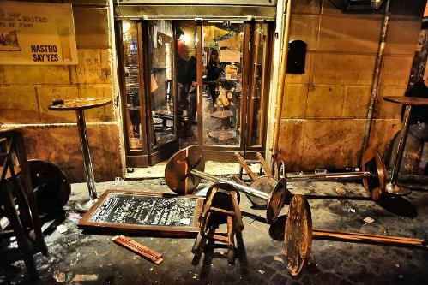
By now all the chairs are broken and the big mirror over the bar is shattered.

Slide 44
Britain, France and America agree that Germany threw the first punch, so the whole thing is Germany's fault. While Germany is still unconscious, they go through its pockets, steal its wallet, and buy drinks for all their friends.

